Slide 1
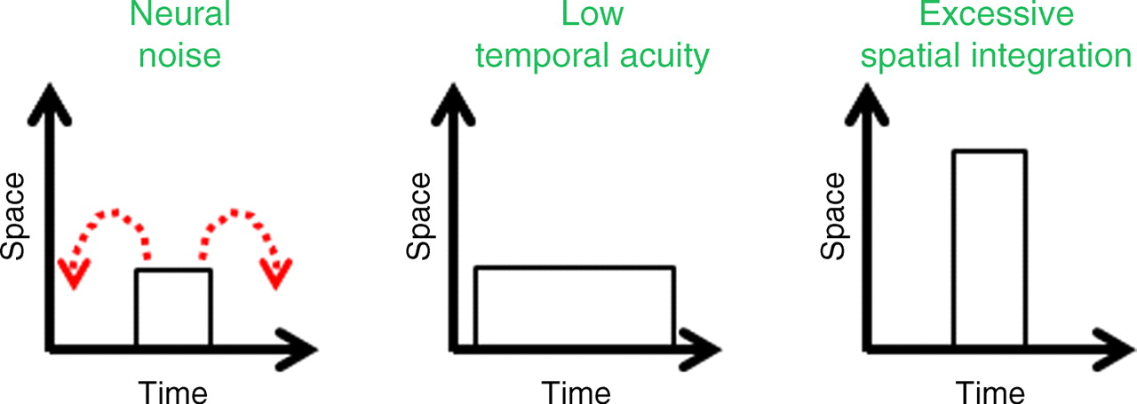
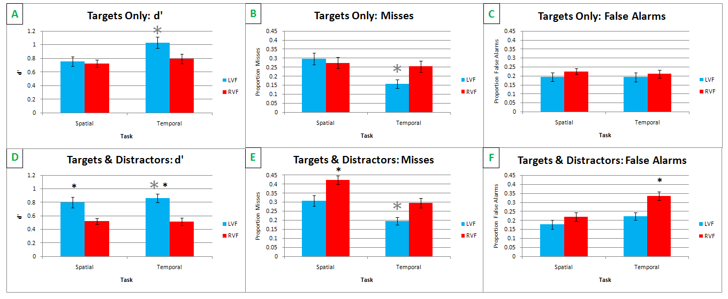
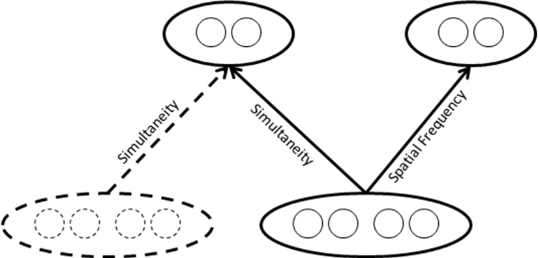
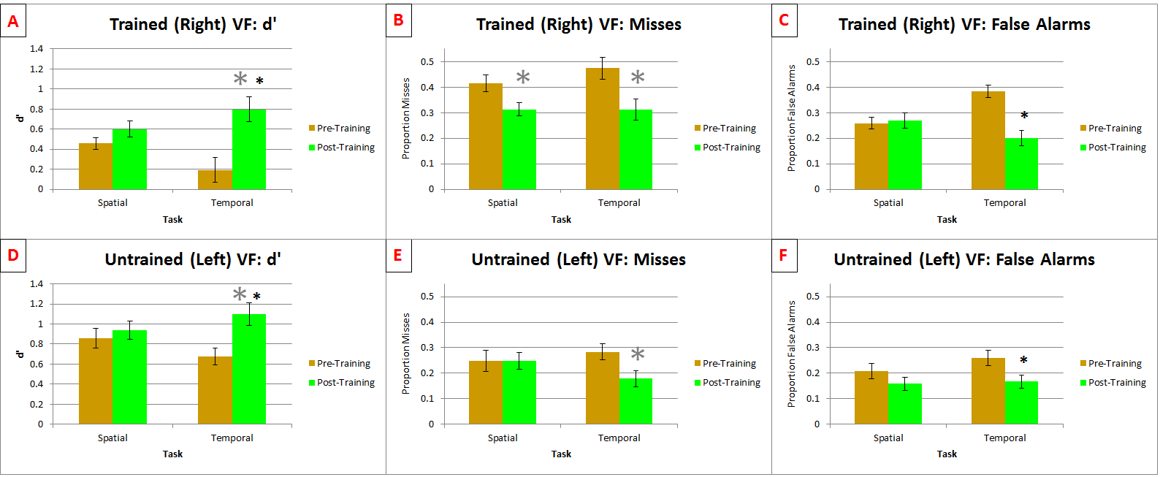
Right Hemifield Deficits in Judging Simultaneity: A Perceptual Learning Study
Poster #
56.314
Nestor Matthews¹, Michael Vawter¹, Jenna Kelly²
Psychology, Denison University¹; CNS, New York University²
Introduction
Method
Discussion
Right visual field (RVF) deficits have been demonstrated for several temporal vision tasks¹⁻⁵. Here, we investigated why (fig. 1) and when (fig. 2) RVF deficits arise in simultaneity judgments.
A
B
C
D
E
F
G
H
I
8°
23°
15°
8°
23°
15°
Exp 1 revealed a pre-attentive RVF timing deficit that arose from low acuity, not from neural noise. Furthermore, distractors caused an additional impairment that was attentional in nature. This attentional impairment was task-specific; distractors generated excessive integration on the timing task and low acuity on the spatial task. These task-specific effects occurred despite identical retinal stimulation on the two tasks.
Exp 2 revealed evidence for task specificity, and against hemifield and retinal location specificity. In each hemifield significantly greater improvement occurred on the temporal task than on the spatial task. This task specificity rules out the stimulus-driven stage (bottom solid oval, fig. 2) as the limiting factor. RVF training on the temporal task significantly improved temporal precision by comparable amounts in each hemifield. This hemifield generalization - combined with the task specificity - implicates either the decision stage (upper left oval, fig. 2) or the connection between the stimulus-driven and decision stages. These two possibilities were teased apart in the retinal location transfer test (dotted lines, fig. 2) . Here, we observed that learning generalized to a new retinal location, implicating the decision stage rather than the connection.
This study was conducted to reveal why and when RVF deficits arise in simultaneity judgments. We found a pre-attentive component that reflects low acuity, and an attentional component that reflects excessive integration. Training significantly reduced each of those deficits. The improvement seems to have occurred at the decision stage.
Which
Letter?
Target
Timing?
Same = S
Different = D
24.5°
14°
11.5°
19°
24.5°
14°
11.5°
19°
n
19°
14°
24.5°
19°
24.5°
11.5°
11.5°
14°
350 ms
200 ms
200 ms
66 ms
100 ms
34 ms
200 ms
Fixation?
Simultaneity?
15°
23°
8°
15°
23°
8°
Results
Trained Retinal Locations
Transfer Test Retinal Locations
Figure 1: SDT⁶ & The Why Question⁷
Experiment 1: Pre-Attentive vs Attentional Effects
Excessive RVF
Misses & F.A.s
Excessive RVF
Misses
Excessive RVF
F.A.s
*
Experiment 2: Perceptual Learning
Figure 2: Perceptual Learning & The When Question⁸
References
Bottom Line
1. Newman & Albino (1977). J Behavioral Science, 2, 203-209.
2. Newman & Albino (1979). PMID: 530795
3. Verleger et al. (2009). PMID: 18564053
4. Smigasiewicz et al. (2010). PMID: 20546763
5. Kelly & Matthews (2011). PMID: 21602558
6. Green & Swets (1966). Signal detection theory and psychophysics. New York.
7. Vul, Hanus & Kanwisher (2009). PMID: 19883136
8. Petrov, Dosher & Lu (2005). PMID: 16262466
Poster: http://denison.edu/~matthewsn/vss2012righthemifield.html
JOV Article: http://www.journalofvision.org/content/12/2/1.full

