Slide 1
Welcome
To
Psychology!

Slide 2
Psychology
The science of behavior, thoughts & feelings.
Epistemology – The nature of our knowledge.
Definition of Science
“The use of evidence to construct testable explanations and predictions of natural phenomena, as well as the knowledge generated through this process.”
Science, Evolution & Creationism (2008). National Academy of Sciences. Page 10.

Slide 3
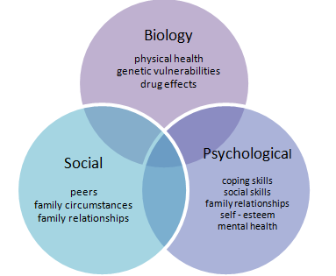
Bio-Psycho-Social Model
https://commons.wikimedia.org/wiki/File:Biopsychosocial_Model_of_Health_1.png

Slide 4
Research Questions & Answers
Basic Research & Applied Research
Observation & Experiment

