Slide 1
Perception

Slide 2
Perception Definition
Perception – “The organization, identification, and interpretation of sensory information to understand the environment.” http://en.wikipedia.org/wiki/Perception

Slide 3
Gestalt Psychology
Max Wertheimer: 1880 – 1943
Kurt Koffka: 1886 – 1941
Wolfgang Köhler: 1887 – 1967

Slide 4
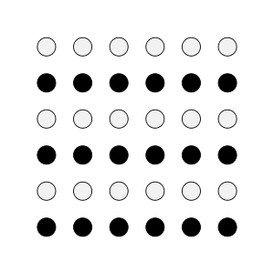
Gestalt Psychology
Gestalt Psychology – “The whole is different than the sum of the parts.”
Gestalt Laws of Perceptual Grouping include “similarity”, “proximity”, “good continuation”.
http://commons.wikimedia.org/wiki/File:Gestalt_proximity.svg
http://commons.wikimedia.org/wiki/File:Gestalt_similarity.svg
http://commons.wikimedia.org/wiki/File:CrossKeys.png

Slide 5
Figure Ground / Reversible Figures
http://en.wikipedia.org/wiki/File:Gestalt_Principles_Composition.jpg

Slide 6
Illusory Figures
http://en.wikipedia.org/wiki/File:Gestalt_Principles_Composition.jpg

Slide 7
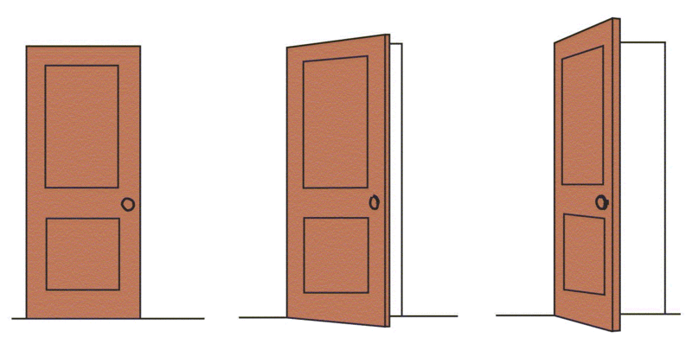
Perceptual Constancy
Perceptual Constancy – The perception of an object or quality as unchanging despite changes in the proximal stimulus.
http://en.wikipedia.org/wiki/File:Shape_constancy.gif

Slide 8
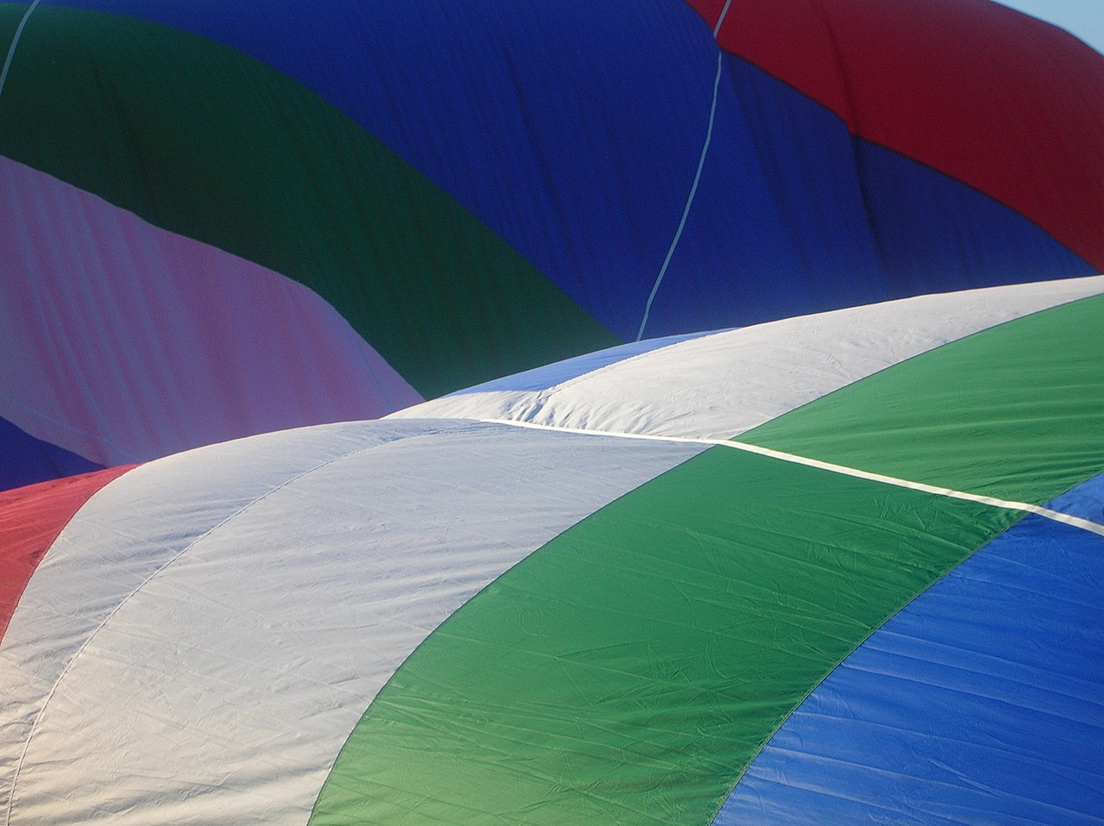
Perceptual Constancy
https://commons.wikimedia.org/wiki/File:Hot_air_balloon__color_constancy.jpg

Slide 9
Top-Down vs Bottom-Up
Top-Down Process –
“Knowledge Driven”
Requires information beyond the stimulus
Bottom-Up
“Stimulus Driven”
Relies entirely on the neural response to stimulation

Slide 10
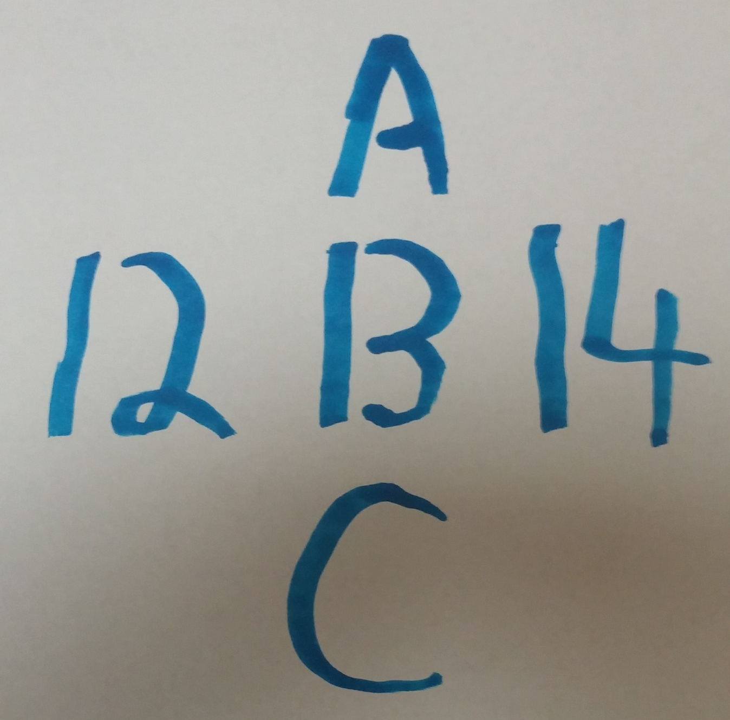
Top-Down vs Bottom-Up

Slide 11
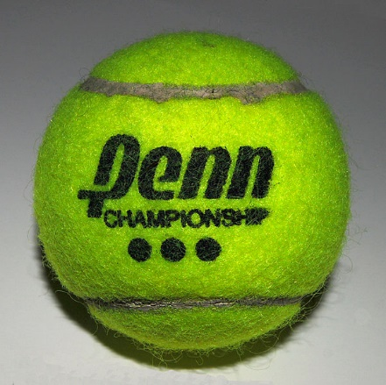
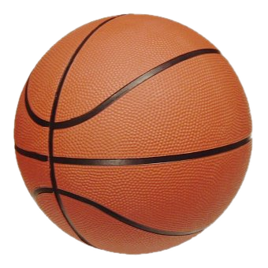
Top-Down vs Bottom-Up
https://commons.wikimedia.org/wiki/File:Basketball.png
https://commons.wikimedia.org/wiki/File:Tennis_ball_01.jpg

Slide 12
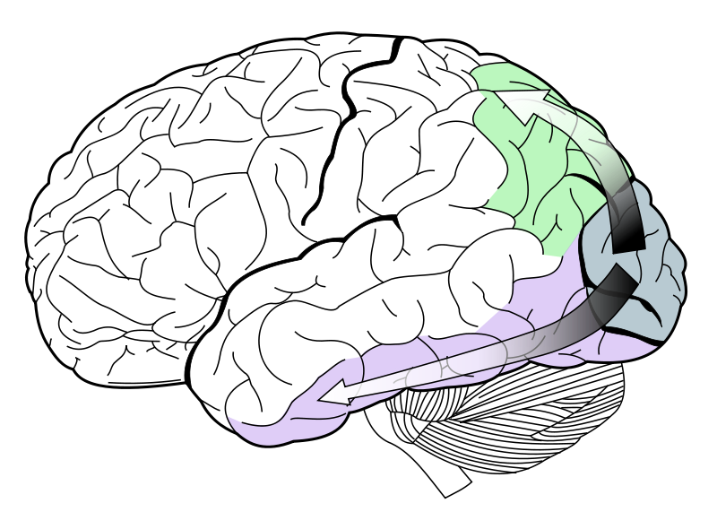
Visual Neuroscience: What / Where
Dorsal Pathway
“Where”
Ventral Pathway
“What”
http://en.wikipedia.org/wiki/File:Ventral-dorsal_streams.svg

Slide 13
The Binding Problem
The Binding Problem - How is neural activity from different brain regions combined to give a coherent perceptual experience?

Slide 14
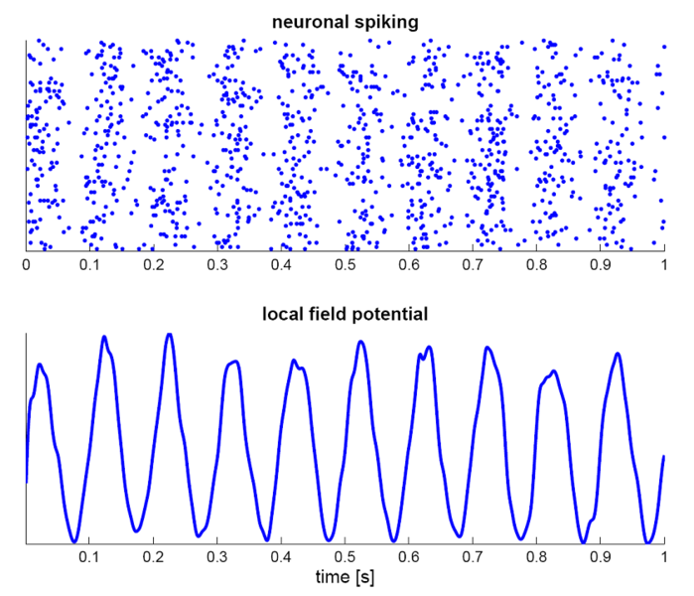
The Binding Problem: Neural Synchrony
http://en.wikipedia.org/wiki/File:SimulationNeuralOscillations.png

Slide 15
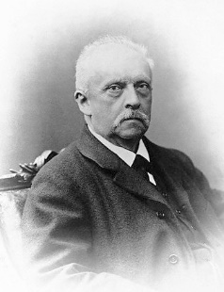
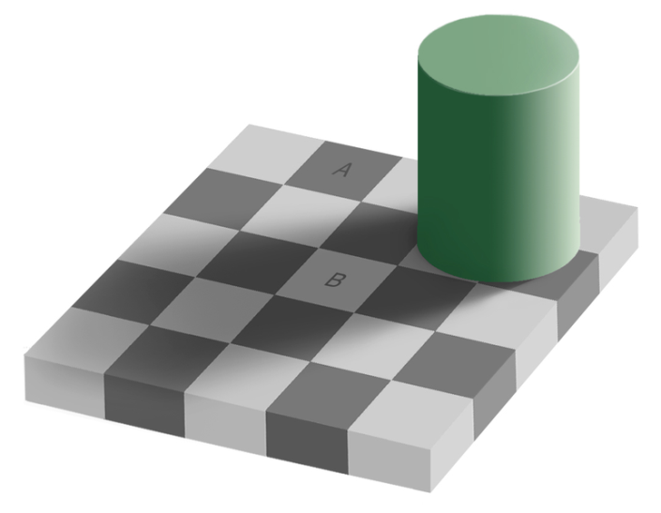
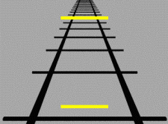
Unconscious Inference
http://en.wikipedia.org/wiki/File:Hermann_von_Helmholtz.jpg
Unconscious Inference – The phenomenon that occurs when one’s statistical knowledge of the environment alters the perception of proximal stimulation, without effort on the part of the perceiver.
http://en.wikipedia.org/wiki/File:Grey_square_optical_illusion.PNG
http://en.wikipedia.org/wiki/File:Ponzo_illusion.gif

Slide 16
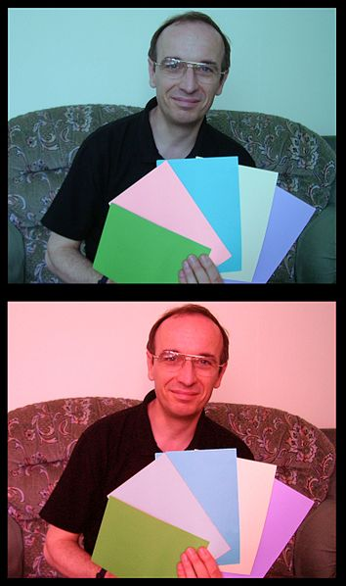
Unconscious Inference
From Wiki – “The second card from the left seems to be a stronger shade of pink in the top picture. In fact they are the same color, but the brain changes its assumption about color due to the color cast of the surrounding photo.” http://en.wikipedia.org/wiki/Color-constancy
http://en.wikipedia.org/wiki/File:ColourIllusion2.jpg

