Slide 1
Observation
& Correlation

Slide 2
Observational Studies
Observational studies can be used to disconfirm hypotheses.
Observational data are often analyzed using the correlational statistics
Chi-Square → nominal data
Spearman Rho → ordinal (rank) data
Pearson r (“r-statistic”)→ Interval / ratio data

Slide 3
Correlation & the r-statistic
The r-statistic
Ranges from -1 to +1
Values near zero → no correlation
Values far from zero → strong correlation
Often describes the (linear) relationship between variables on a scatter plot, which display pairs of (X,Y) scores…

Slide 4
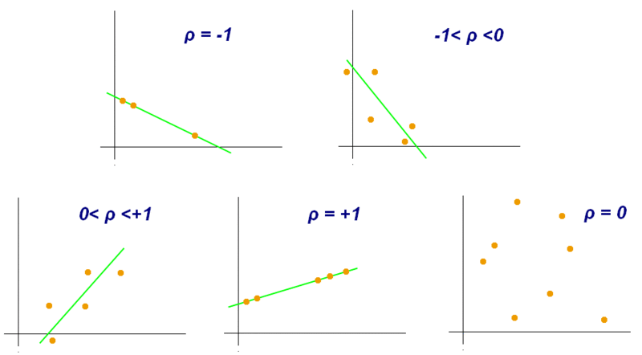
Correlation & the r-statistic
r
r
r
r
r
http://en.wikipedia.org/wiki/File:Correlation_coefficient.gif

Slide 5
Correlation & the r-statistic
r
r
Strong Correlation:
Unlikely due to chance
p < 0.05
r
r
r
Strong Correlation:
Unlikely due to chance
p < 0.05
http://en.wikipedia.org/wiki/File:Correlation_coefficient.gif

Slide 6
Correlation & the r-statistic
r
r
r
r
r
Weak Correlation:
Likely due to chance
p = 0.80
http://en.wikipedia.org/wiki/File:Correlation_coefficient.gif

Slide 7
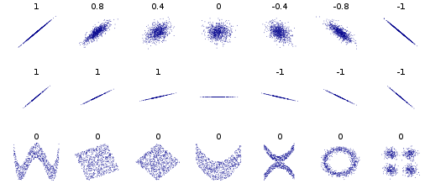
https://en.wikipedia.org/wiki/Correlation_and_dependence#/media/File:Correlation_examples2.svg
Correlation & the r-statistic

Slide 8
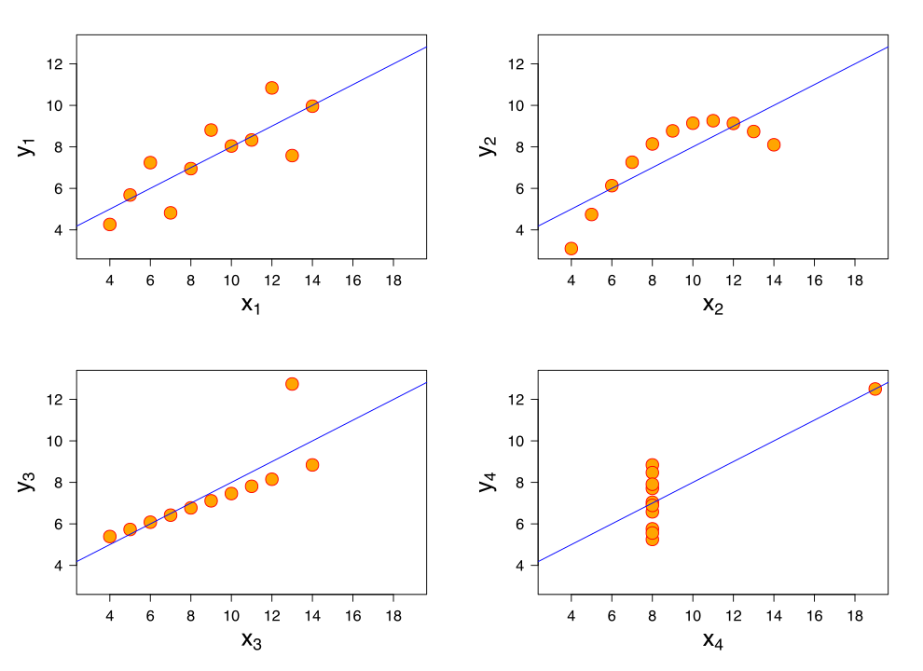
https://en.wikipedia.org/wiki/Correlation_and_dependence#/media/File:Anscombe%27s_quartet_3.svg
Correlation & the r-statistic
Four sets of data with the same correlation of 0.816

Slide 9
Correlation & the r-statistic
The r-statistic can be used to determine
Reliability
Strong, positive r values can confirm
Inter-rater reliability
Consistency across measures (time 1 vs time 2)
Internal Validity
Strong, positive r-values between our measure and a previously established measure of the same variable indicates that “we are measuring what we want to measure”.

Slide 10
Observational Studies
Observational studies have limitations
If an observational study reveals a significant correlation, we can’t draw a CAUSAL inference because
The “third variable” problem …some other (‘third”) variable is driving the correlation between the two observed variables.
Even if the two variables are causally related, the direction of causation can be uncertain.
Does A cause B, or does B cause A?

Slide 11
The Intro Psycology Mantra
Correlation
does not imply
causation!

