Slide 1
Learning Operant (Instrumental) Conditioning

Slide 2
Operant Conditioning
Operant Conditioning – Also called instrumental conditioning; a form of learning that pertains to response-outcome relationships.
Unlike classical (Pavlovian) conditioning, operant conditioning emphasizes responses from the somatic nervous system.
The responses “operate” on the environment, usually to bring about a change suitable to the organism.

Slide 3
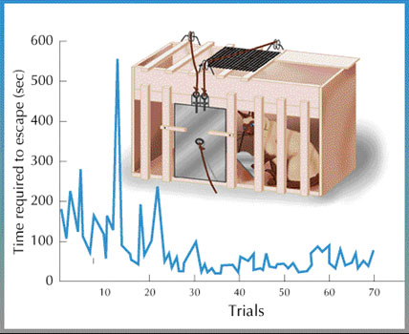
Thorndike & Law of Effect
The Law of Effect – Behavior is modified by its consequences.
http://en.wikipedia.org/wiki/Law_of_effect
Thorndike’s Puzzle Box
http://en.wikipedia.org/wiki/File:Puzzle_box.jpg

Slide 4
Skinner & Logical Positivism
Logical Positivism – A philosophical approach that relies entirely on testable claims.
Logical positivists are known for their inferential caution
They err on the side of Type 2 errors
They might be guilty of “reading too little into the data”
They rarely “read too much into the data”
They are more likely to “Miss” than to “False Alarm”
L.P.s make a strong distinction between the following
“The participant responded to the stimulus” (requires no inference)
L.P.s like such statements
“The stimulus elicited the response” (assigns causal power to stimulus)
L.P.s avoid such statements
Opposition to mentalistic claims, or internal states
L.P.s avoid stating what organisms “know”, “think”, “expect”, “believe”, “want”, “like”, “dislike”, etc.

Slide 5
Skinner & Logical Positivism
L.P.s rely heavily on operational definitions
Stating the procedures (“operations”) used to measure a variable
Examples of Operational Definitions
Attention – The selection of sensory events
L.P.’s refer to the “cued stimulus” rather than to the “attended stimulus”. Why?
Motivation - # of hours of food deprivation
L.P.’s avoid referring to “hungry” or “thirsty”. Why?

Slide 6
Other Logical Positivists
Bertrand Russell –
Russell’s Teapot – “if he were to assert, without offering evidence, that a teapot orbits the Sun somewhere in space between the Earth and Mars, he could not expect anyone to believe him solely because his assertion could not be disconfirmed.”
https://en.wikipedia.org/wiki/Russell%27s_teapot
Assign the burden of evidence to those who make a claim, rather than assigning the burden of disconfirmation to others.

Slide 7
Other Logical Positivists
Christopher Hitchens –
Hitchens Razor
“What can be asserted without evidence can be dismissed without evidence.”
Latin Proverb
“Quod gratis asseritur, gratis negatur”
"What is freely asserted is freely dismissed“

Slide 8
Skinner & Operant Behavior
Operants – emitted behavior
Discriminitive Stimulus - a stimulus, associated with reinforcement, that exerts control over a behavior; S^{D} http://en.wiktionary.org/wiki/discriminative_stimulus

Slide 9
Shaping
Shaping – a conditioning procedure that relies on differential reinforcement of successive approximations.
Critical Thinking Question – How is “shaping” similar to the process of evolution?
How is it different?

Slide 10
Behavioral Contrast
Behavioral Contrast – “a change in the strength of one response that occurs when the rate of reward of a second response, or of the first response under different conditions, is changed.”
http://en.wikipedia.org/wiki/Behavioral_contrast
Example:
“Rat X” initially receives 5 pellets per response
“Rat Y” initially receives 9 pellets per response
If each rat subsequently receives 7 pellets per response, Rat X’s response rate increases while Rat Y’s response rate decreases.
Informal comments about “sense of entitlement”? ☺

Slide 11
Reinforcers
Primary Reinforcers
Examples: food, water, sex, escape
Conditioned (Learned) Reinforcers
Examples: money, a wink of an eye
Some scientists argue that reinforcers can be defined only “post hoc” (after the fact) i.e., after determining whether the behavioral response rate increased….

Slide 12
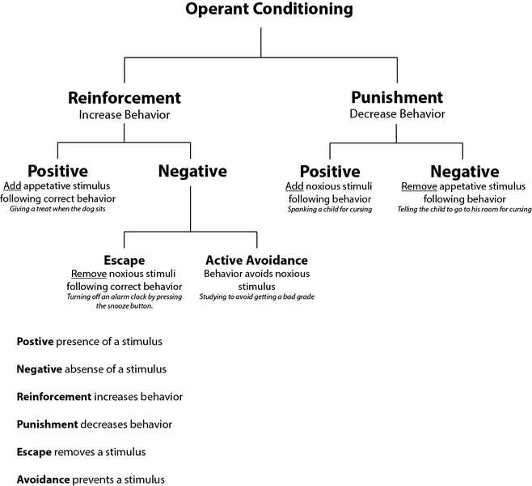
http://en.wikipedia.org/wiki/File:Operant_conditioning_diagram.png

Slide 13
Schedules of Reinforcement
Continuous Reinforcement – A “reward” is earned after each desired response.
Continuously reinforced responses are vulnerable to extinction
Partial Reinforcement – A “reward” is earned only after multiple desired responses.
Partially reinforced behaviors are resistant to extinction (Ex. gambling)

Slide 14
Fixed Reinforcement Schedules
Fixed Ratio Schedule – (FR) reinforcement occurs after a set number of responses.
Ex: FR 2 → reinforcement after every 2 responses
Ex: “Buy 2 soft drinks, get the third one free”
Fixed Interval Schedule – (FI) reinforcement of the first response after a set time duration.
Ex: FI 300 → reinforcement of 1st response after 300 seconds (i.e., 5 minutes)
Ex: Mom rewards requests for attention only on the 1st request after 5 minutes. (Other requests ignored.)

Slide 15
Variable Reinforcement Schedules
Variable Ratio Schedule – (VR) reinforcement occurs after an AVERAGE # of responses.
Ex: VR 200 → reinforcement after every 200 responses on average.
Ex: A telephone sales person needs to make 200 calls on average before making a sale.
Variable Interval Schedule – (VI) reinforcement of the first response after an average duration.
Ex: VI 1,800 → reinforcement of 1st response after 1,800 seconds (i.e., 30 minutes) on average.
Ex: Email checking is rewarded, on average, every 30 minutes. (More frequent responses yield no reinforcement.)

Slide 16
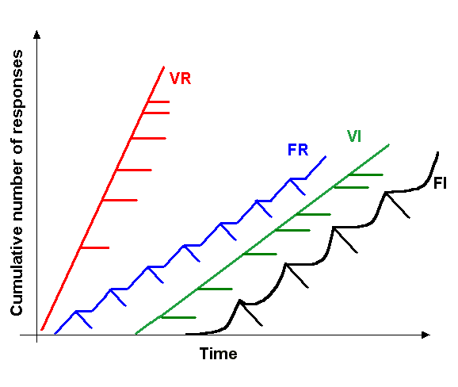
Hash Marks Indicate Reinforcement
http://en.wikipedia.org/wiki/File:Schedule_of_reinforcement.png
Potential Pop Quiz Question – Why do the response rates slow immediately after
reinforcement on fixed schedules (F) but not variable schedules (V)?

