Slide 1
Cognition:
Decision Making
&
Problem Solving

Slide 2
Influences on Decision Making
http://en.wikipedia.org/wiki/Framing_effect_(psychology)
Framing – “a cognitive bias, in which people react differently to a particular choice depending on whether it is presented as a loss or as a gain.”
Framing | Outcome
Option A: Positive | "Saves 200 lives"
Option B: Negative | "400 people will die"
Tversky & Kahneman, 1981

Slide 3
Influences on Decision Making
http://en.wikipedia.org/wiki/Loss_aversion
Loss Aversion - The tendency to strongly prefer avoiding losses to acquiring gains.
Decision makers often weigh losses more heavily than gains.
Informally the loss of $500 generates a bigger change in subjective well-being than does a $500 gain.
Discussion Question – How might loss aversion have arisen in a universe characterized by the law of entropy (i.e., the 2nd law of thermodynamics)?
https://en.wikipedia.org/wiki/Second_law_of_thermodynamics

Slide 4
Problem Solving
Ill-Defined Problems – a challenge in which the goal and/or intermediate steps are poorly specified.
Examples:
Publishing a research article in a prestigious journal.
Creating a computerized device.
Achieving peace in a conflict-ridden region.
Responding effectively to natural disasters.

Slide 5
Problem Solving
http://en.wikipedia.org/wiki/File:9dots.svg
Well Defined Problem – a challenge in which the goal and intermediate steps are clearly specified.
Link all 9 dots using four straight lines or fewer, without lifting the pen and without tracing the same line more than once.

Slide 6
Obstacles to Problem Solving
Mental Set – “the tendency to approach a problem in a particular way”.
Functional Fixedness – “a cognitive bias that limits a person to using an object only in the way it is traditionally used”.
http://en.wikipedia.org/wiki/Set_(psychology)
http://en.wikipedia.org/wiki/Functional_fixedness

Slide 7
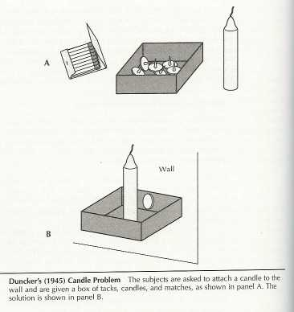
Functional Fixedness
http://en.wikipedia.org/wiki/File:Genimage.jpg

Slide 8
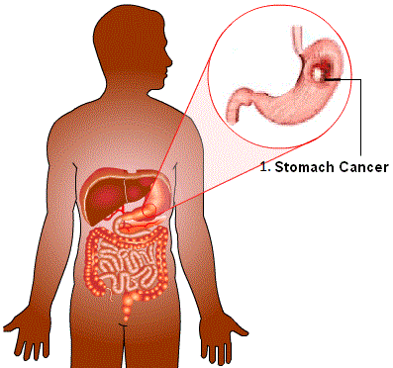
Strategies to Improve Problem Solving
https://commons.wikimedia.org/wiki/Category:Stomach_cancer#/media/File:Skrand%C5%BEio_v%C4%97%C5%BEys.gif
Example Problem – How to use radiation to eliminate a tumor w/o harming surrounding tissue?
Gick & Holyoak (1980)
Cognitive Psychology,
12, 306-355.
Gick & Holyoak (1983)
Cognitive Psychology,
15, 1-38.

Slide 9
Strategies to Improve Problem Solving
http://en.wikipedia.org/wiki/File:Bodiam-castle-10My8-1197.jpg
One problem-solving strategy entails finding a relevant analogy, and applying it to the current problem.
Gick & Holyoak (1980)
Cognitive Psychology,
12, 306-355.
Gick & Holyoak (1983)
Cognitive Psychology,
15, 1-38.

