Slide 1
Chromosomes,
Genes
&
DNA

Slide 2
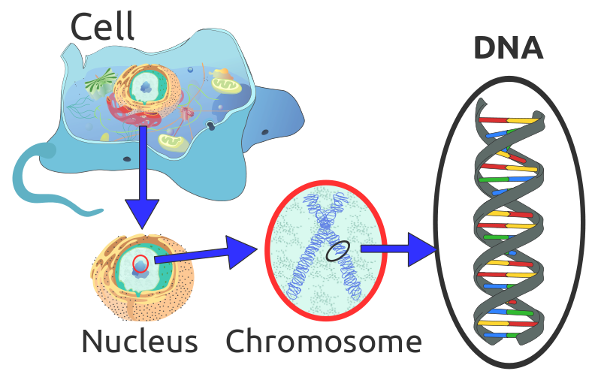
Chromosomes, Genes, & DNA
http://en.wikipedia.org/wiki/File:Eukaryote_DNA-en.svg

Slide 3
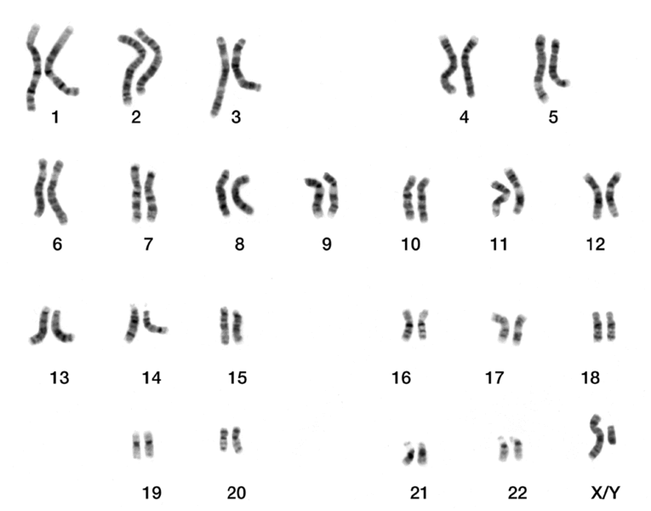
Humans have 23 Chromosome Pairs
Each person’s genome contains ~25,000 protein-coding genes
23rd Pair
Most Males → XY
Most Females → XX
http://commons.wikimedia.org/wiki/File:DNA_human_male_chromosomes.gif

Slide 4
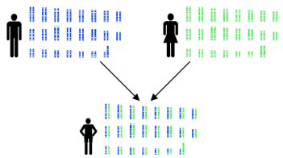
Chromosomes, Genes, & DNA
http://www.usher-syndrome.org/index.cfm/page/Basic-Genetics/cdid/11059/pid/10248

Slide 5
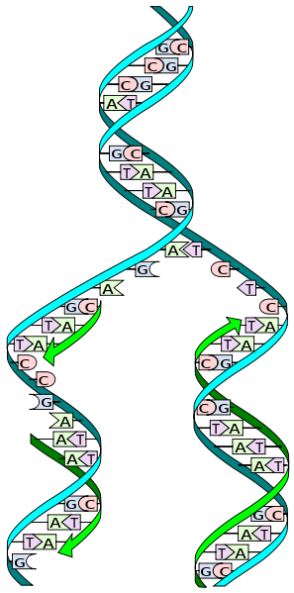
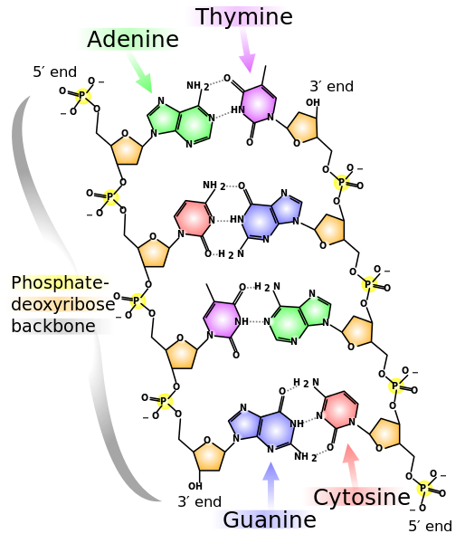
Double Helix: “A-T” “C-G”
http://en.wikipedia.org/wiki/File:DNA_replication_split.svg
http://en.wikipedia.org/wiki/File:DNA_chemical_structure.svg

Slide 6
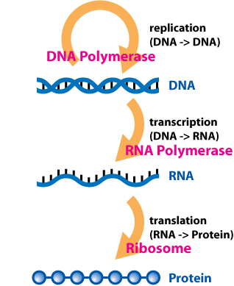
Central Dogma of Molecular Biology
http://commons.wikimedia.org/wiki/File:Central_Dogma_of_Molecular_Biochemistry_with_Enzymes.jpg

Slide 7
Chromosomes, Genes, & DNA
Genotype - The genetic makeup of an organism or a group of organisms.
Phenotype - The physical appearance or biochemical characteristic of an organism as a result of the interaction of its genotype and the environment.

Slide 8
Chromosomes, Genes, & DNA
At any point in time, some of a cell’s genes are expressed and some are not.
Note: Most characteristics arise from interactions among many genes
Avoid the “one gene, one protein” over-simplification
Mantra (from Richard Dawkins)
“ Genes aren’t that deterministic!”
We don’t have a “gene for fill-in-the-blank.”
We have “genes for fill-in-the blank IF !!!”

Slide 9
Chromosomes, Genes, & DNA
Beware of overly simplistic dichotomies.
“Nature (genes) versus nurture (environment)”
The area of a rectangle depends equally on its length and width: Area = L x W
Gene expression depends on environment and gene interactions.
Epigenetics – “Heritable phenotypic change that does not derive from a modification of the genome.”
https://en.wikipedia.org/wiki/Epigenetics

