Slide 1



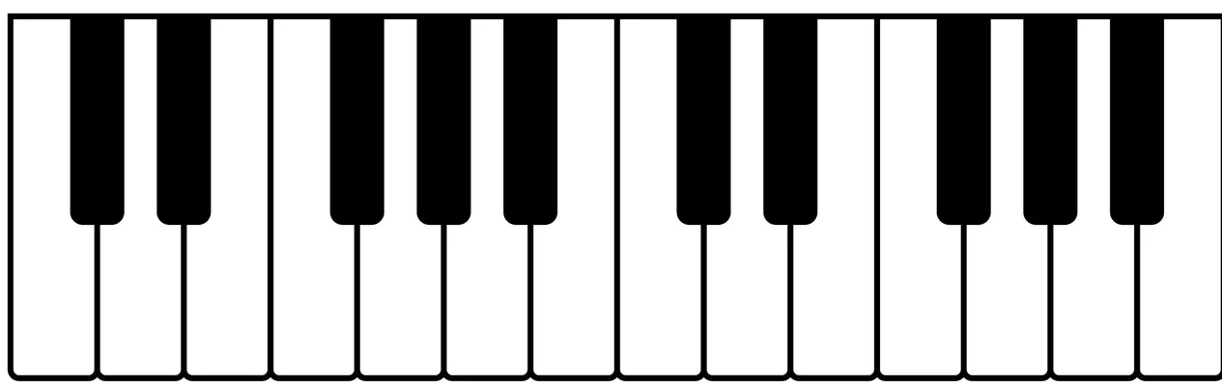
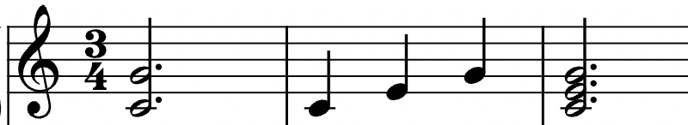
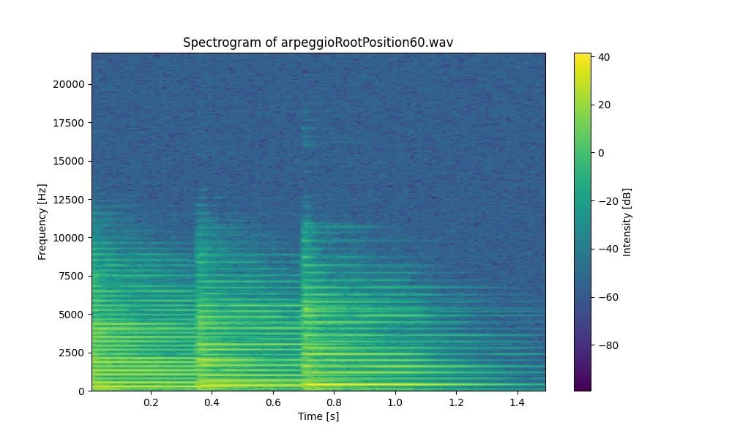
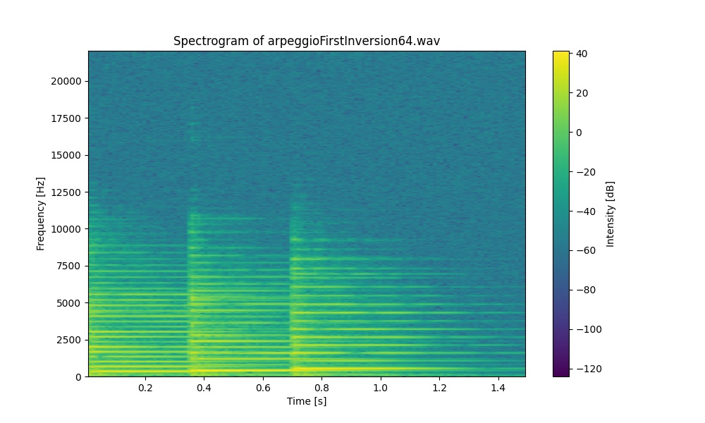

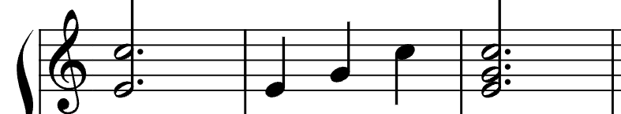
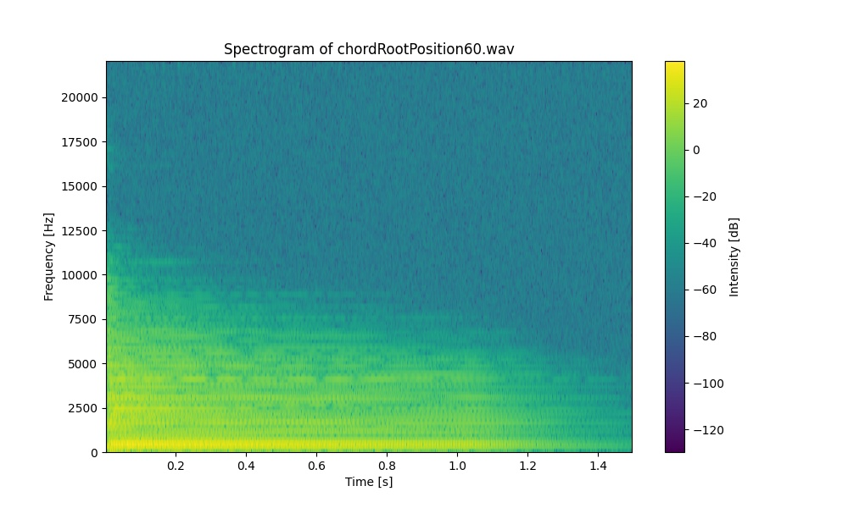
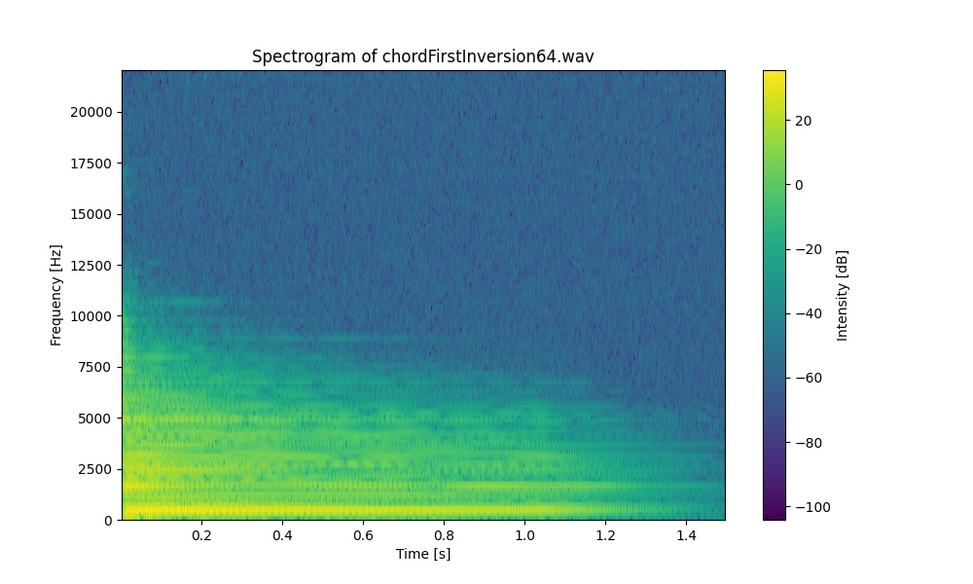
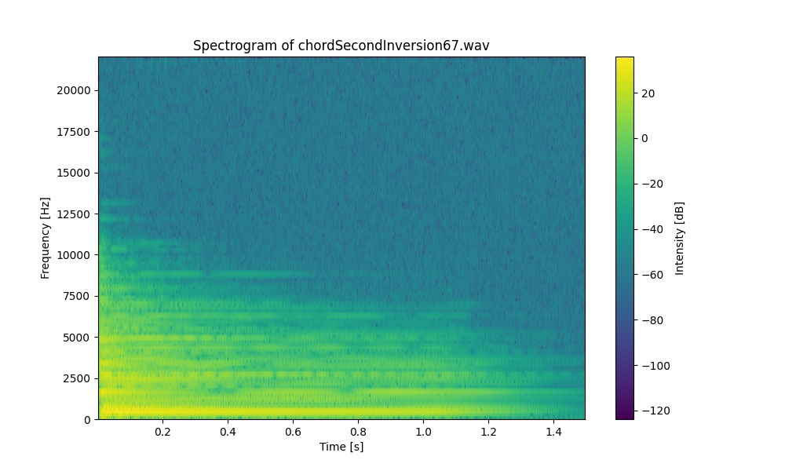
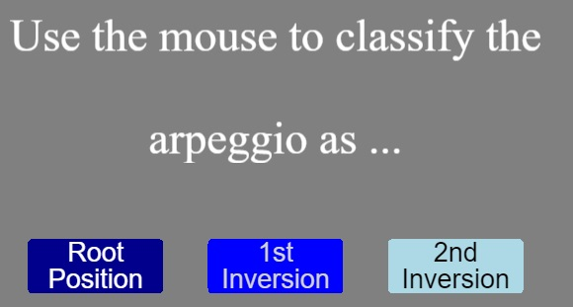
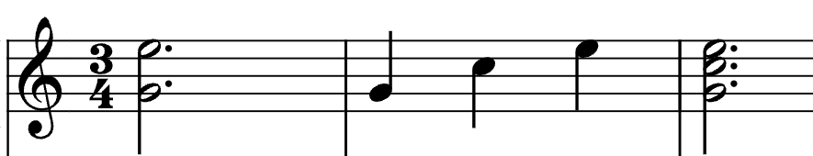
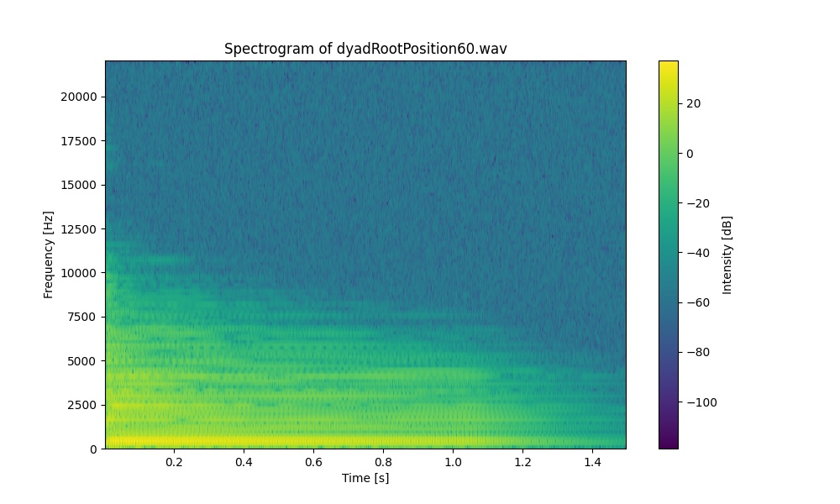
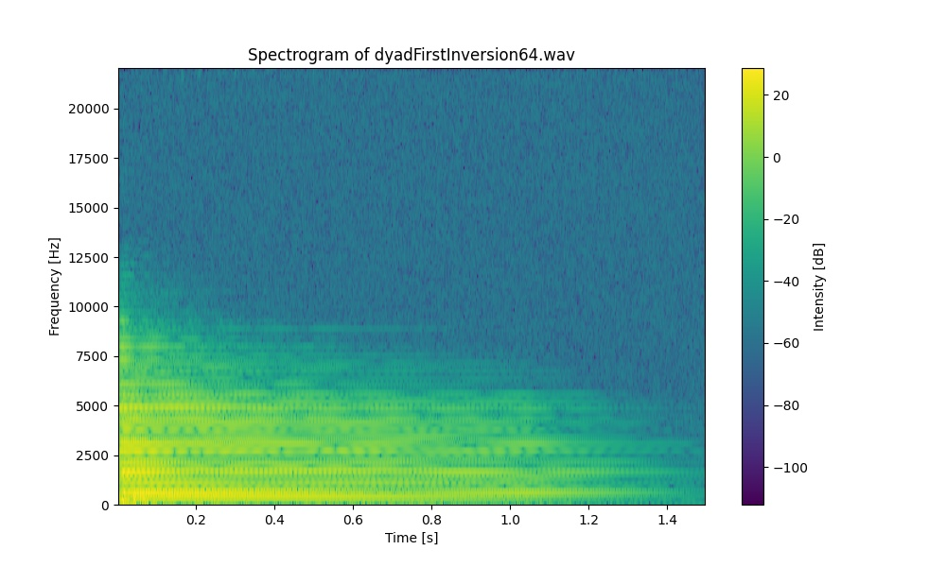
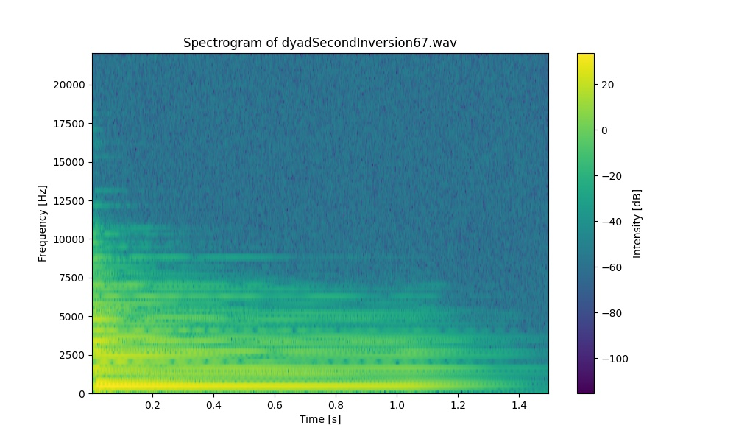
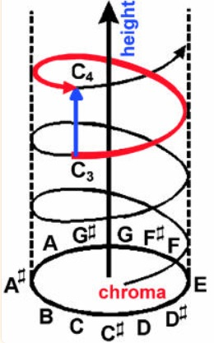
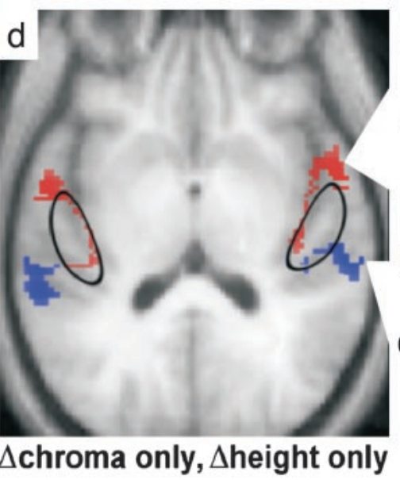
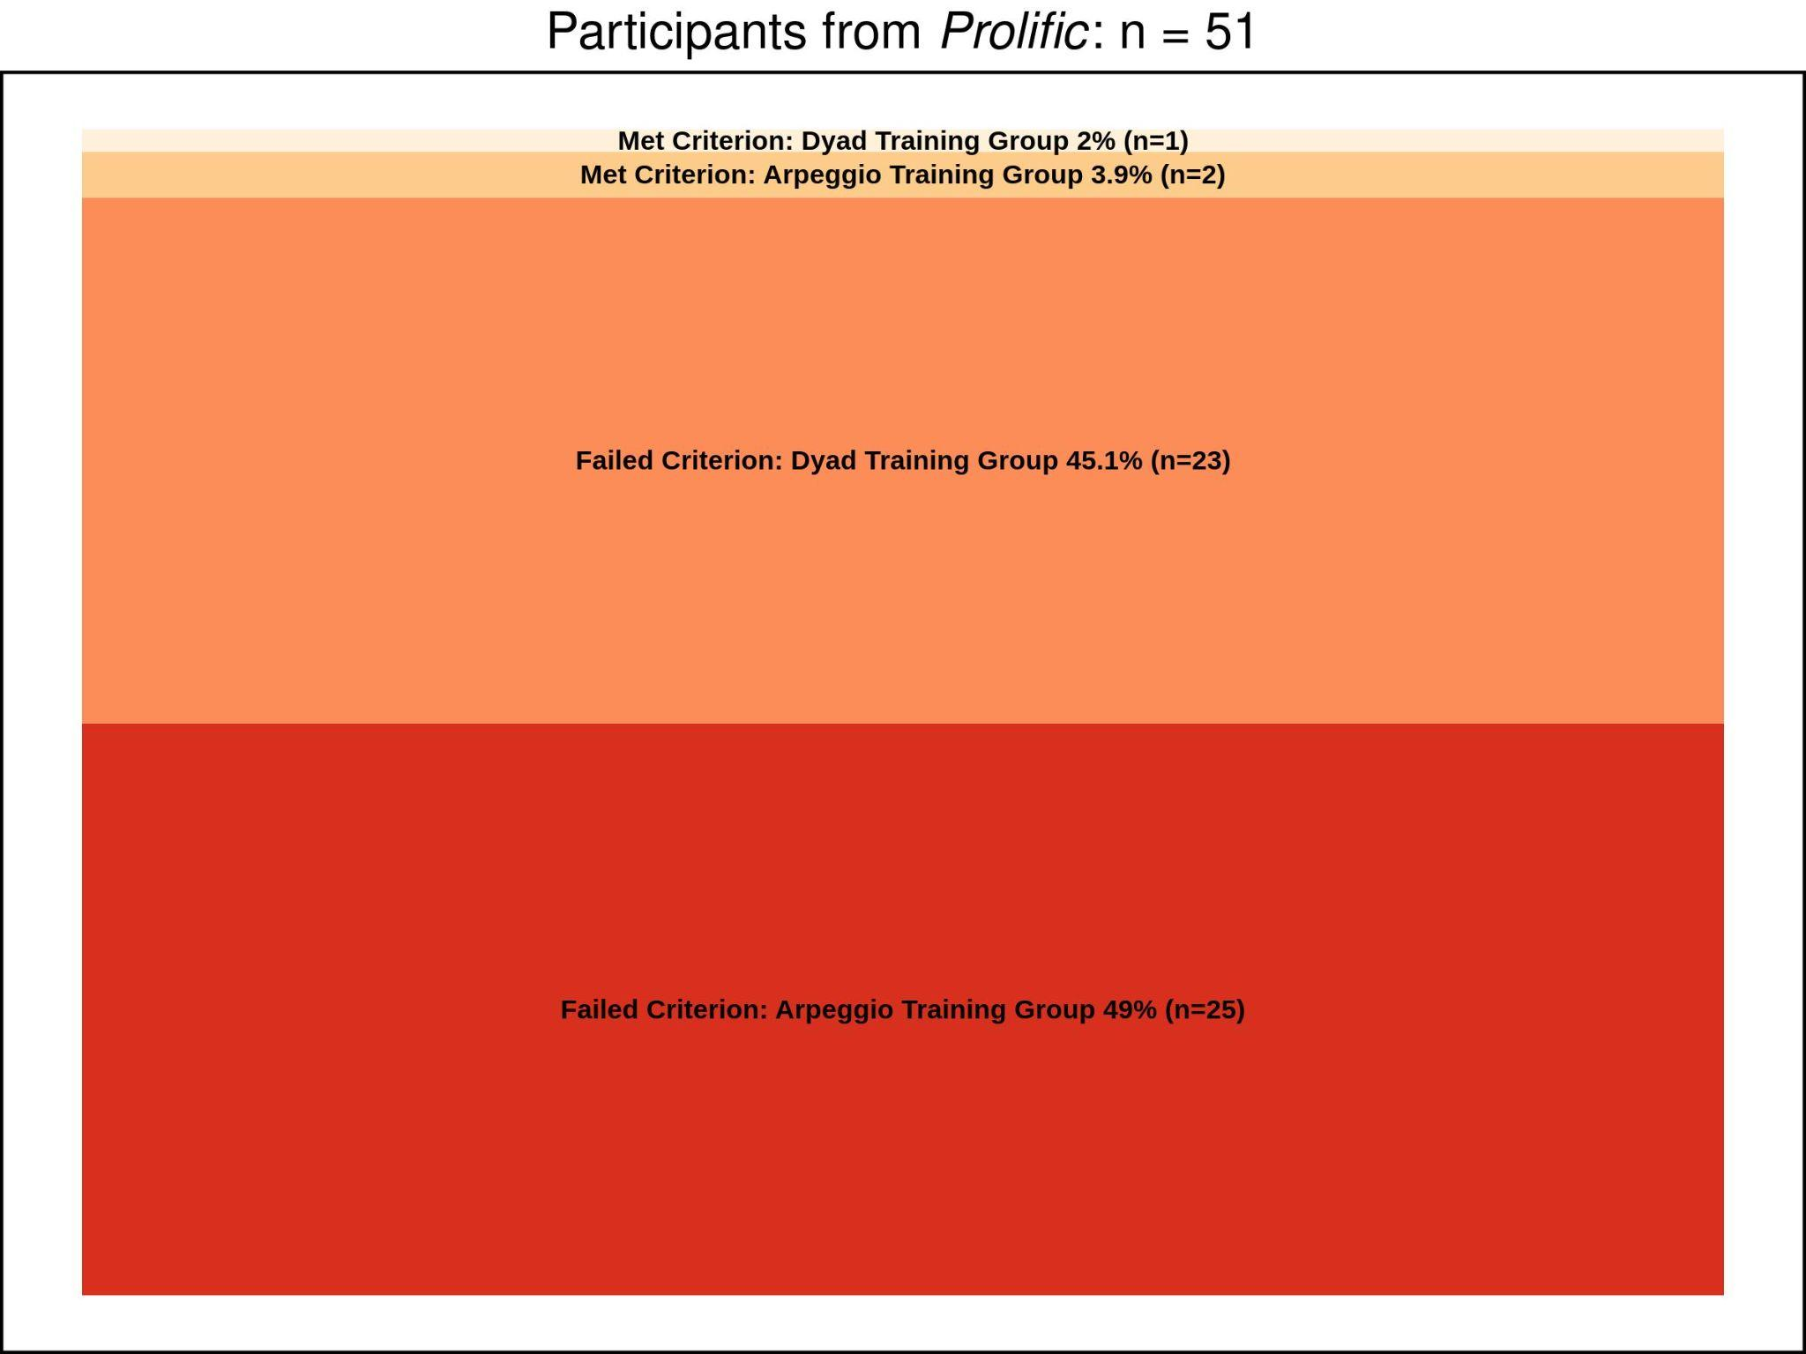
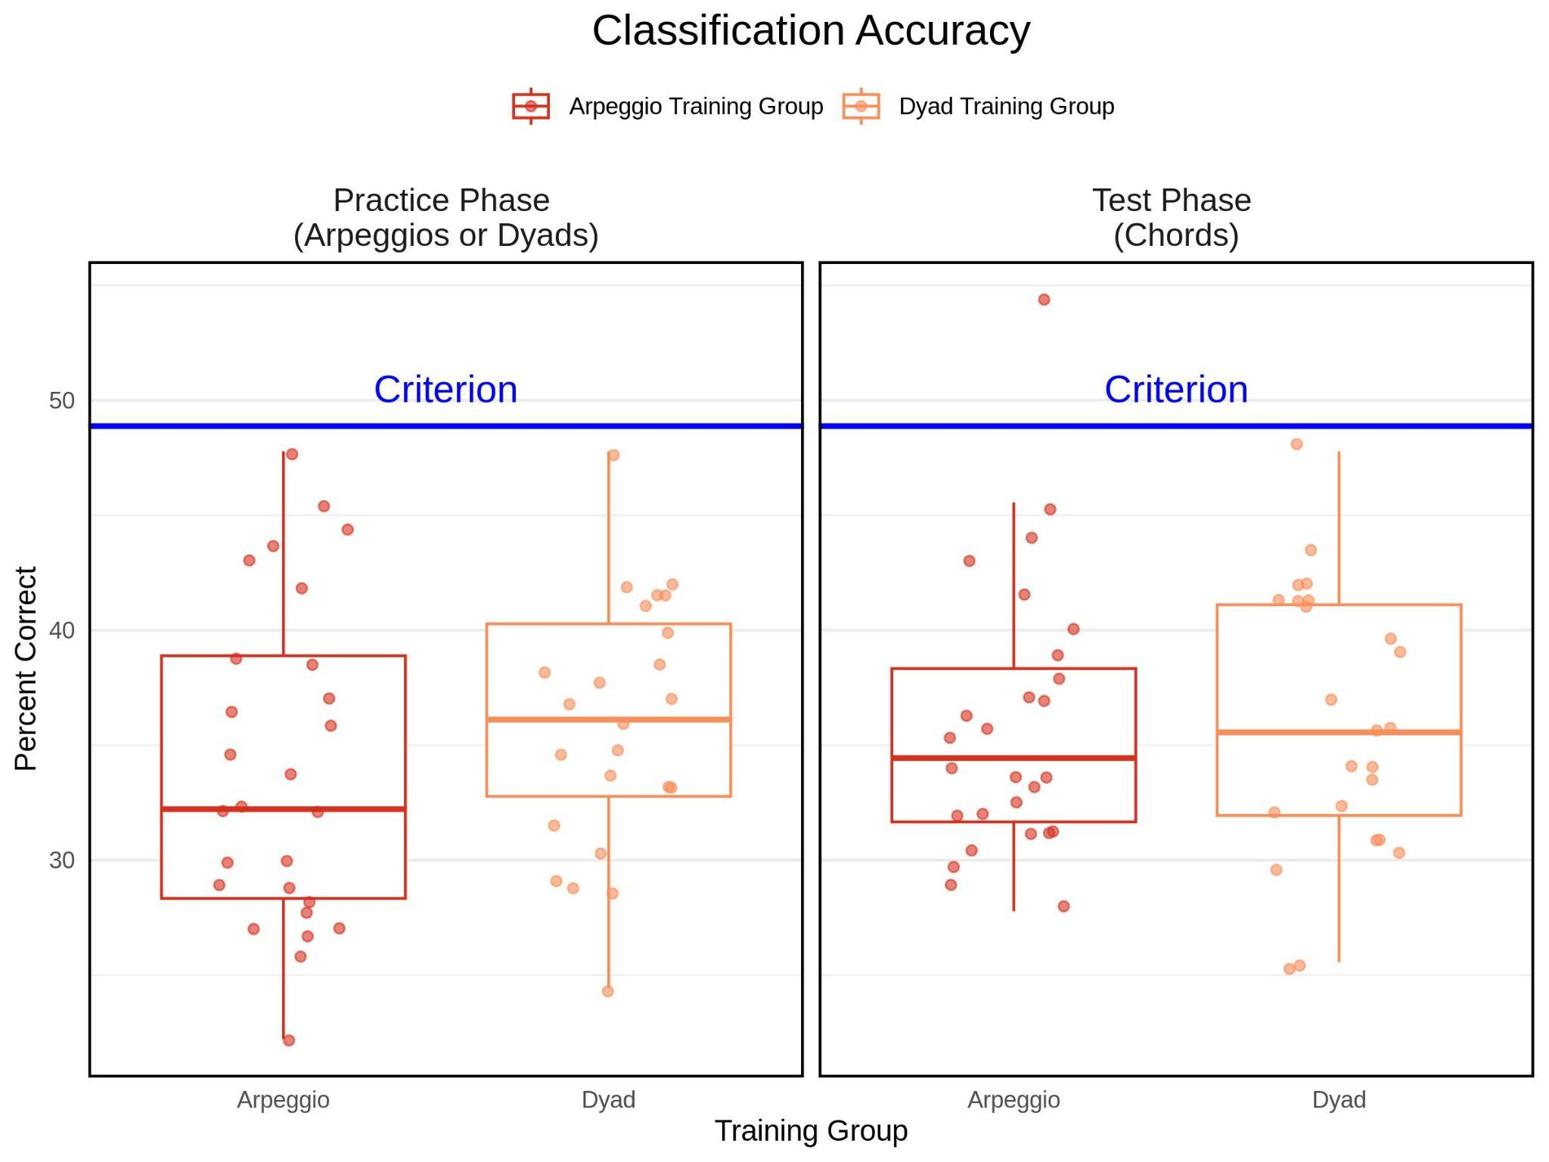
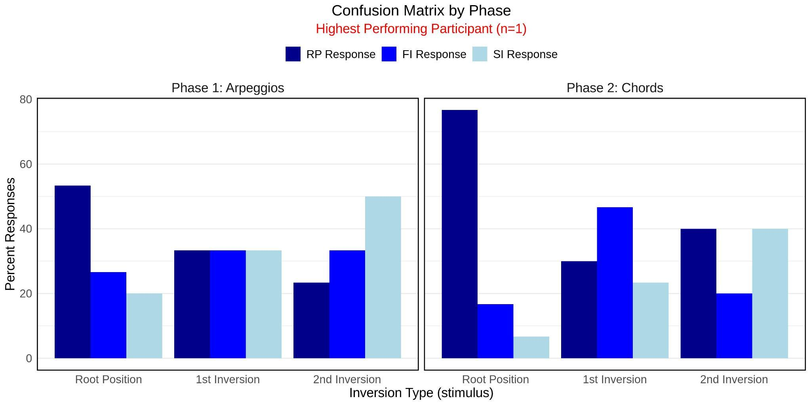
Perceptual Learning On Musical Chord Inversions
Jacob Bernstein & Dr. Nestor Matthews, Department of Psychology
Poster
Preregistration on OSF
Introduction
Why are chord inversions difficult to classify? Most music is based on chords. Chords contain three notes played simultaneously. By contrast, arpeggios contain three separate notes played successively, and dyads contain two notes played simultaneously. The notes in a chord, arpeggio, or dyad can be arranged into different positions called “inversions.” Prior research on the perception of chord inversions has suggested that people can hear the differences among various chord inversions⁽¹⁾. In principle, listeners could hear differences while lacking the ability to classify the differences into specific categories. Here, we sought to expand on the prior research^{(1,2)} to better understand how listeners best learn to classify chord inversions.
Hypotheses
The arpeggio hypothesis predicts that people best learn to classify musical chord inversions by first learning to classify a chord’s three notes heard separately. By contrast, the dyad hypothesis predicts that people best learn to classify musical chord inversions by first learning to classify a chord’s “critical dyad.” We operationally define a critical dyad as a chord’s lowest and the highest notes heard together. Stated differently, arpeggios and critical dyads are each “embedded” in a three-note chord.
Discussion
Summary & Implications
Among music educators, it is known that classifying chord inversions is a difficult perceptual task.
Motivated by this task’s challenge, we attempted to scaffold the chord classification task using a perceptual learning paradigm.
The perceptual learning paradigm had participants practice either arpeggios or dyads.
Surprisingly, even these scaffolded steps generated floor effects (see the box plots on arpeggio accuracy and dyad accuracy).
Our finding that the scaffolded steps generated floor effects suggests that the various chord inversions generate highly similar neural responses.
  When the neural responses overlap, the behavioral response is not distinct.
As the pitch helix demonstrates, the notes, or chroma (angular differences in the pitch helix) in any given chord inversion are identical, regardless of pitch height⁽³⁾.
fMRI experiments show that the anterior auditory cortex registers changes in chroma, while the posterior auditory cortex registers changes in pitch height⁽³⁾.
Our floor effects suggest that participants were relatively insensitive to pitch height manipulations, which would register in the posterior auditory cortex⁽³⁾.
Future Research
Although our scaffolded steps were not sufficiently accessible to our participants, future research might more precisely scaffold the components of chord inversions.
Future research might also harness the power of mnemonics on musical memory.
Results
51 participants from Prolific completed our study.
  27 participants completed our arpeggio training.
  24 participants completed our dyad training.
Inclusion Criterion: To be included in our pre-registered data analyses, a participant had to exceed chance-level accuracy (binomial p < 0.001).
We observed a salient floor effect. The task was very difficult, as demonstrated by the fact that only three (5.9%) of 51 participants met our inclusion criterion.
  2 of the 27 arpeggio training group participants met criterion.
  1 of the 24 dyad training group participants met criterion. (See stacked bar chart below.)
Further evidence of the floor effect can be seen below in the box plots. Importantly, the median of each box plot lands near chance-level accuracy (33.33% correct on our 3 alternative forced choice task).
Because only 3 of 51 participants met inclusion criteria, we were not able to conduct our pre-registered inferential statistics. Here is a link to our pre-registered hypotheses and statistical plans on the Open Science Framework: https://osf.io/mhb2g.
Regarding descriptive statistics, the confusion matrix below offers a close inspection of our highest performing participant. The participant demonstrated precision in classifying root position chords, but performed only at chance when classifying 1st inversion arpeggios.
Chord Inversions
C4
E4
G4
C5
E5
G5
Root Position | First Inversion | Second Inversion
Note, Note +4, Note +7 | Note, Note +3, Note+8 | Note, Note +5, Note+9
Midi Notes 60, 64, 67 | Midi Notes 64, 67, 72 | Midi Notes 67, 72, 76
C4 | E4 | G4 | C5 | E5
261.63 Hz | 329.63 Hz | 392 Hz | 523.25 Hz | 659.25 Hz
Root
Position
Arpeggios
Root Position
1st Inversion
2nd Inversion
1st
Inversion
Chords
2nd
Inversion
Dyads
Method
Ethics: The Denison University IRB approved this study.
Participants: The Prolific online crowdsourcing service recruited 51 adults. All 51 participants completed the experiment online after adjusting their computer audio level before the experiment.
Stimuli & Task: Stimuli were chords, arpeggios, and dyads, each played for 1 second. The task required each participant to classify the musical stimulus on each trial as either root position, 1st inversion, or 2nd inversion; a 3-alternative forced-choice (3-AFC) task.
Procedure: In Phase 1, participants either classified ninety ascending major arpeggios or ninety major dyads as either root position, 1st inversion, or 2nd inversion. In Phase 2, participants classified ninety major chords. After each response, participants received feedback indicating both the accuracy of their response and the correct response.
Measures: Our dependent variable was the speed and accuracy of the responses. The independent variables were musical chord inversions (root position, 1st inversion, 2nd inversion; within-subjects), training group assignment (arpeggios versus dyads; between subjects), and experimental phase (practice phase and test phase; within subjects).
Design: The study had a 3x2x2 mixed experimental research design.
Red corresponds to a pitch chroma change in the stimulus, generating anterior activity⁽³⁾.
Blue corresponds to a pitch height change in the stimulus, generating posterior activity⁽³⁾.
Selected References & Acknowledgments
1. Hubbard, T. L. (1998). Listeners can discriminate among major chord positions. Perceptual and motor skills, 87(3), 891-897.
2. Hubbard, T. L,. & Datteri, D. L. (2001). Recognizing the component tones of a major chord. The American Journal of Psychology, 114(4), 569-589.
  3. Warren J.D., Uppenkamp S., Patterson R.D., & Griffiths, T.D. Separating pitch chroma and pitch height in the
  human brain. Proc Natl Acad Sci U S A. 2003 Aug 19;100(17):10038-42. doi: 10.1073/pnas.1730682100. Epub 2003 Aug 8. PMID: 12909719; PMCID: PMC187755.
  * This project and research would not have been possible without the support of the Kim Sharfstein Summer Scholar Endowed Fund. I would also like to give a special thanks to Dr. Nestor Matthews for his assistance and mentorship throughout the research process.

