Slide 1
Biological Psychology: Macro Level

Slide 2
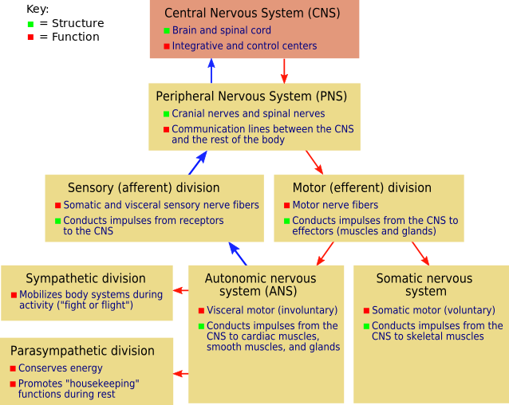
Parts of the Nervous System
http://en.wikipedia.org/wiki/File:NSdiagram.svg
“Rest & Digest”
“Feed & Breed”

Slide 3
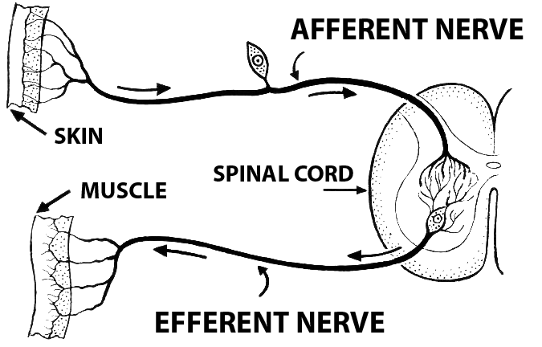
CNS / PNS Interaction
http://en.wikipedia.org/wiki/File:Afferent_%28PSF%29.png
“Inbound Signals”, toward the CNS
Dorsal
“back”
Ventral
“front”
“Outbound Signals”, away from the CNS

Slide 4
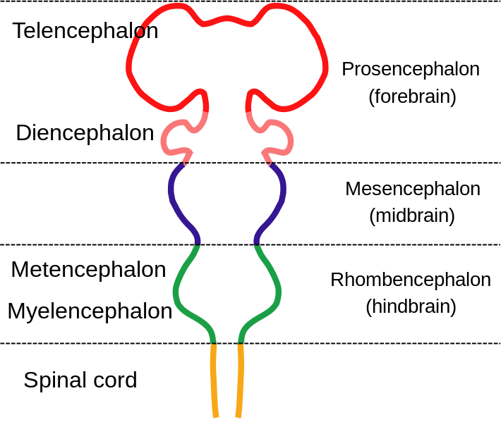
Brain = Encephalon
http://commons.wikimedia.org/wiki/File:EmbryonicBrain.svg

Slide 5
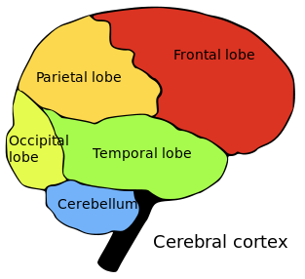
Lobes of the Brain
http://en.wikipedia.org/wiki/File:Brainlobes.svg

Slide 6
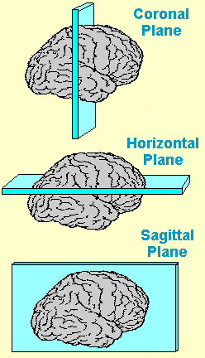
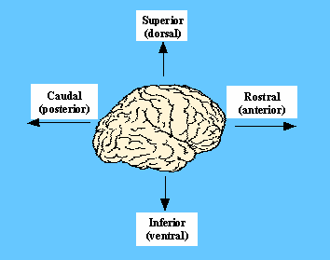
Neural Navigation
http://faculty.washington.edu/chudler/slice.html
Eyes

Slide 7
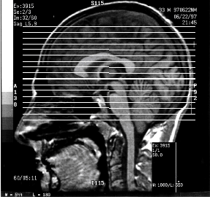
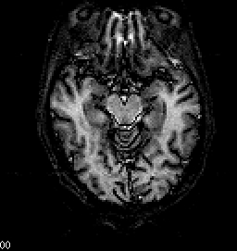
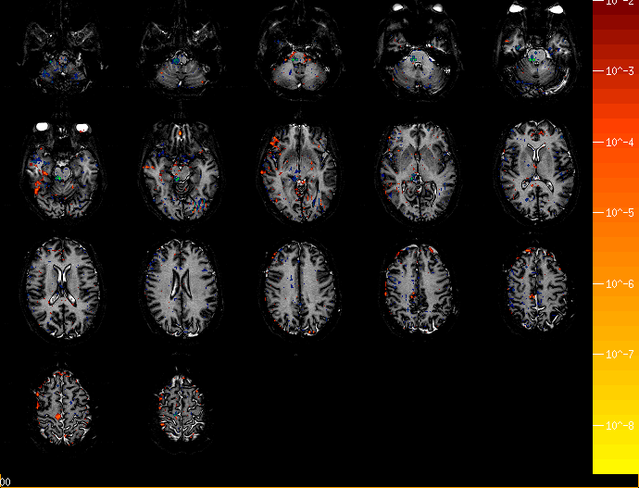
My Brain

Slide 8
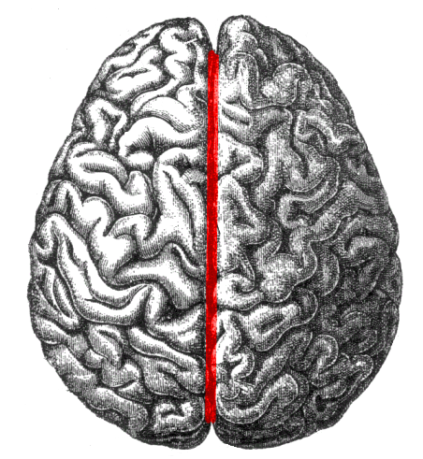
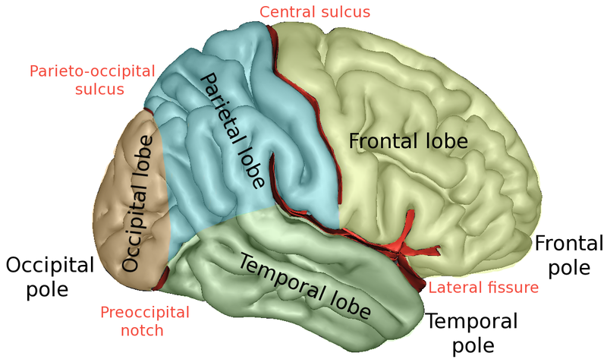
Fissure = Sulcus = Deep Groove
http://en.wikipedia.org/wiki/File:Human_brain_longitudinal_fissure.png
http://en.wikipedia.org/wiki/File:LobesCaptsLateral.png
Longitudinal Fissure

Slide 9
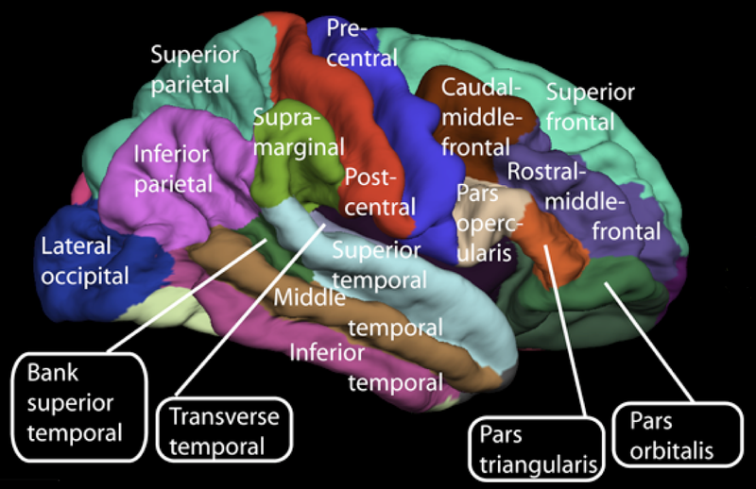
The Cerebral Cortex
http://en.wikipedia.org/wiki/File:Lateral_surface_of_cerebral_cortex_-_gyri.png

Slide 10
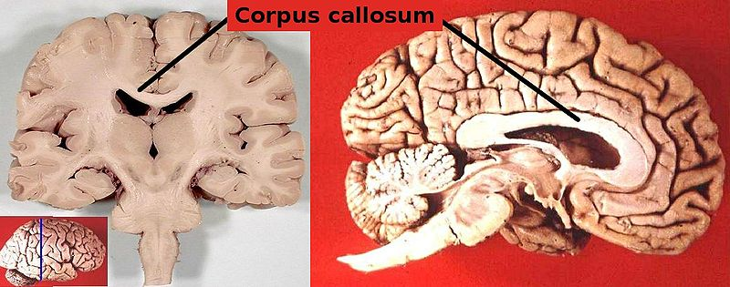
Corpus Callosum – Links Hemispheres
http://en.wikipedia.org/wiki/File:Corpus_callosum.jpg

Slide 11
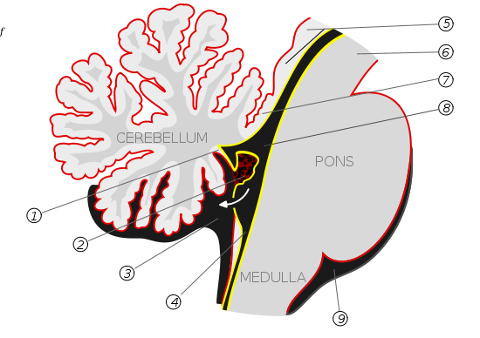
Hind Brain
http://en.wikipedia.org/wiki/File:Gray708.svg

Slide 12
CNS, Endocrine System, Hormones
http://en.wikipedia.org/wiki/Endocrine_system
Endocrine System - the collection of cells, glands, and tissues of an organism that secrete hormones directly into the bloodstream to control the organisms' physiological and behavioral activities.
Note:
Hormones act slowly, and over long distances
Action potentials occur quickly over short distances

Slide 13
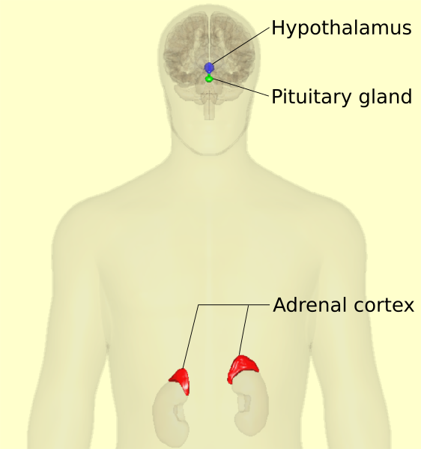
HPA Axis: Stress Response
https://commons.wikimedia.org/wiki/File:HPA-axis_-_anterior_view_(with_text).svg

