Slide 1
Mathematical and statistical views on the opioid epidemic
David White
Denison University
Notes:
This talk is a scaled back version of the one I gave in February of 2020.
Mathematical and Statistical Views on the Opioid Epidemic
Bowling Green, April 2024
Thanks for the invitation and for coming.
Disclaimer: in this talk we're going to be discussing a heavy and emotional topic. Every year in Ohio thousands of people die from unintentional drug overdoses. This research seeks to tackle the problem head-on and carry out statistical analyses to find polices that can reduce the number of overdose deaths.

Slide 2
Key Take-Aways
  There are tons of freely available datasets about the opioid epidemic: CDC, SUDORS, BCI, NSDUH, epicenter (hospitals), prescriptions (OARRS), marijuana laws, NFLIS (DEA), FBI, OMAS Medicaid survey, mental health.
  There is a huge need to educate people about what actually works to combat the opioid epidemic. This is a heavy topic, but the data tell us very important information.
  Many data sets have never been analyzed – lots of low-hanging fruit, and nowhere near enough math/stats people working on this.
  Even simplistic analyses are valuable to harm reduction professionals, can save lives, and can get published. Great for students.
  I’m happy to help you get involved, sharing datasets, analyses, and papers, and connecting you to experts. Current team includes faculty and students from Denison, Kent State, Ohio State, Kenyon, University of Dayton, plus Harm Reduction Ohio.
Notes:
About saying “should” – meaning what strategies/policies are associated with a reduction in deaths.

Slide 3
Plan for today:
Overdose Deaths in Ohio and USA
  History = Triple Wave Epidemic: Pills, Heroin, Fentanyl.
  Iron Law of Prohibition. Efforts of Harm Reduction Ohio.
Police Seizures of Drugs (BCI)
  130,000 drug seizures in 2014-2018: types of drugs seized, weight, county, date, name of the law enforcement department.
Ohio SUDORS Data: Unintentional Overdose
  9,300 individuals who died of drug overdose, 750 attributes for each: demographics, mental health/substance abuse history, personal problems, bystanders, Naloxone, polysubstance abuse, etc.
  This study includes data provided by the Ohio Department of Health, which should not be considered an endorsement of this study or its conclusions.

Slide 4
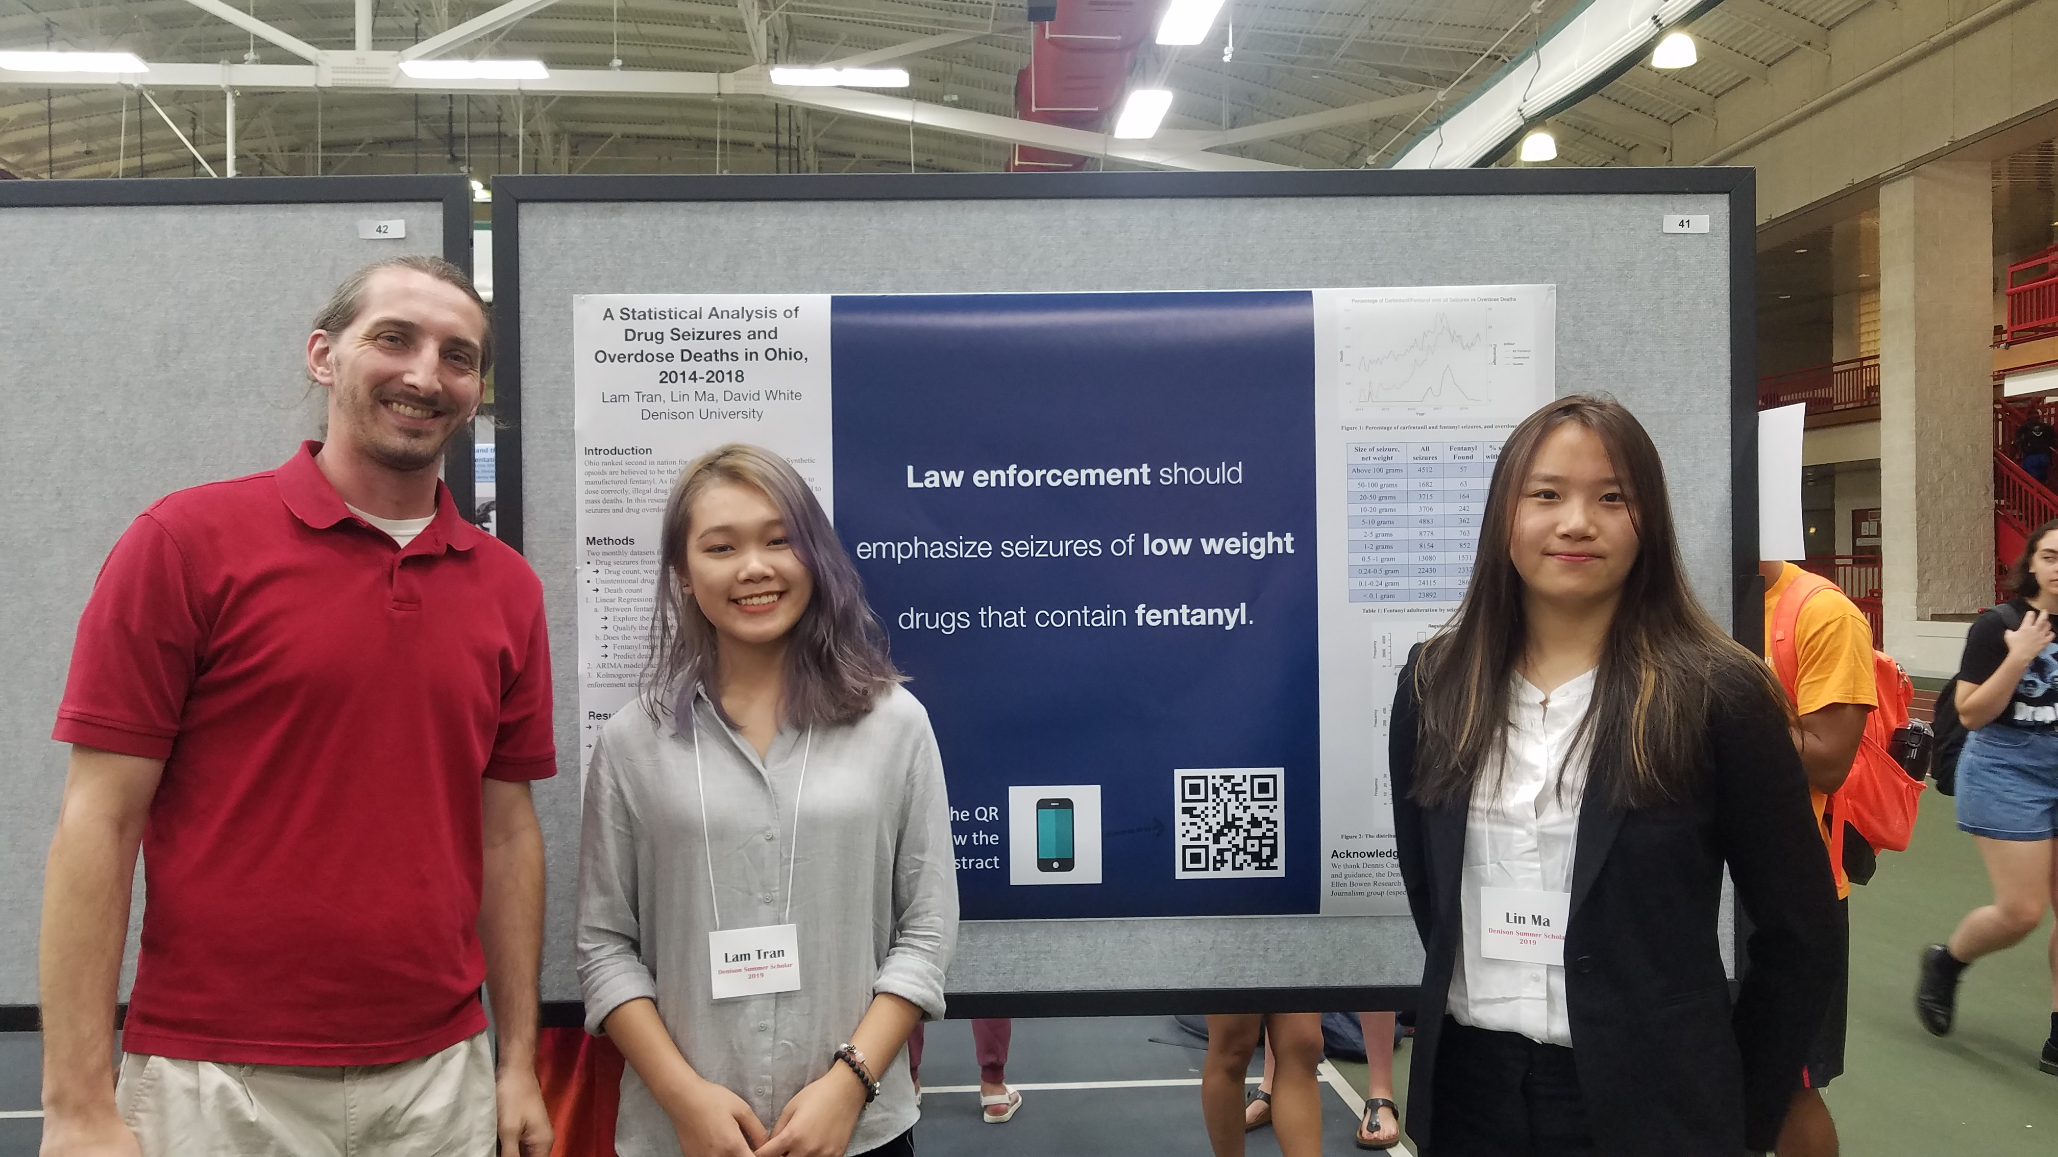

Funded by Summer Scholars Program, Narrative Journalism concentration, and the Andrew W. Mellon Foundation.
Joint with Lin Ma (‘20) and Lam Tran (‘21)
Inspired by work of Dennis Cauchon (Harm Reduction Ohio)

Slide 5
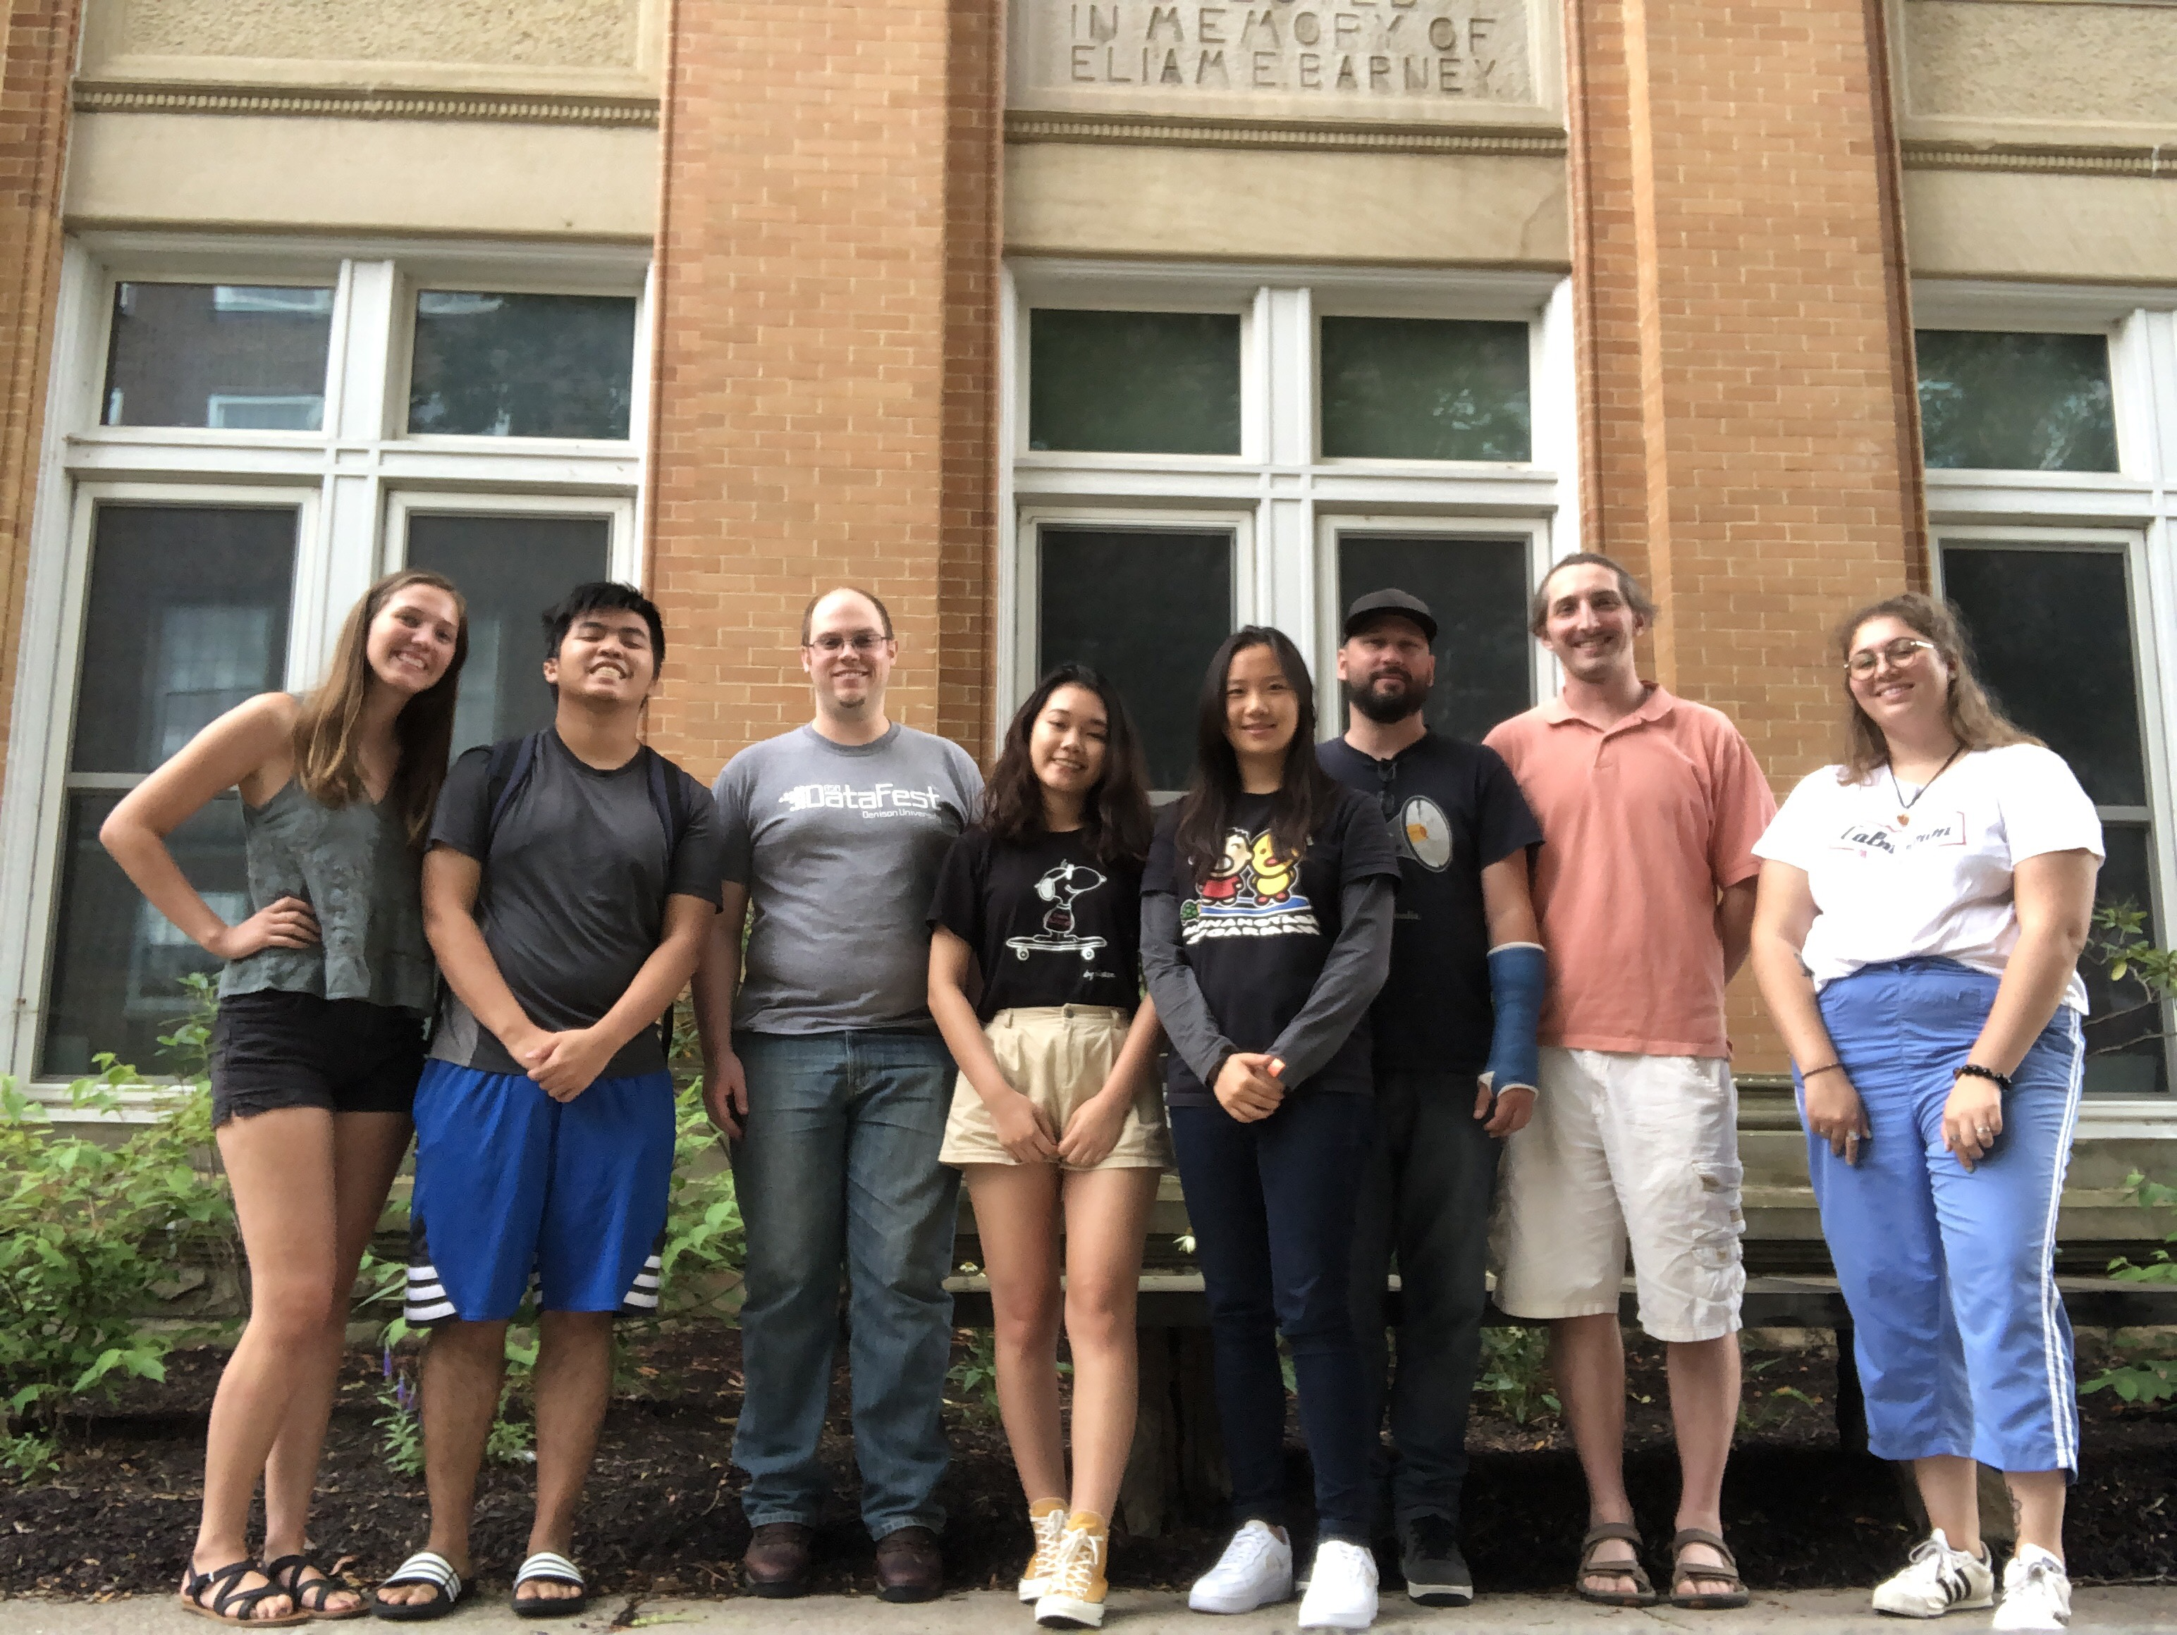
Our research team

Slide 6
Overdose Deaths in USA
  The yearly number of drug overdose deaths surged in the US from 16,849 cases in 1999 to 107,941 cases in 2022.
  In 2022, more than 295 people died every day in the US after overdosing on opioids.
  The number of fentanyl encounters has been increasing exponentially, from 5,343 in 2014 to 117,045 in 2020. It has continued to increase.
  As of now, an American is more likely to die from an unintentional drug overdose than in a car accident.
  Ohio has average drug use patterns, but in 2017 was second in the country for unintentional drug overdose deaths, and now seventh highest. Why?
  Iron Law of Prohibition: if you crack down on one type of drugs, dealers will select more potent drugs to traffic in.
Notes:
A lot of the graphics were not created by me, but for each graphic I can give you the reference.
Six-fold increase in the number of drug overdose deaths
Next slide is national deaths growing

Slide 7
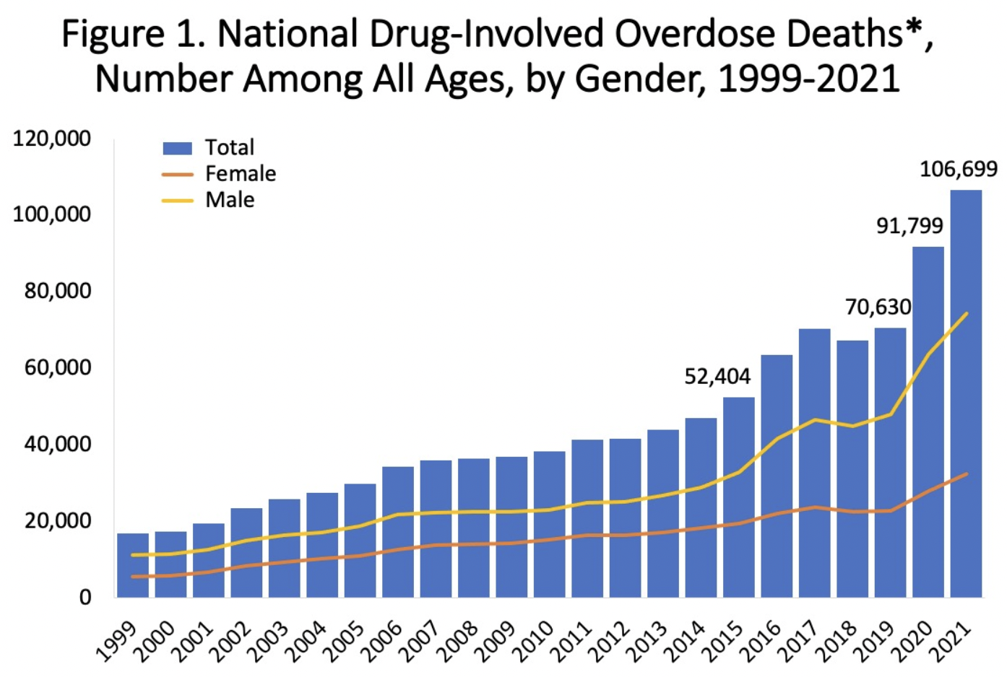
Notes:
Source: NIH https://nida.nih.gov/research-topics/trends-statistics/overdose-death-rates
Overdose deaths rising fast
Next slide is opioid deaths growing. “What is driving this growth?”

Slide 8
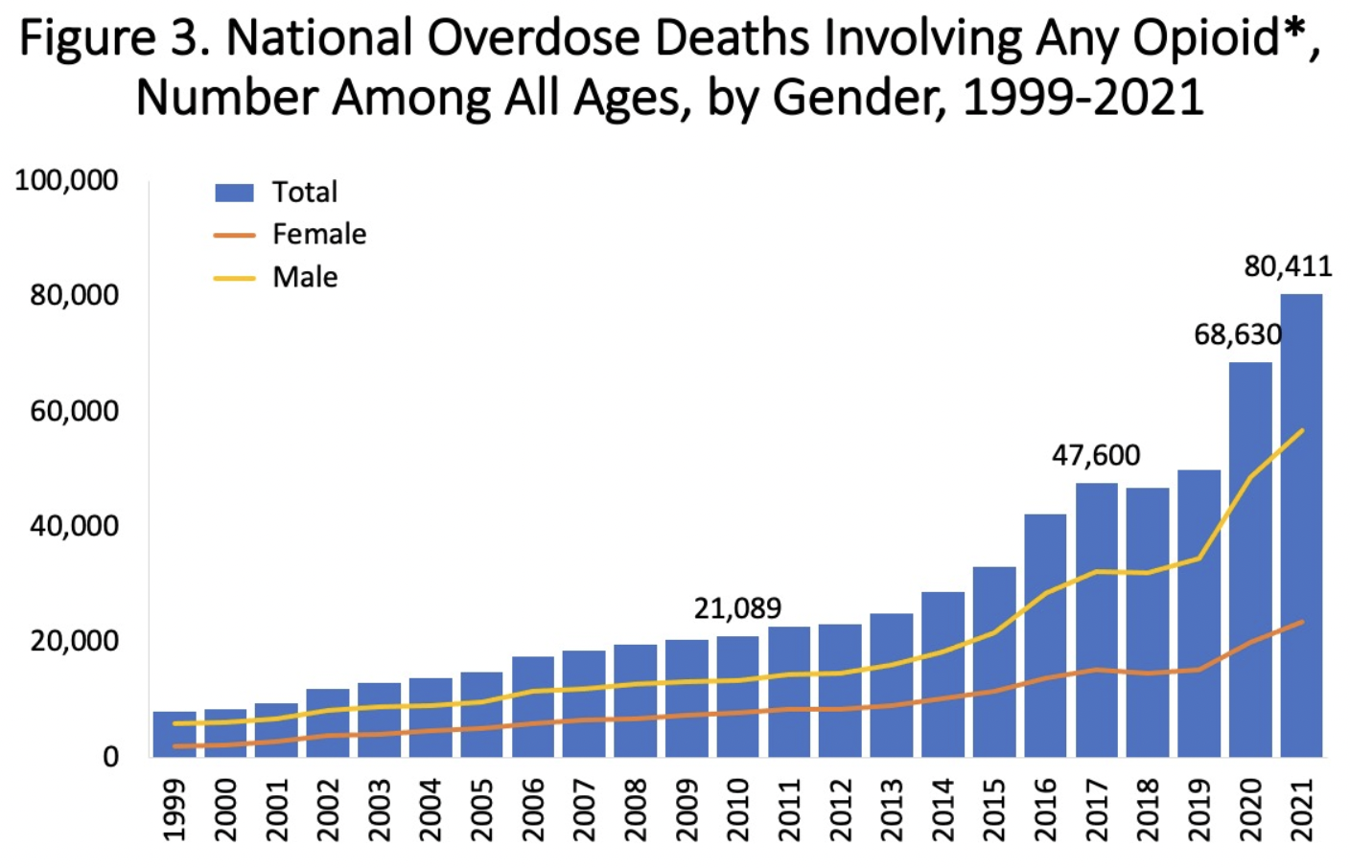
Notes:
NIH
Driven by opioid overdoses
Next slide: “What about other drugs than opioids?”

Slide 9
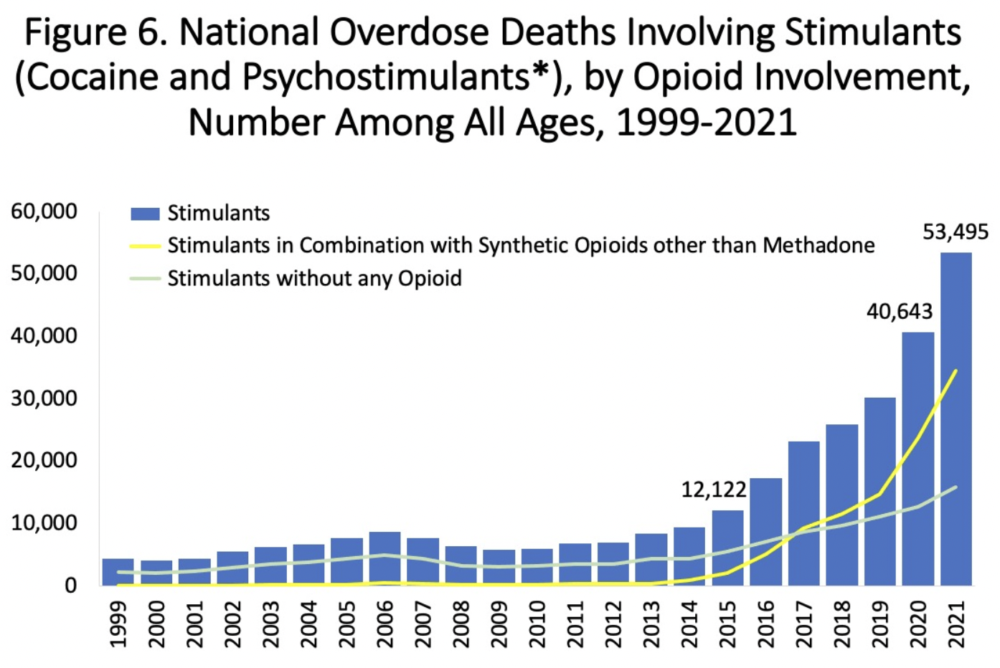
Notes:
NIH
Even when it’s psychostimulants (like moli), it’s still opioid involved because fentanyl can be added
Next slide: “What about meth?”

Slide 10
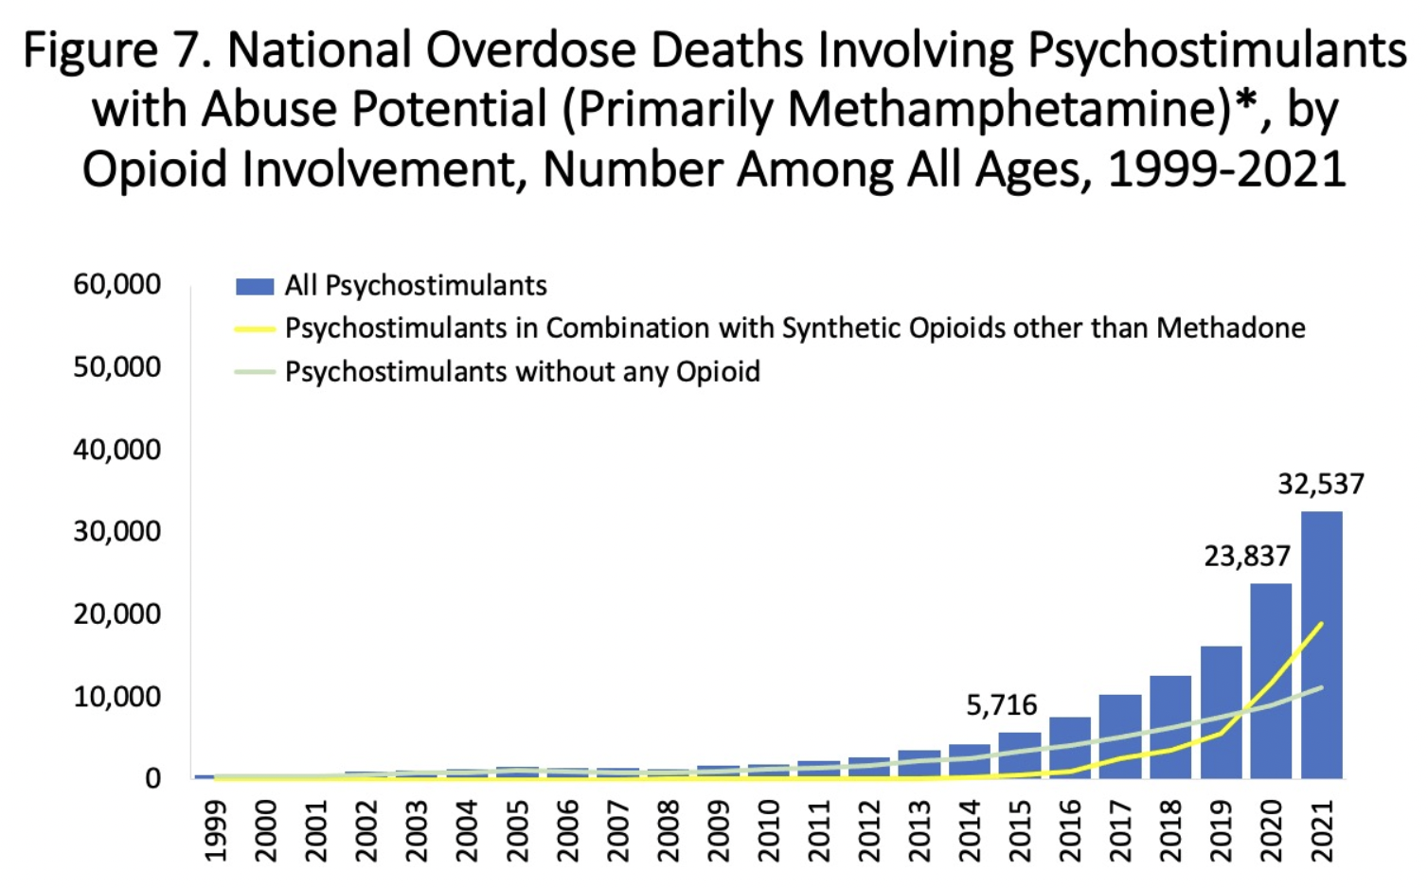
Notes:
NIH
Even when it’s meth, there’s still opioid involvement
Next slide: “What about cocaine?”

Slide 11
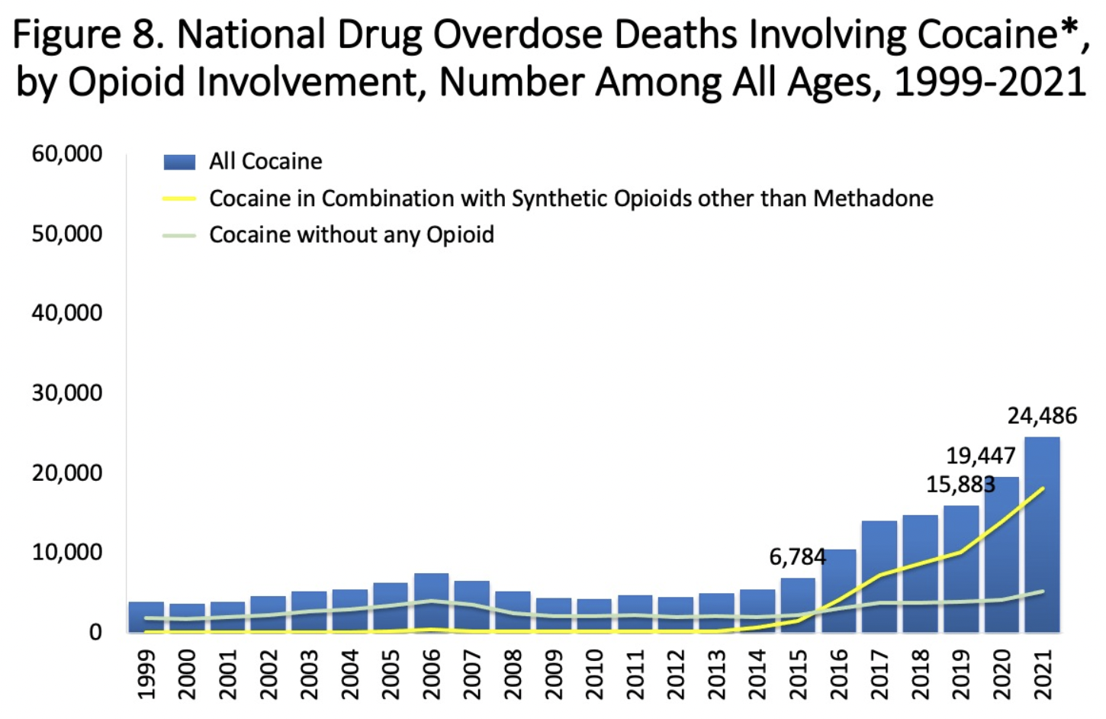
Notes:
NIH
Even when it’s cocaine, there’s still opioid involvement
Next slide: what about benzodiazepine?

Slide 12
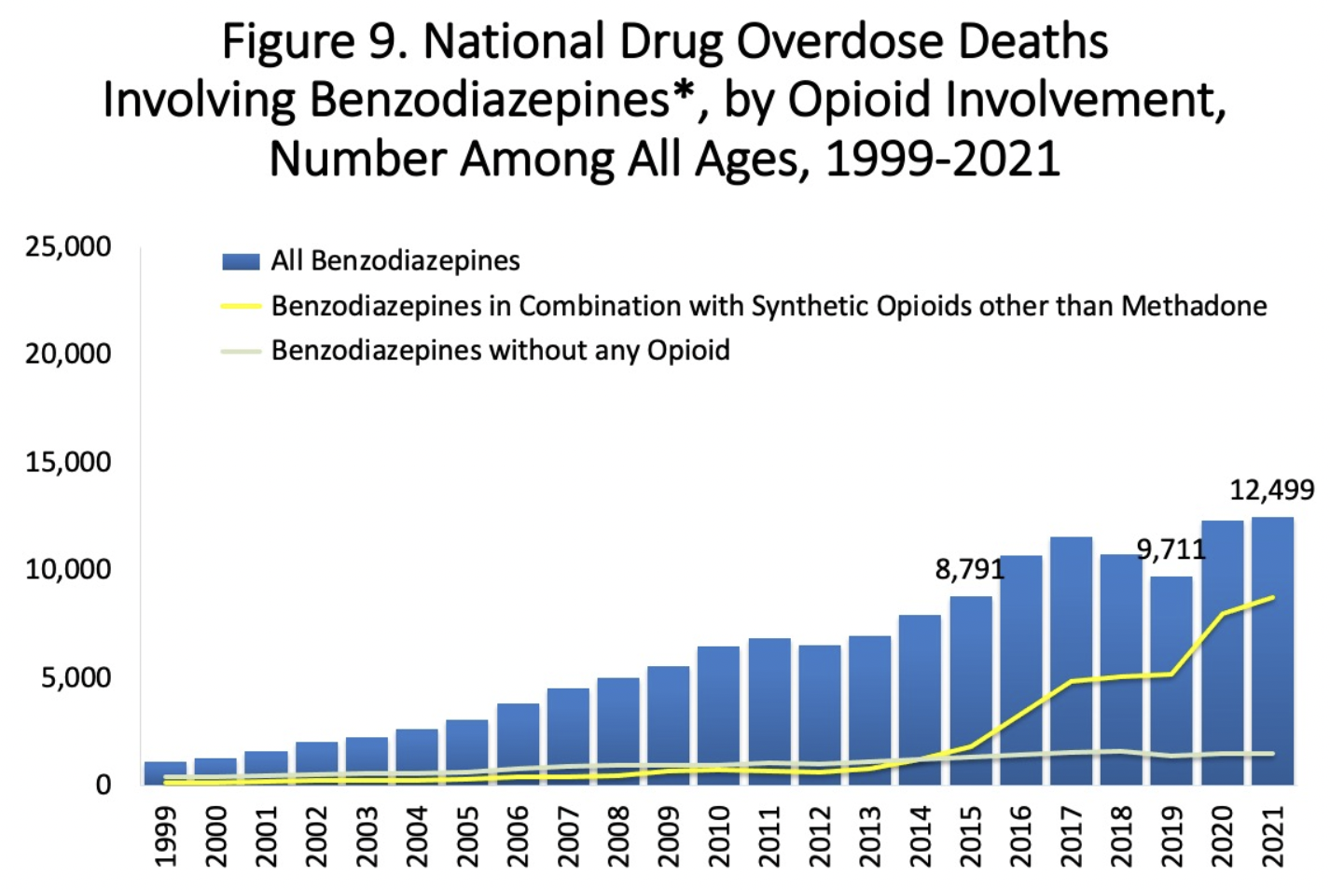
Notes:
NIH
Even when it’s benzodiazepine, there’s still opioid involvement
Next slide: epidemic is hitting all races

Slide 13
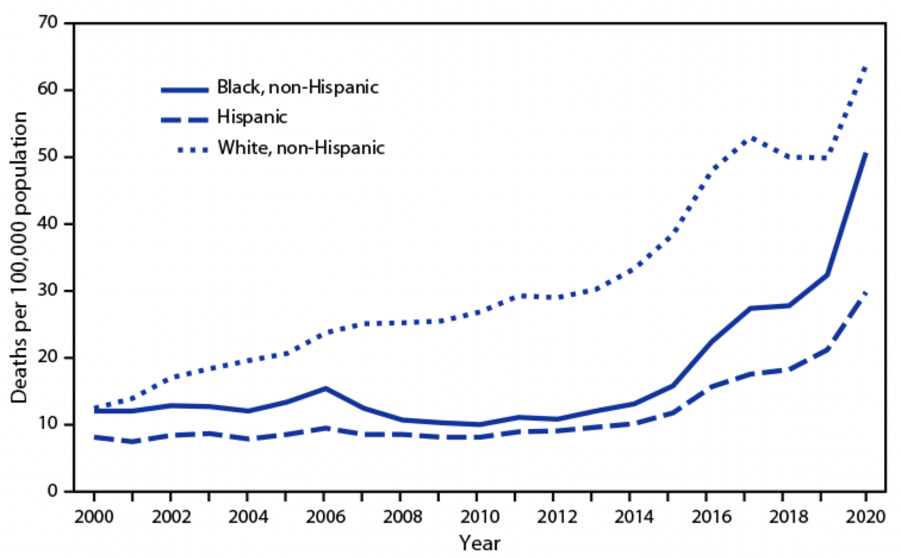
Notes:
Death toll is rising across all racial/ethnic groups.
https://www.cdc.gov/mmwr/volumes/71/wr/mm7146a4.htm
Next slide: it’s really not about pain pills and has not been for a long time

Slide 14
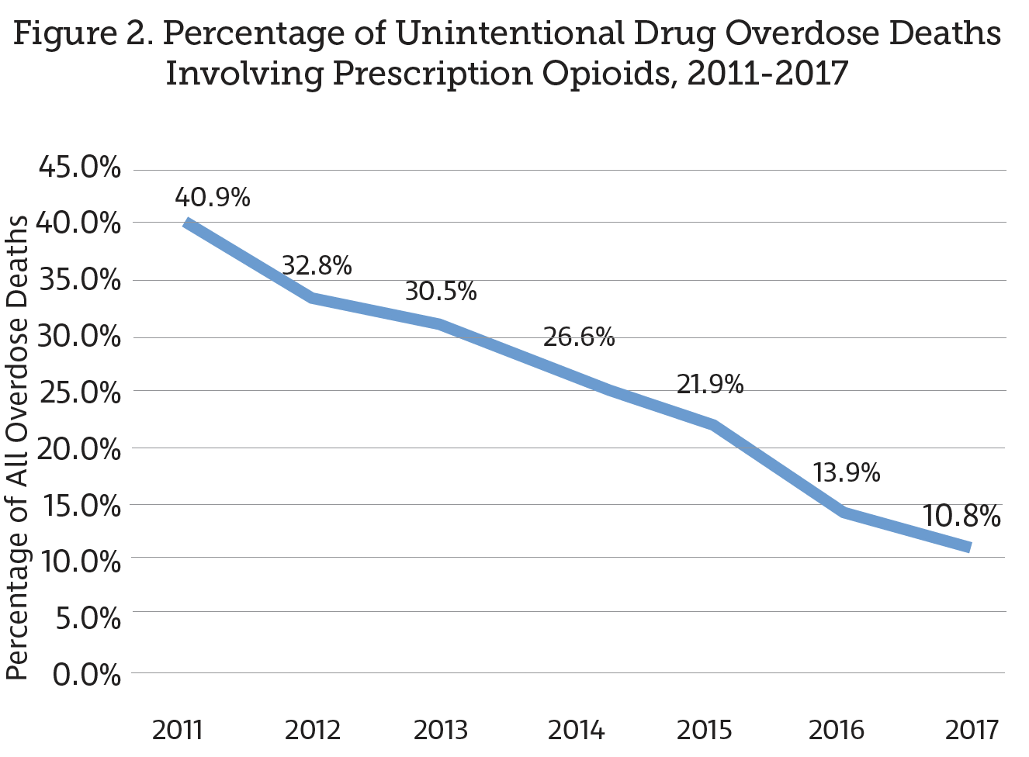
Notes:
https://odh.ohio.gov/wps/wcm/connect/gov/5deb684e-4667-4836-862b-cb5eb59acbd3/2017_OhioDrugOverdoseReport.pdf?MOD=AJPERES&CONVERT_TO=url&CACHEID=ROOTWORKSPACE.Z18_M1HGGIK0N0JO00QO9DDDDM3000-5deb684e-4667-4836-862b-cb5eb59acbd3-moxPbu6
It’s not prescription opioids like pain pills
Next slide: three waves of the epidemic

Slide 15
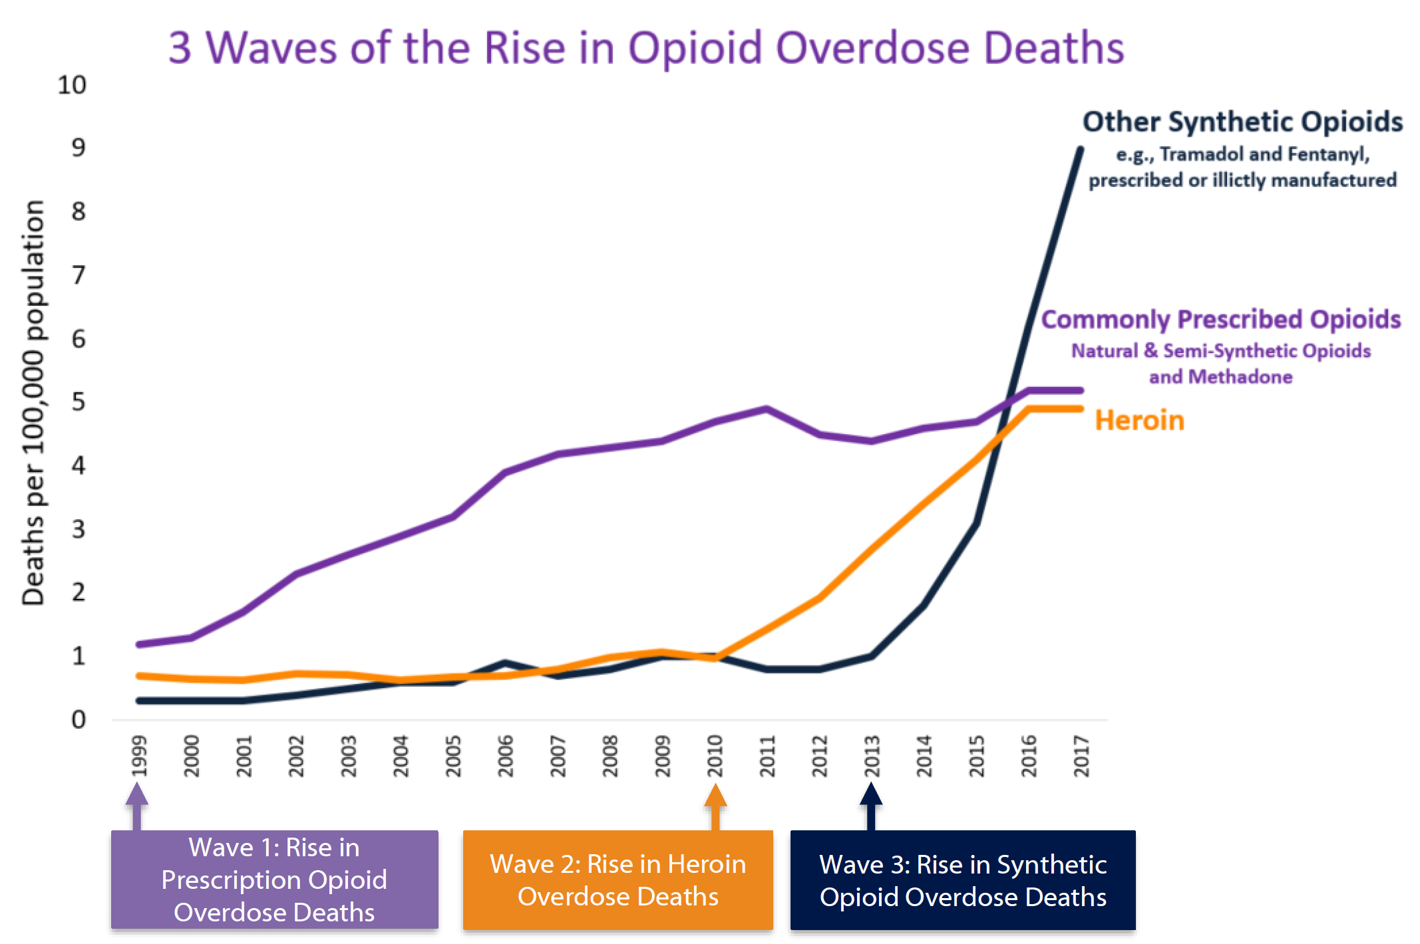
Notes:
Ciccarone - 2019 - The triple wave epidemic Supply and demand drivers of the US opioid epidemic
Also: CDC/NCHS (2018). National Vital Statistics System, Mortality. CDC WONDER, Atlanta, GA: US Department of Health and Human Services, CDC; 2018. https://wonder.cdc.gov.
Also: slides of Mattson & O’Donnell, “Enhancing Opioid Overdose Surveillance in States” https://www.thename.org/assets/2018Handouts/9.1%20-%20Mattson%2C%20Christine.pdf
Next slide: fentanyl is driving it

Slide 16
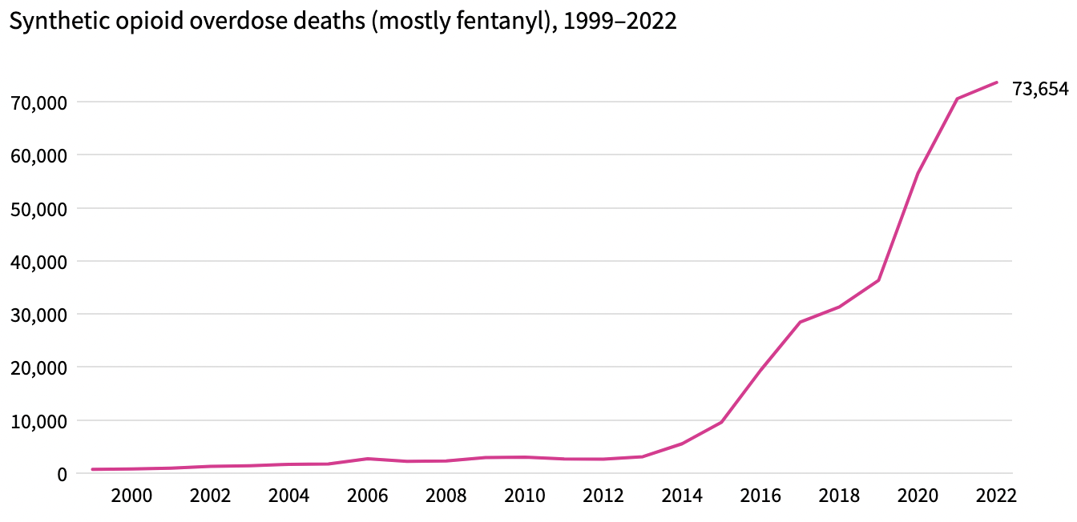
Notes:
https://usafacts.org/articles/are-fentanyl-overdose-deaths-rising-in-the-us/
CDC data
Next slide: more about fentanyl

Slide 17
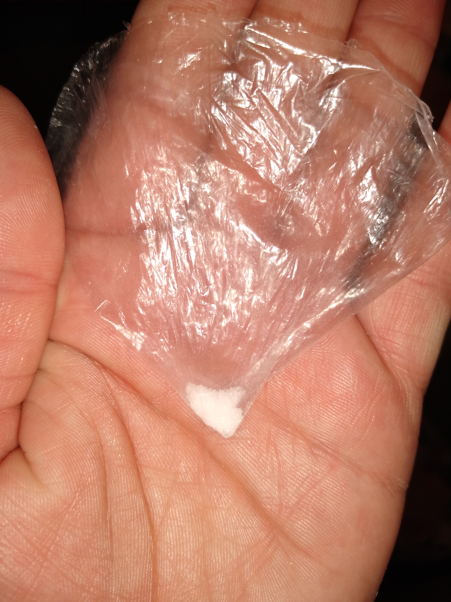
Fentanyl is a synthetic opioid
Cheap to manufacture.
Very powerful.
Easy to mix with other drugs.
Many variants of unknown strength.
Strongest known variant is Carfentanil.
Notes:
Photo courtesy of Dennis
Next slide: let’s look at where in the country this is hitting.

Slide 18
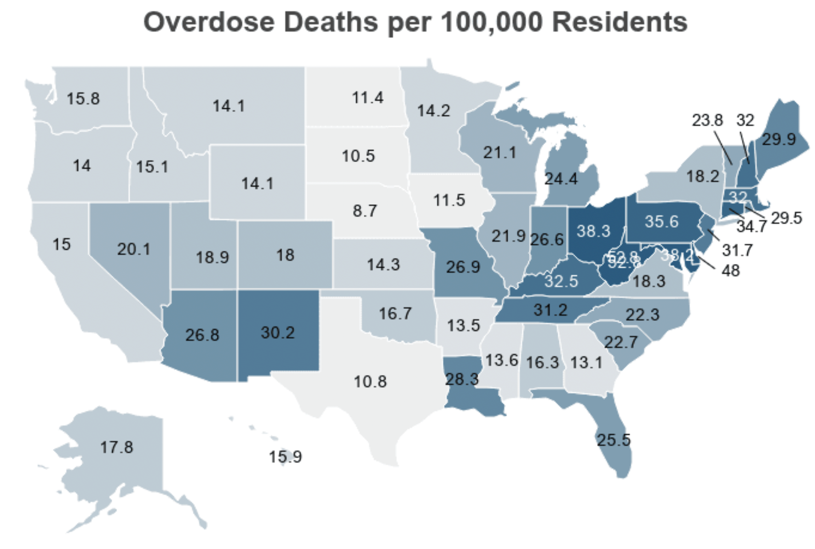
Notes:
https://drugabusestatistics.org/drug-overdose-deaths/
https://www.cdc.gov/nchs/pressroom/sosmap/drug_poisoning_mortality/drug_poisoning.htm
2021 data
Appalachia
Hitting both urban and rural
Hitting all racial groups
Next slide: focus on Ohio

Slide 19
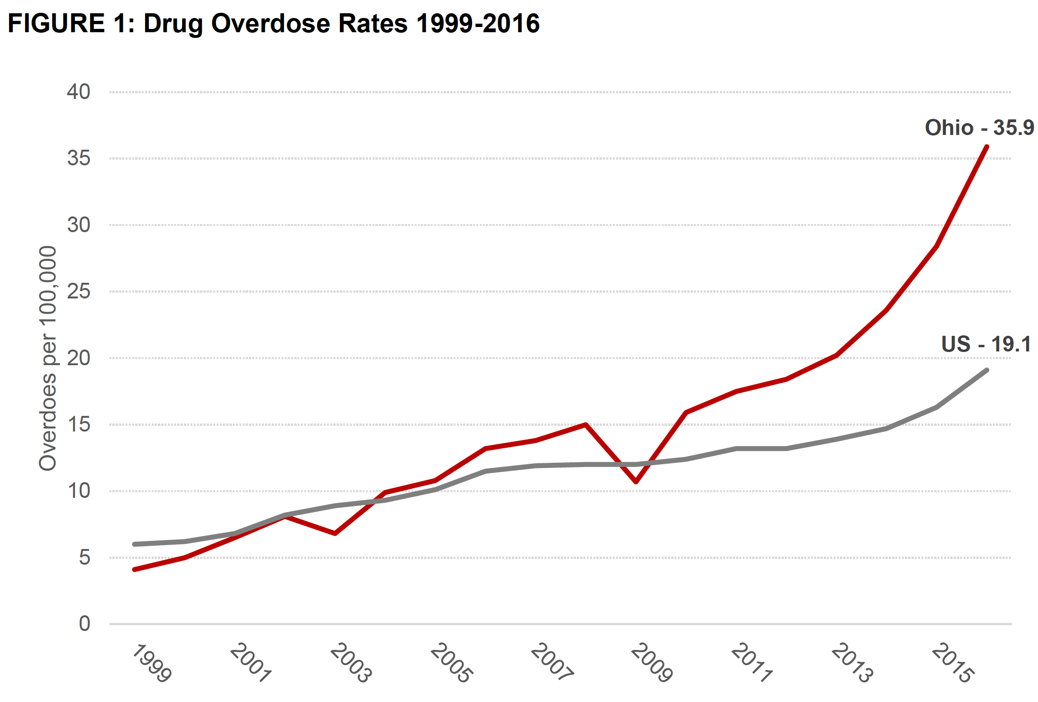
Notes:
SWANK report: https://cpb-us-w2.wpmucdn.com/u.osu.edu/dist/2/14548/files/2017/10/SWANK-Taking-Measure-of-Ohios-Opioid-Crisis-1vtx548.pdf
Next slide: focus on fentanyl in Ohio (“what’s driving this?”)

Slide 20
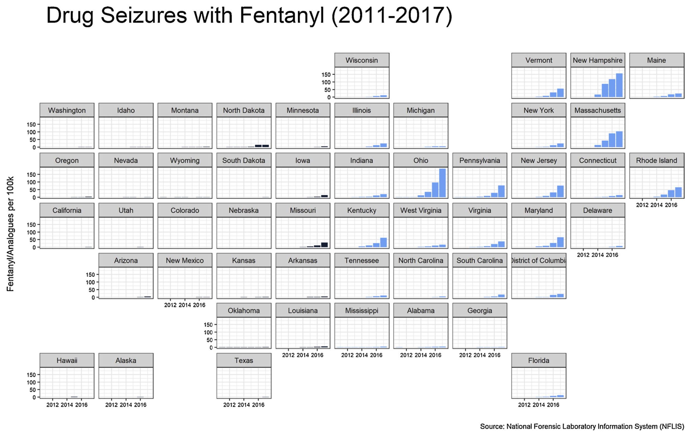
Notes:
Zoorob: Fentanyl shock: The changing geography of overdose in the United States
Next slide: fentanyl is closely tied to mortality

Slide 21
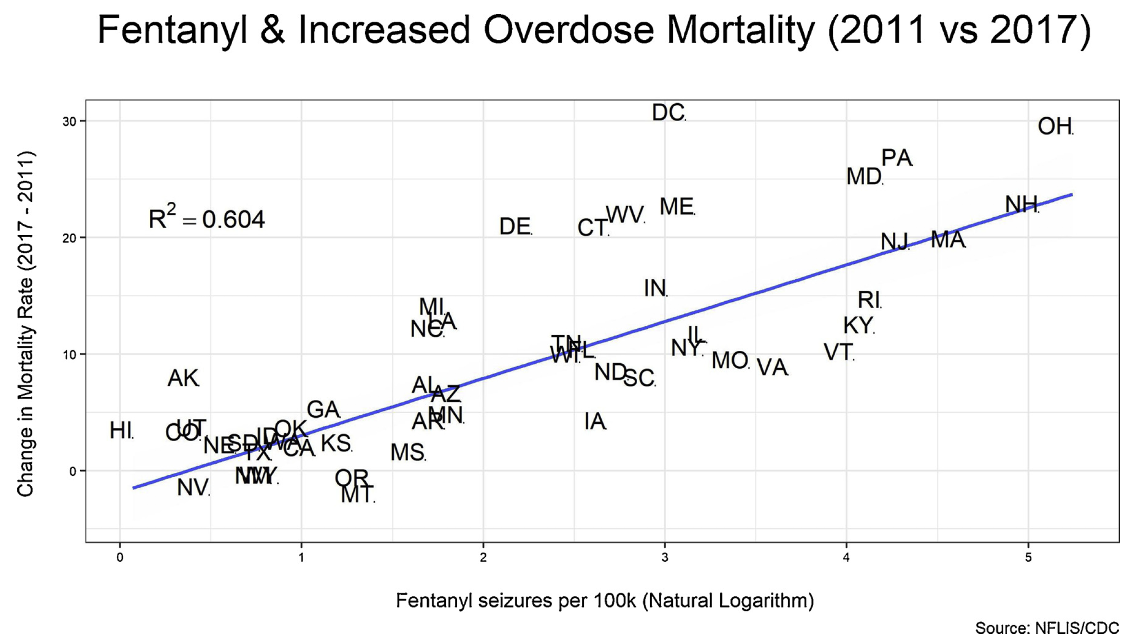
Notes:
Zoorob: Fentanyl shock: The changing geography of overdose in the United States
Next slide: focus on Ohio. What’s killing people?

Slide 22
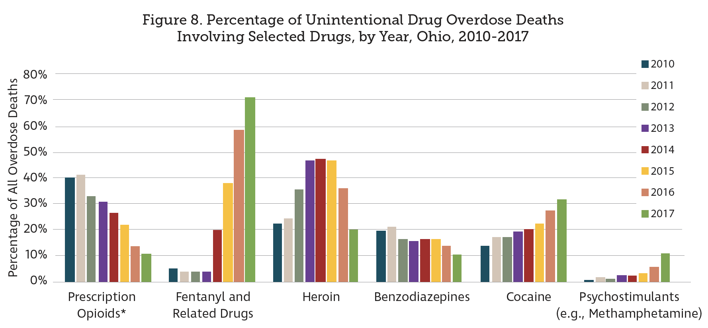
Notes:
https://odh.ohio.gov/wps/wcm/connect/gov/5deb684e-4667-4836-862b-cb5eb59acbd3/2017_OhioDrugOverdoseReport.pdf?MOD=AJPERES&CONVERT_TO=url&CACHEID=ROOTWORKSPACE.Z18_M1HGGIK0N0JO00QO9DDDDM3000-5deb684e-4667-4836-862b-cb5eb59acbd3-moxPbu6
Note that prescription is falling, heroin rose then fell, and fentanyl is spiking. Also, most of the time when these other things are involved (cocaine etc) fentanyl is often involved too.
Next slide: looking at fentanyl vs other

Slide 23
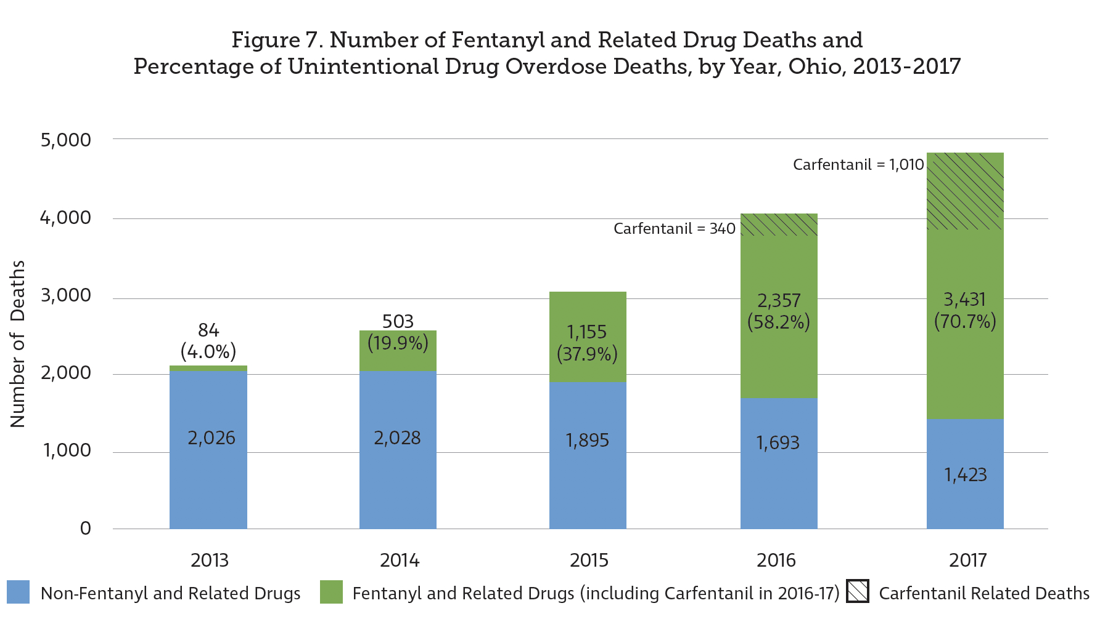
Notes:
https://odh.ohio.gov/wps/wcm/connect/gov/5deb684e-4667-4836-862b-cb5eb59acbd3/2017_OhioDrugOverdoseReport.pdf?MOD=AJPERES&CONVERT_TO=url&CACHEID=ROOTWORKSPACE.Z18_M1HGGIK0N0JO00QO9DDDDM3000-5deb684e-4667-4836-862b-cb5eb59acbd3-moxPbu6
Non-fentanyl deaths dropping; fentanyl rising, carfentanil too.
Next slide: learning about carfentanil

Slide 24
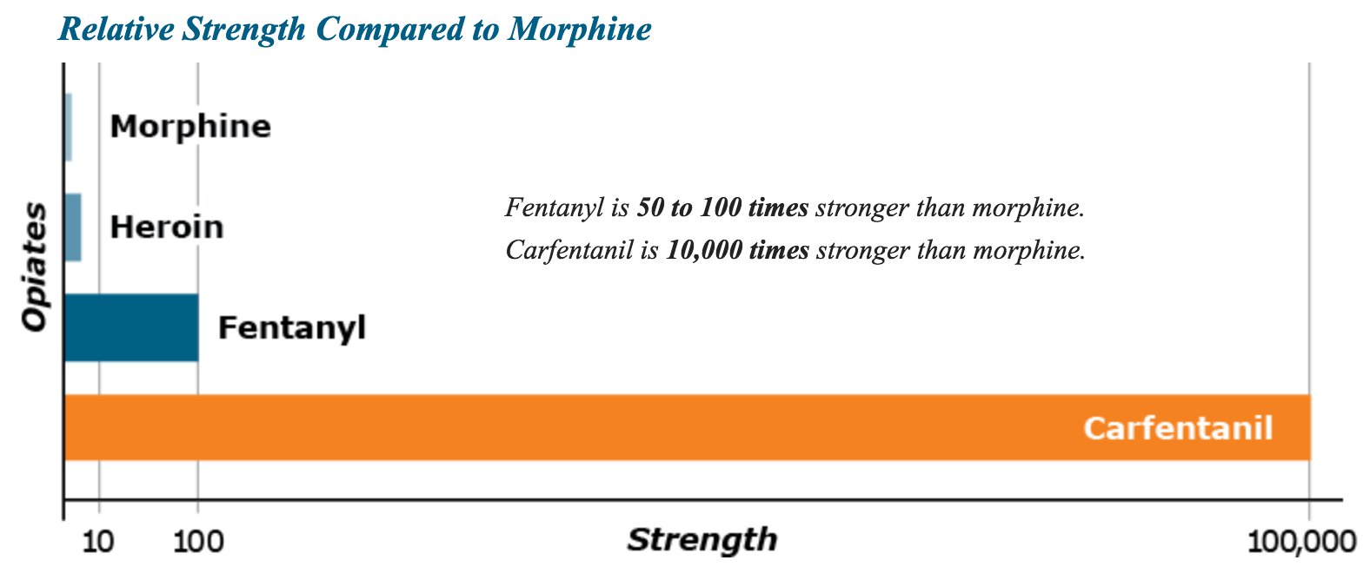
Notes:
http://www.getcleannowclermont.org/fentanyl-and-carfentanil.html
Next slide: research plan

Slide 25
Overdose Deaths in Ohio
  Ohio drug use patterns are statistically average, but there was a rapid increase in fentanyl related deaths in recent years. The huge spike in Ohio overdose deaths in 2017 is due to fentanyl analogs, especially carfentanil.
  One problem: death data is often delayed by a year or more. Coroners are sometimes wrong, and the CDC has to correct coroner data.
Ohio Bureau of Criminal Investigations (BCI) Drug Lab Data
  Shows large increase in synthetic opioids mixed into the Ohio drug supply.
  Police data is immediate and can be an “early warning system”
BCI Test Data is Strongly Correlated with Deaths
  One additional positive test of carfentanil predicts 0.45 more deaths.
  One additional positive test of fentanyl/fentanyl analog predicts 0.2 more deaths.
Notes:
Adapted from: https://moritzlaw.osu.edu/depc/wp-content/uploads/sites/115/2018/10/Dan-Rosenblum-presentation.pdf
Next slide: discussion of the data

Slide 26
Discussion of data that we had:
Number of overdose deaths per (month, county) pair.
BCI data set with one row per drug seizure by police, with date, county, list of drugs taken, and weight.
Data wrangling:
Aggregate the BCI data to the monthly level.
In the BCI data, use text-matching algorithms to identify the seizures that contained fentanyl and other fentanyl variants.
Merge the data sets together so we can regress deaths on seizures.
Two analyses:
Aggregate all counties together, to study Ohio as a whole, one row per month.
Do a county-by-county analysis, with a general linear mixed model.
Notes:
Next slide: research plan
Note: there were seven other crime labs that did NOT give us their data.

Slide 27
Analyzing BCI dataset alongside Ohio Dept of Health (ODH) Mortality data. Plan:
  Exploratory: Fentanyl seizures and deaths track together over time.
  Quantify the amount of variability in deaths that it explained by drug seizures and by fentanyl seizures. Seizures is a powerful predictor for deaths.
  Use time-series analysis to quantify lag between seizures and deaths.
  Low weight drug seizures are more likely to contain fentanyl than higher weight seizures. The weight variable adds predictive power.
  Fit an ARIMA model for deaths and seizures, then a general linear mixed model.
  Compare the efficacy of different types of law enforcement, including national law enforcement (FBI/DEA), drug task forces, and local police and sheriff’s departments
Notes:
Next slide: look at how fentanyl seizures track with overdose deaths

Slide 28
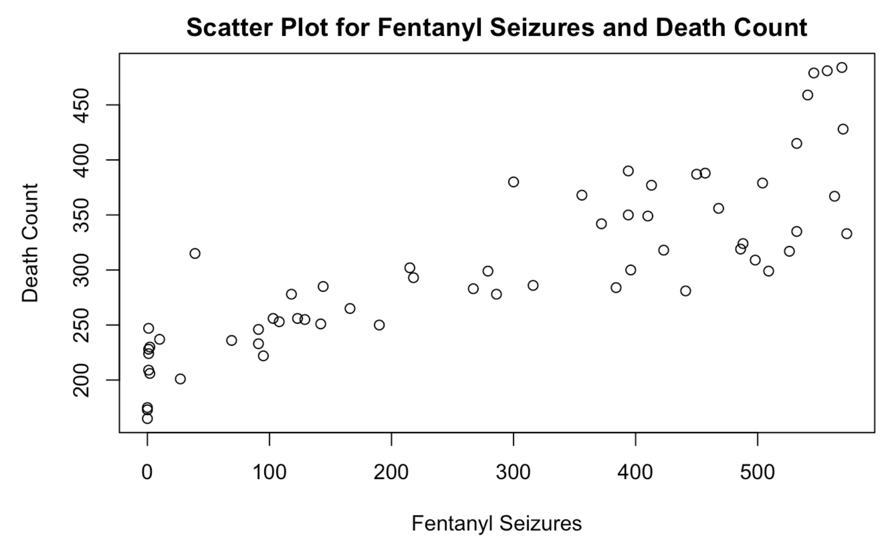
Note: Each data point is a month.
Notes:
Drug seizure composition and weight have F = 27.14, p < 1e-15, R² = .7799
Each point here is a month. Months with a lot of fentanyl seizures also had a lot of deaths.
Source: “A statistical analysis of drug seizures and opioid overdose deaths in Ohio from 2014 to 2018”
Lam Tran, Lin Ma, and David White
Next slide: focus on the counties of Ohio, exploratory

Slide 29
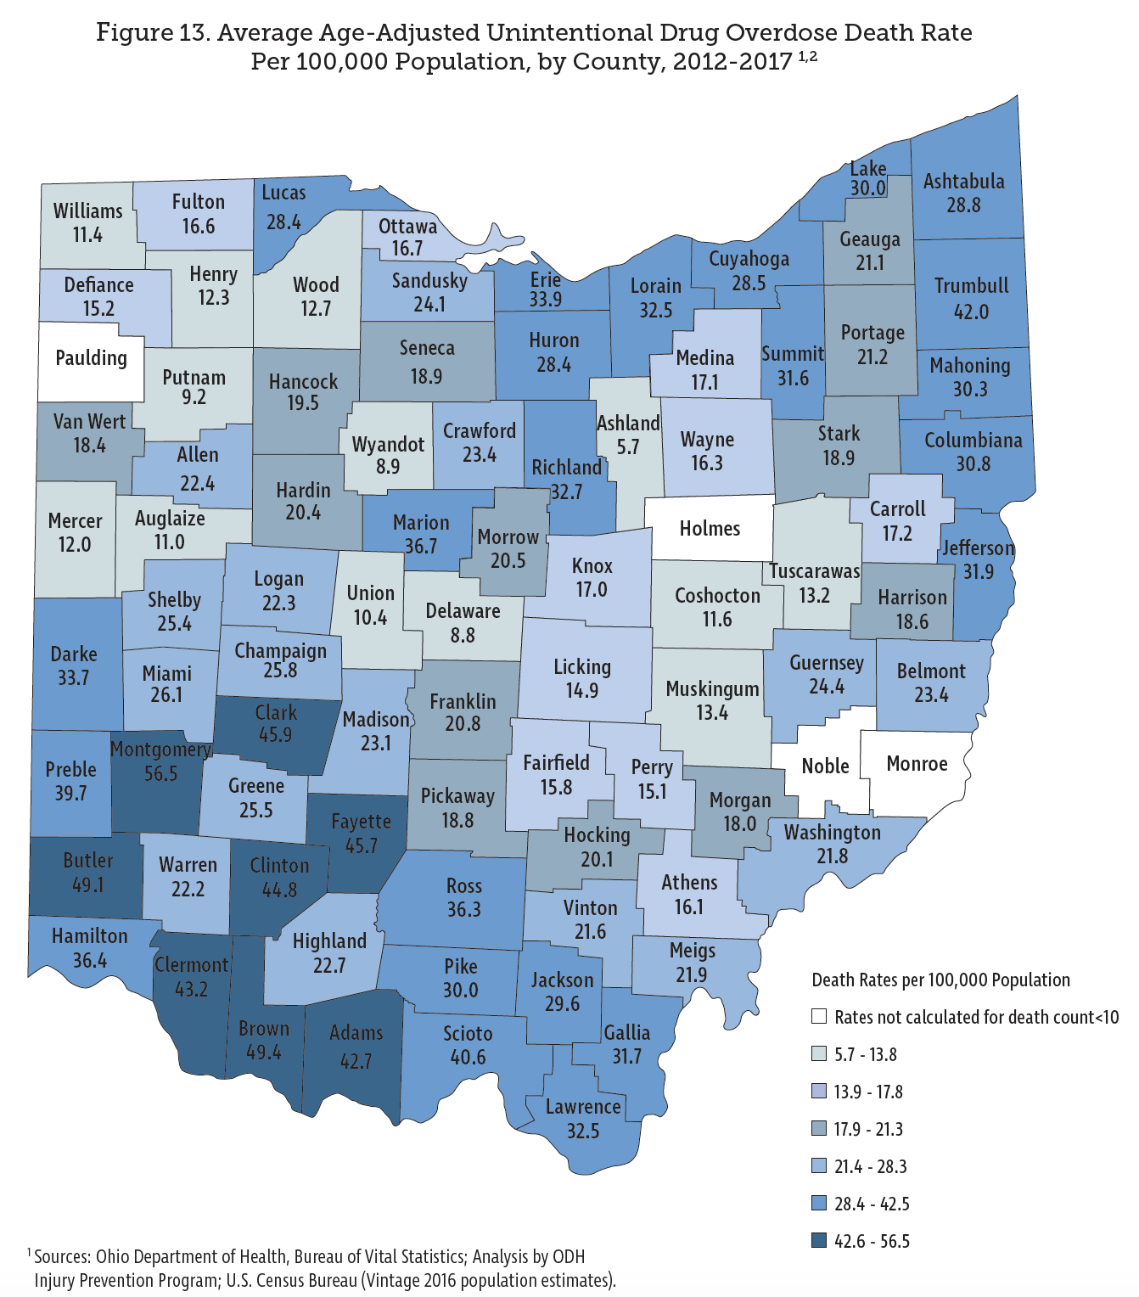
Notes:
https://odh.ohio.gov/wps/wcm/connect/gov/5deb684e-4667-4836-862b-cb5eb59acbd3/2017_OhioDrugOverdoseReport.pdf?MOD=AJPERES&CONVERT_TO=url&CACHEID=ROOTWORKSPACE.Z18_M1HGGIK0N0JO00QO9DDDDM3000-5deb684e-4667-4836-862b-cb5eb59acbd3-moxPbu6
This is where the deaths were happening. Next slide: where the drug seizures were happening.
Note: in 2021 it shifted east
Next slide showing where drug seizures were happening

Slide 30
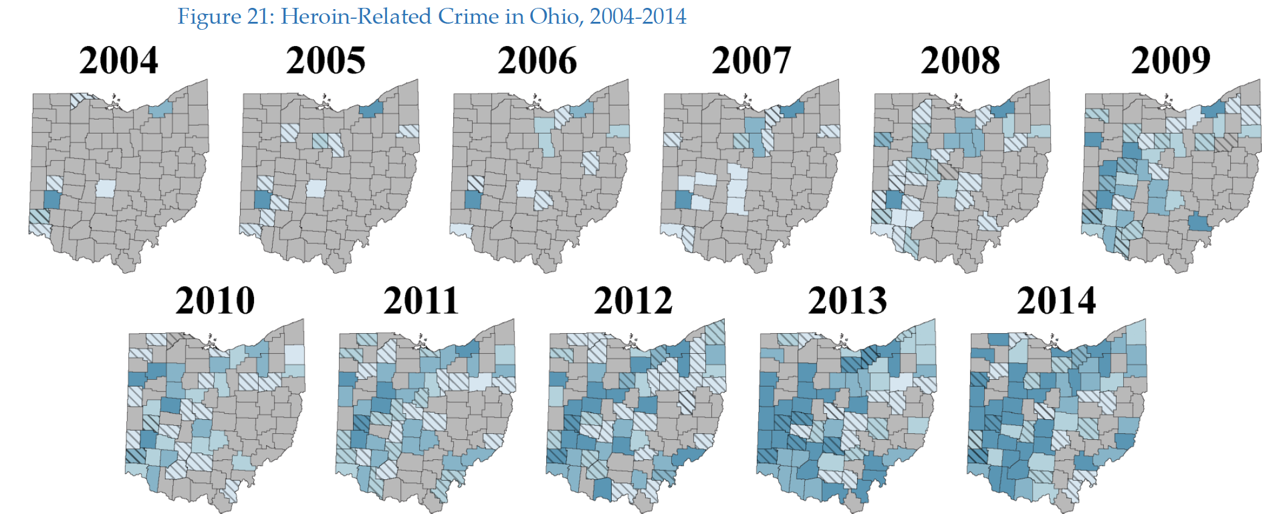
Seizure data tracks with death data.
Notes:
Drug seizure data
https://www.ocjs.ohio.gov/links/ocjs_DrugCrimesReportedOIBRS2016.pdf
Next slide: is there a lag?

Slide 31
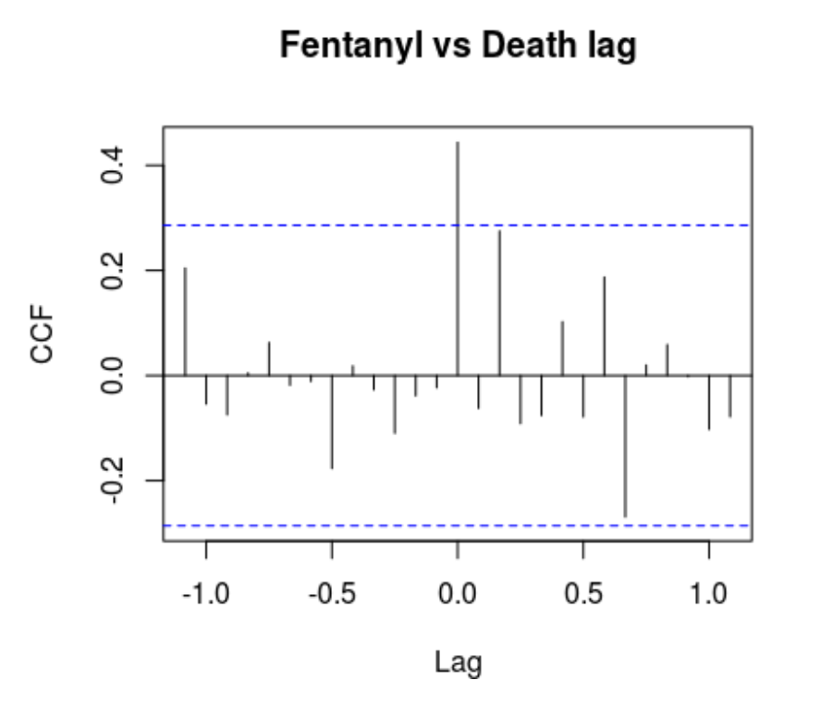
A natural question: are police seizures lagging behind deaths?
Cross-correlation function (CCF) shows highest correlation is at lag 0.
For every integer, h, the CCF at h is the correlation between:
x_{t} = fentanyl seizures at time t, and the shifted time series
y_{t-h} = deaths h months ago,
after both are pre-whitened.
Here, the only statistically significant cross-correlation is h = 0. There is no lag between seizures and deaths.
Notes:
Source: “A statistical analysis of drug seizures and opioid overdose deaths in Ohio from 2014 to 2018”
Lam Tran, Lin Ma, and David White
Note: these graphs WERE made using prewhitening.
Next slide, focus in on each county

Slide 32
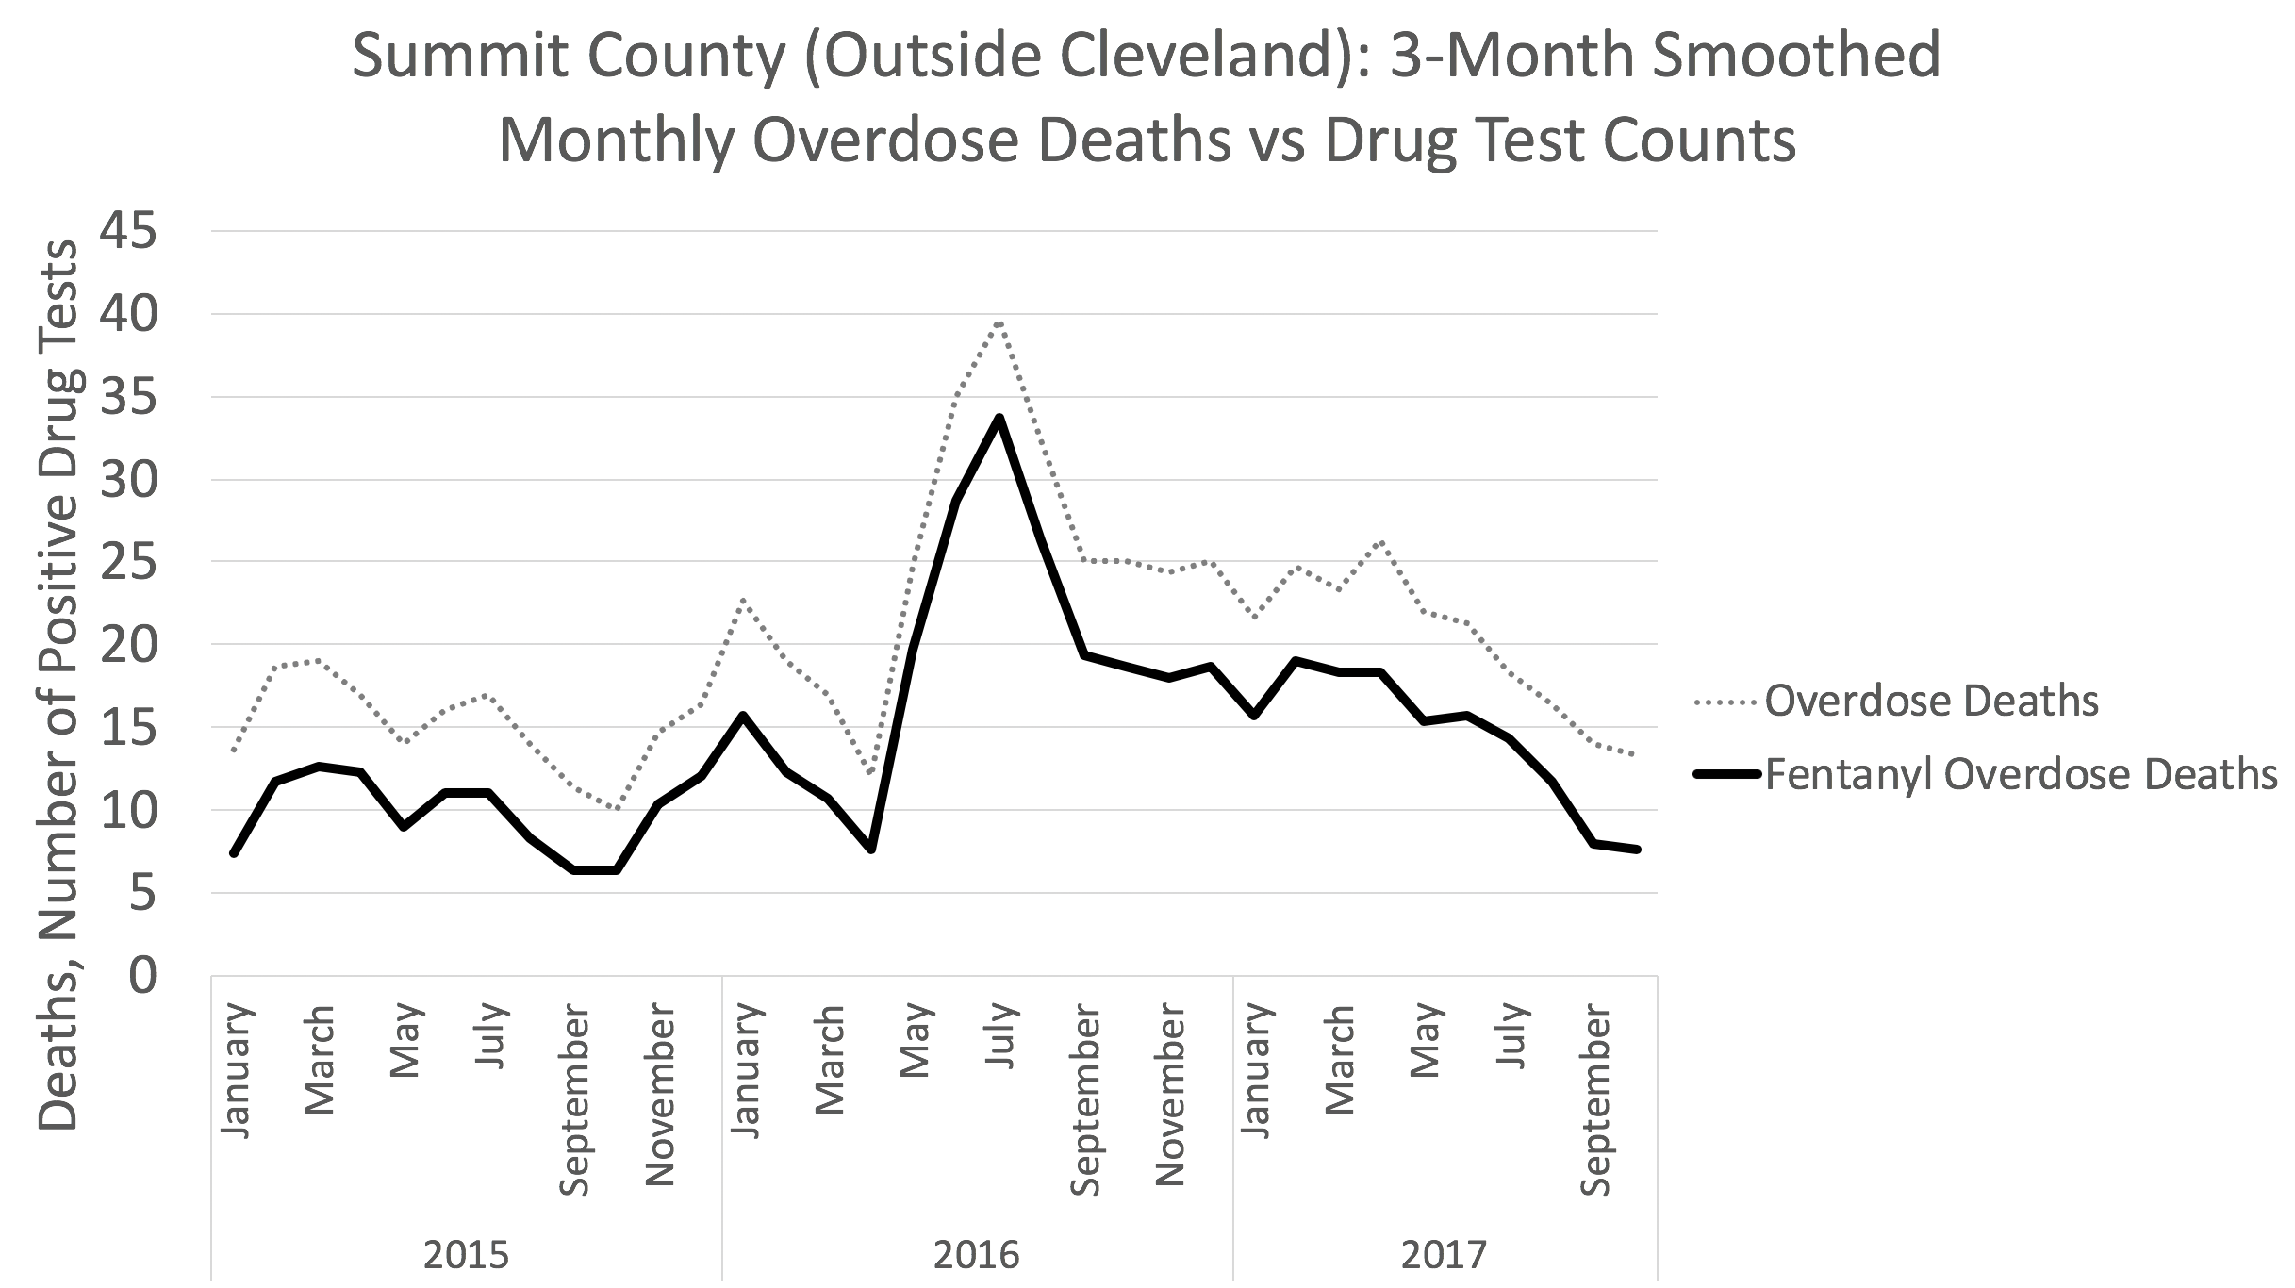
Notes:
Source: https://moritzlaw.osu.edu/depc/wp-content/uploads/sites/115/2018/10/Dan-Rosenblum-presentation.pdf
Punchline: fentanyl is driving the overdose deaths. Now let’s see how seizures track.

Slide 33
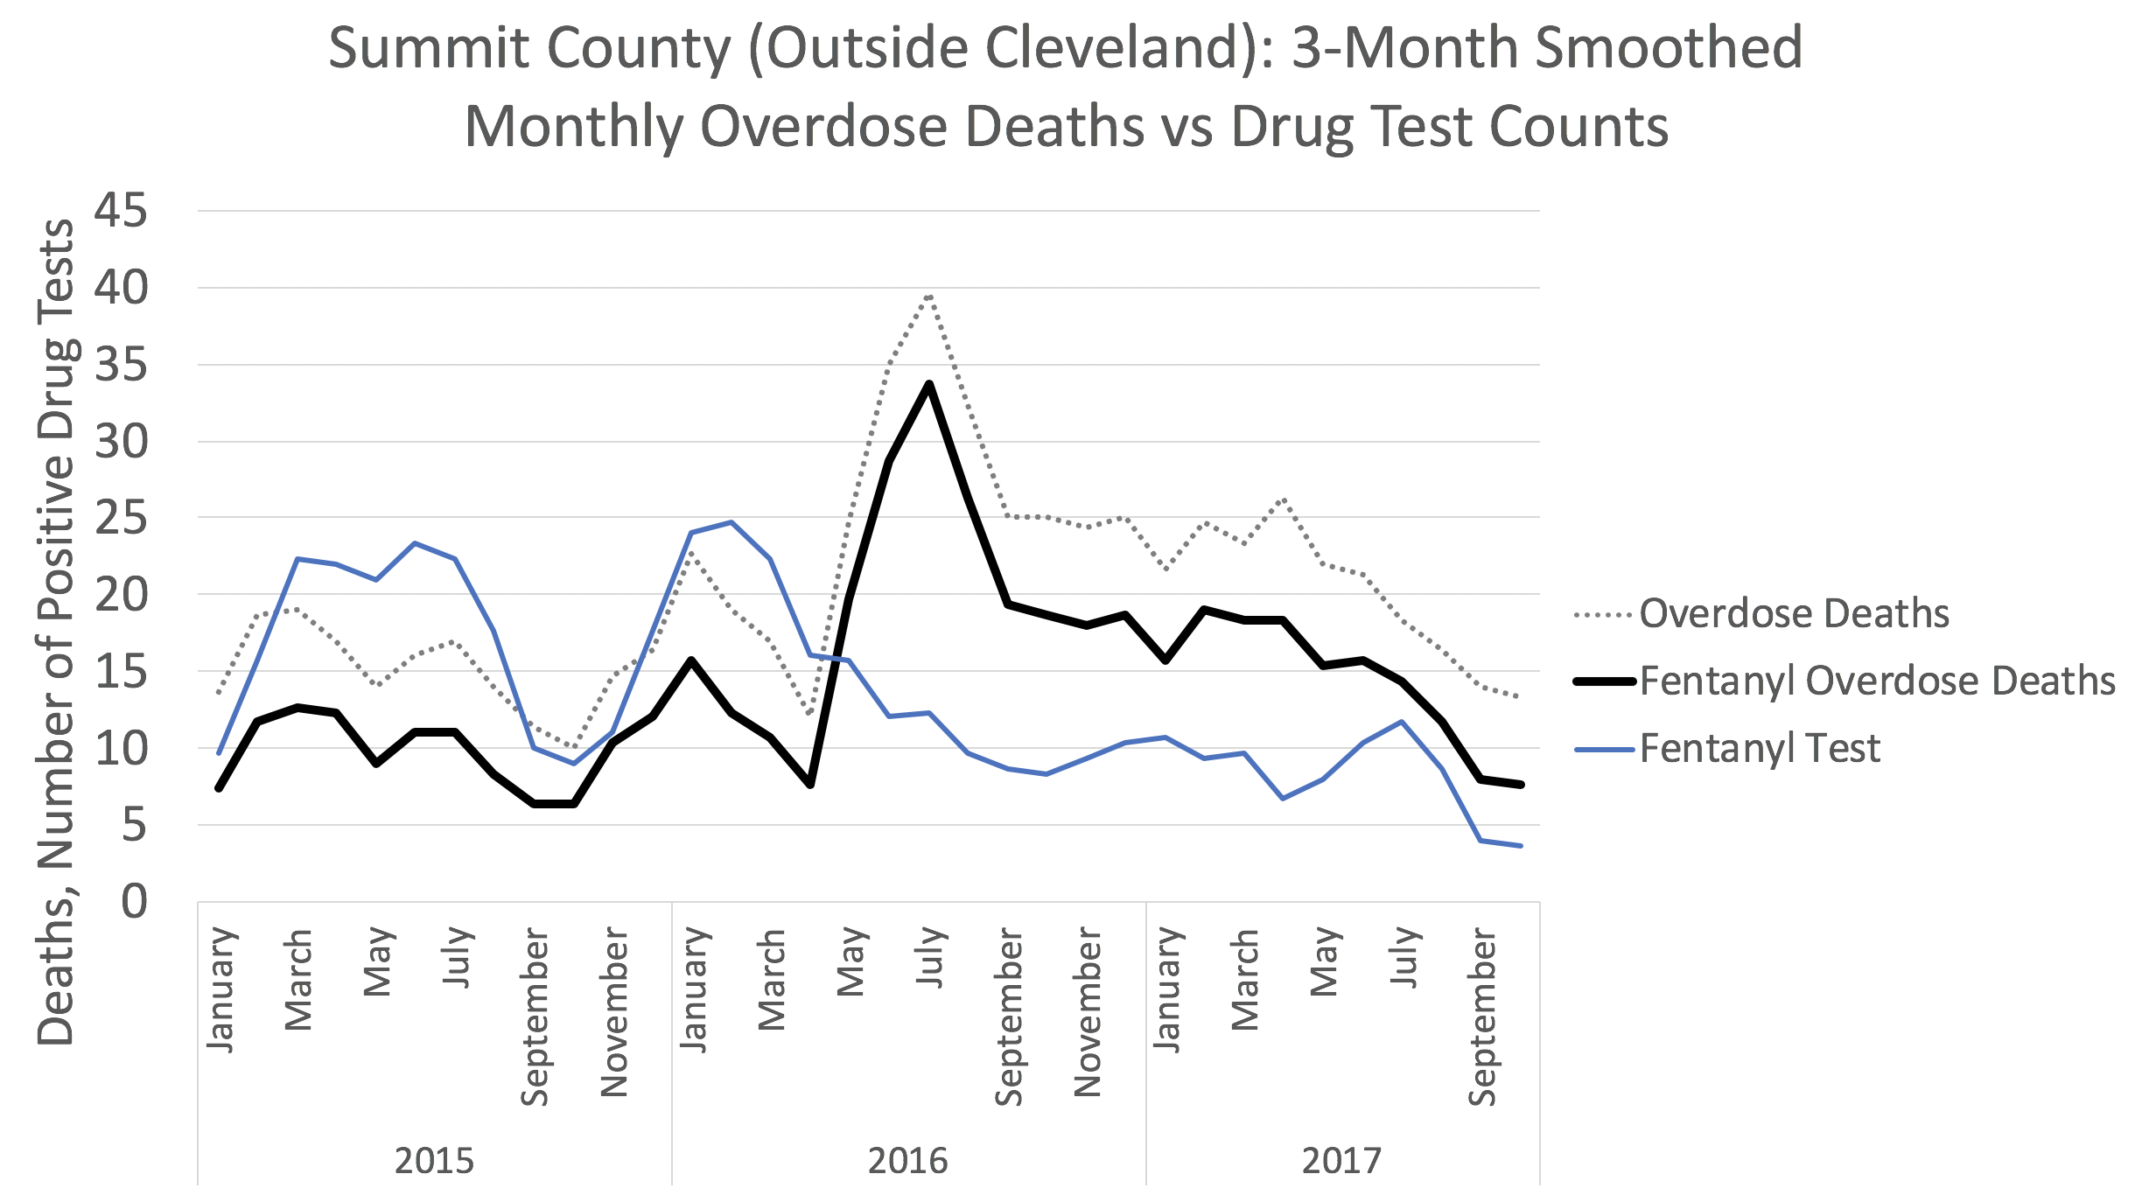
Notes:
Source: https://moritzlaw.osu.edu/depc/wp-content/uploads/sites/115/2018/10/Dan-Rosenblum-presentation.pdf
This explains two spikes but not the big one. Let’s bring in carfentanil

Slide 34
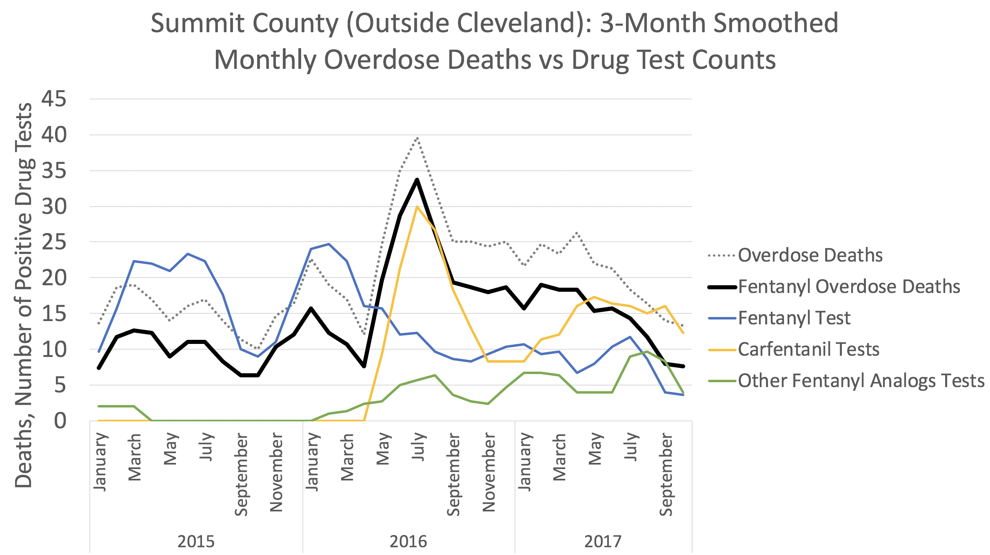
Notes:
Source: https://moritzlaw.osu.edu/depc/wp-content/uploads/sites/115/2018/10/Dan-Rosenblum-presentation.pdf
Now we’ve explained the big spike. Next slide: Ohio as a whole.

Slide 35
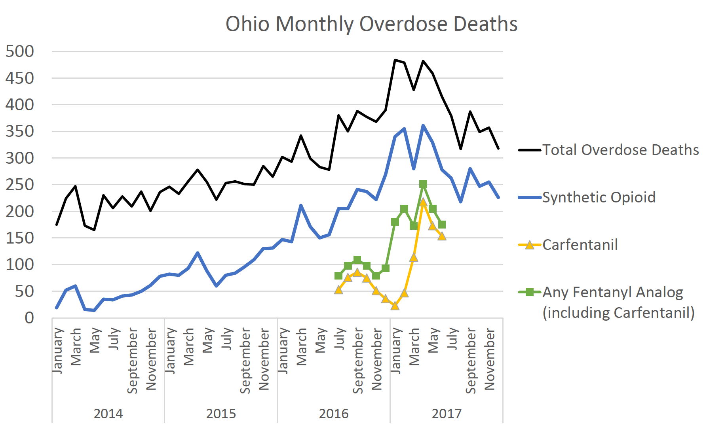
Notes:
Rosenblum and Ciccarone, “The Rapidly Changing US Illicit Opioid Market and the Potential for an Improved Early Warning System: Evidence from Ohio Drug Crime Labs, 2015-2017”
This shows the same as the previous slide for Ohio as a whole
Next slide: focus on carfentanil

Slide 36
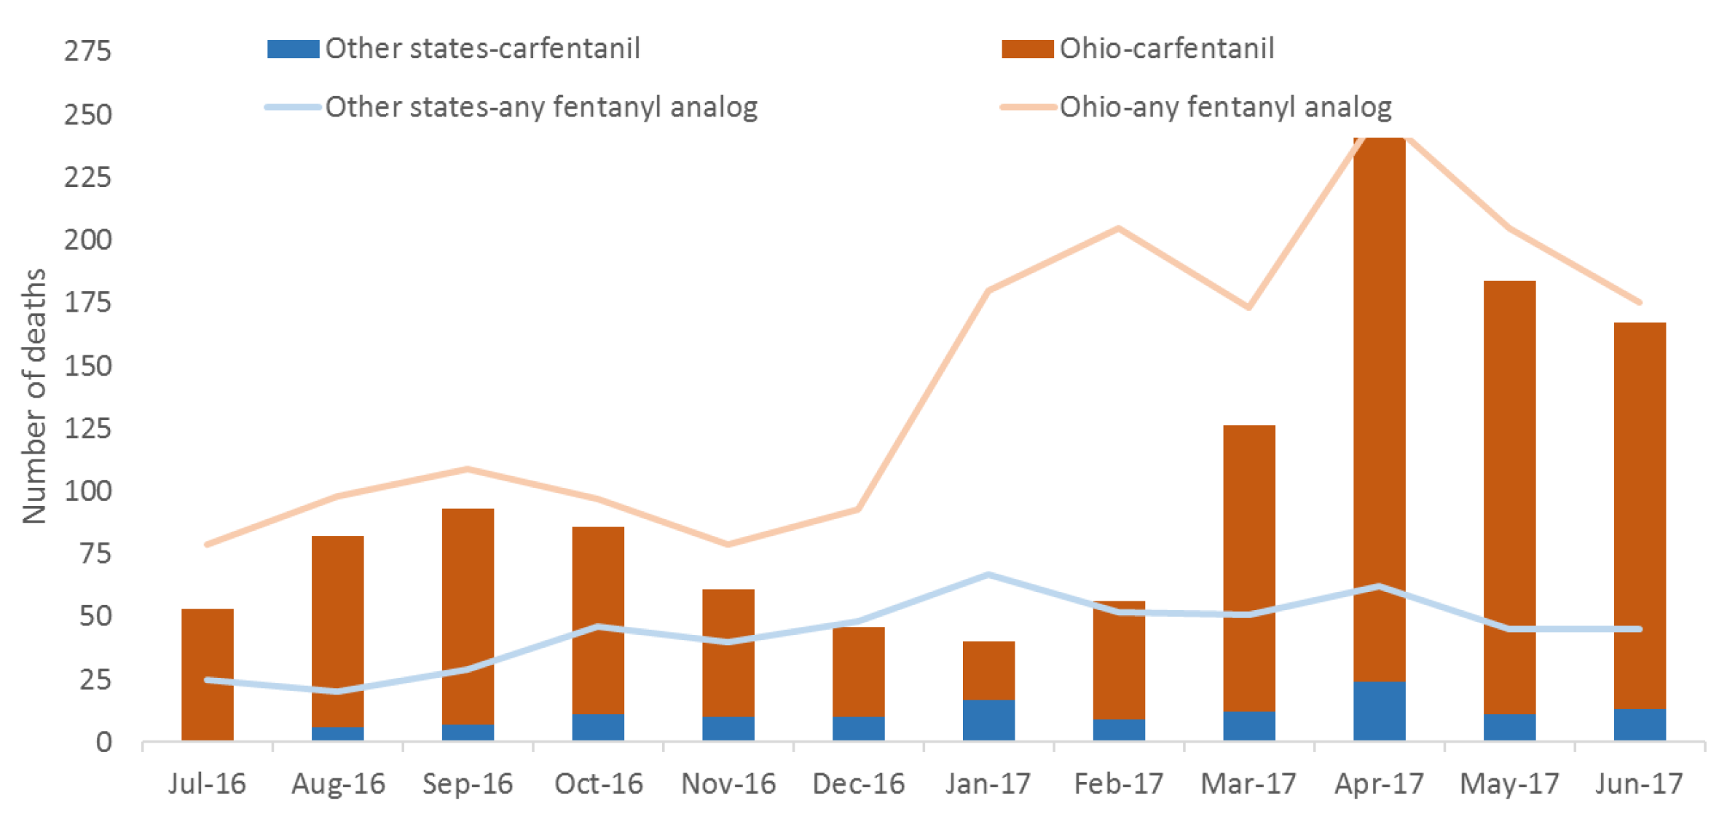
Notes:
Adapted from: O’Donnell J, Gladden RM, Mattson CL, Kariisa M.Notes from the Field:Overdose Deaths with Carfentanil and Other Fentanyl Analogs Detected—10 States, July 2016–June 2017. MMWR Morb Mortal Wkly Rep 2018;67:767–768. DOI:http://dx.doi.org/10.15585/mmwr.mm6727a4
O’Donnell slides “CDC’s Enhanced State Opioid Overdose Surveillance Program: Tracking NPS Overdoses”
We asked at the start “what made Ohio different in terms of mortality in 2017?” The answer is: Carfentanil. A large amount of it got into the drug supply and we didn’t realize it till too late.
Next slide, let’s return to our research plan.

Slide 37
Analyzing BCI dataset alongside Ohio Dept of Health (ODH) Mortality data. Plan:
  Exploratory: Fentanyl seizures and deaths track together over time.
  Quantify the amount of variability in deaths that it explained by drug seizures and by fentanyl seizures. Seizures is a powerful predictor for deaths.
  Use time-series analysis to quantify lag between seizures and deaths.
  Low weight drug seizures are more likely to contain fentanyl than higher weight seizures. The weight variable adds predictive power.
  Fit an ARIMA model for deaths and seizures, then a general linear mixed model.
  Compare the efficacy of different types of law enforcement, including national law enforcement (FBI/DEA), drug task forces, and local police and sheriff’s departments
Notes:
Next slide: look at the weight variable

Slide 38
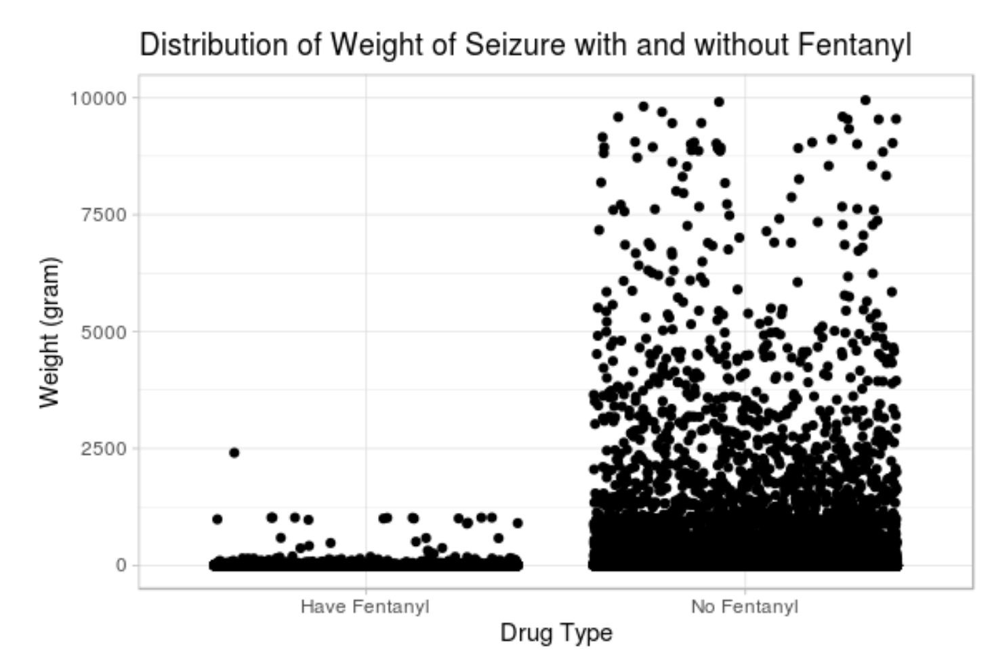
Notes:
Source: “A statistical analysis of drug seizures and opioid overdose deaths in Ohio from 2014 to 2018”
Lam Tran, Lin Ma, and David White
Next slide: digging deeper to see that low-weight seizures are more likely to contain fentanyl

Slide 39
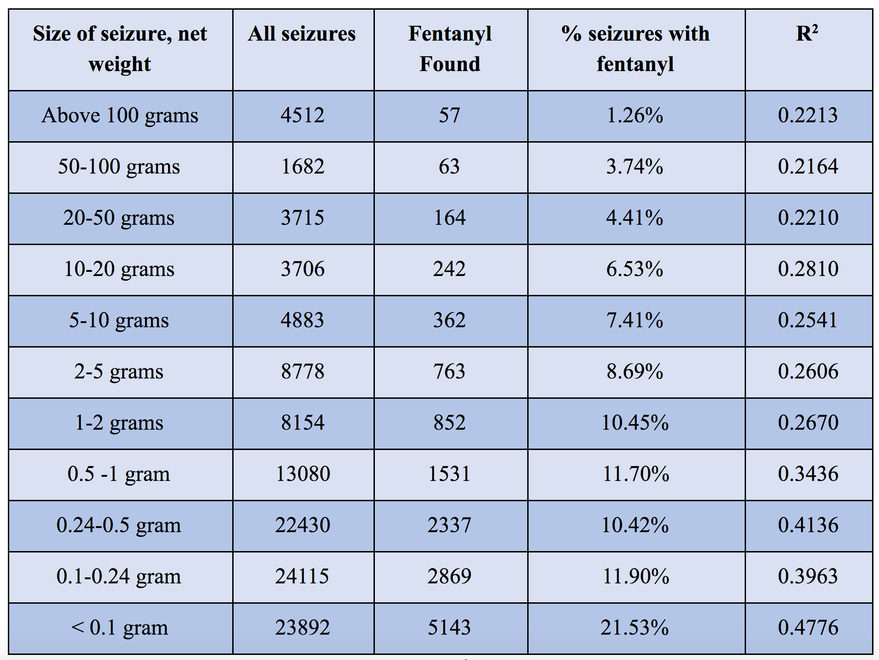
Notes:
Source: “A statistical analysis of drug seizures and opioid overdose deaths in Ohio from 2014 to 2018”
Lam Tran, Lin Ma, and David White
Punchline: since fentanyl is the killer, if you want to stop fentanyl, go after low-weight seizures not big truckloads.
Note: the weight variable is slightly odd because sometimes they don’t test the entirety of what they seize. That’s a potential source of bias.
Next slide: statistical modeling

Slide 40
Drug seizure composition and weight have strong predictive value for drug overdose deaths
Low weight seizures are more likely to contain fentanyl, have a larger R² for predicting drug overdose deaths.
Recall our scatterplot relating deaths and seizures. But, linear regression inference assumes data points are independent. Our data points represent months. Number of deaths in January is probably related to number of deaths in February! So, not independent!
The solution: time series analysis.
We build a statistically significant model with R² = .7799.
Notes:
Mentally recall the scatterplot from 4 slides ago.
Next slide: time series

Slide 41
Time Series Analysis
How much do deaths at time t depend on deaths in previous months?
Goal: fit an ARIMA(p,d,q) model (“autoregressive integrated moving average”)
AR(p) is Deaths_{t} depends on Deaths_{t-1}, Deaths_{t-2}, …, Deaths_{t–p}
I(d) if you have to do “differencing” d-times to make the time series stationary.
MA(q) if Deaths_{t} depends on ε_{t-1}, ε_{t-2}, …, ε_{t-q}
Find optimal (p,d,q) using
Autocorrelation function (ACF) = corr(Deaths_{t}, Deaths_{t-x}) for all x.
Partial autocorrelation function (PACF) = autocorrelation that remains after removing “carried over” autocorrelation; useful for error terms ε_{t-x}
Next, use Seizures_{t} to predict Deaths_{t}
Recall: no lag between police seizures and overdose deaths.
Notes:
Stationary means that the statistical mean, variance, etc. do not change over time. If you look at the deaths time series, this is definitely false. The idea of differencing is to replace y_t by the difference y_t – y_{t-1}. If you difference again, you apply it to this new time series getting (y(t) – y(t-1)) - (y(t-1) – y(t-2)), etc. The first differencing is like a first derivative and the second is like second derivative. So this is a nice application of calculus-style thinking in stats.
Second difference is like local acceleration, i.e. the rate of change of the rate of change.
Test stationarity with the Dickey Fuller ”unit root” test. This means the coeff on y(t-1) is less than 1 in magnitude. That’s necessary to be stationary. This is a test where the alternative hypothesis is stationarity, because we don’t want a unit root.
Next slide: ARIMA for death series

Slide 42
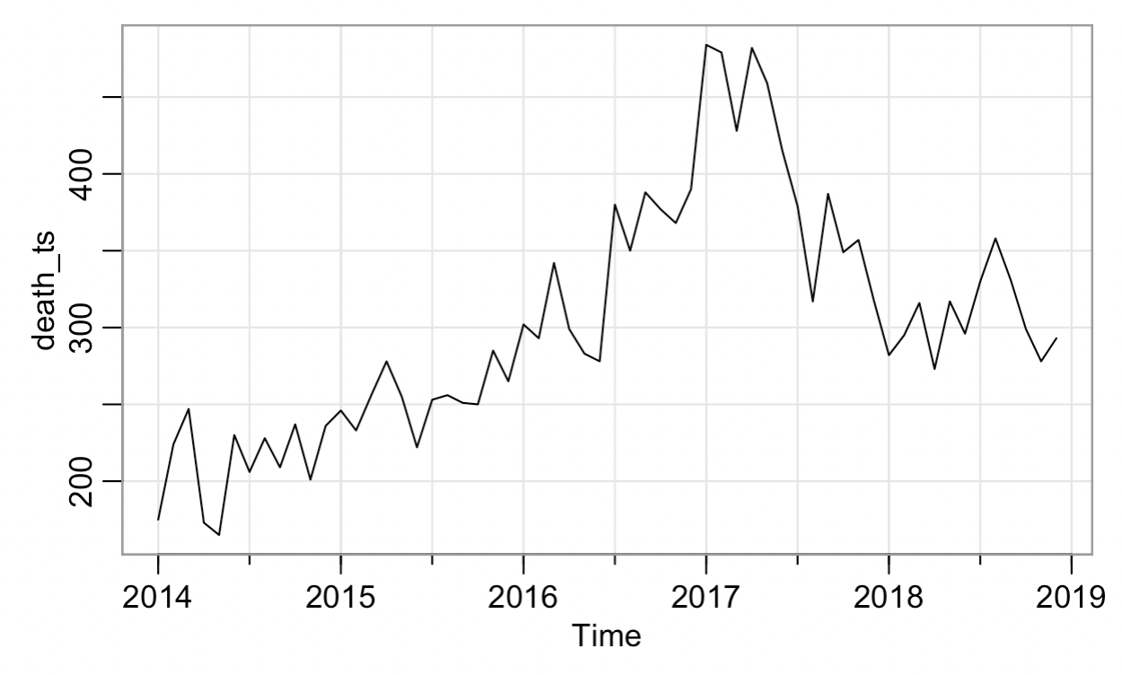
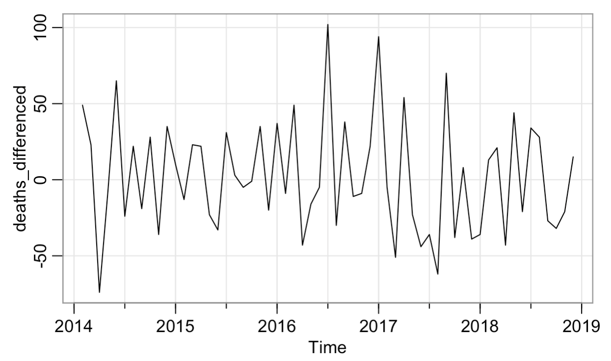
Death time series is not stationarity, so difference it
Δ Deaths_{t} = Deaths_{t} - Deaths_{t-1}
Δ Deaths_{t} is stationary and passes the Augmented Dickey-Fuller test.
Next question: does Δ Deaths_{t} depend on its own history? If so, how much?
We want random and independent residuals at the end of the day.
Notes:
Stationary means that the statistical mean, variance, etc. do not change over time. If you look at the deaths time series, this is definitely false. The idea of differencing is to replace y_t by the difference y_t – y_{t-1}. If you difference again, you apply it to this new time series getting (y(t) – y(t-1)) - (y(t-1) – y(t-2)), etc. The first differencing is like a first derivative and the second is like second derivative. So this is a nice application of calculus-style thinking in stats.
Second difference is like local acceleration, i.e. the rate of change of the rate of change.
Test stationarity with the Dickey Fuller ”unit root” test. This means the coeff on y(t-1) is less than 1 in magnitude. That’s necessary to be stationary. This is a test where the alternative hypothesis is stationarity, because we don’t want a unit root.
Next slide: autocorrelation structure for death time series

Slide 43
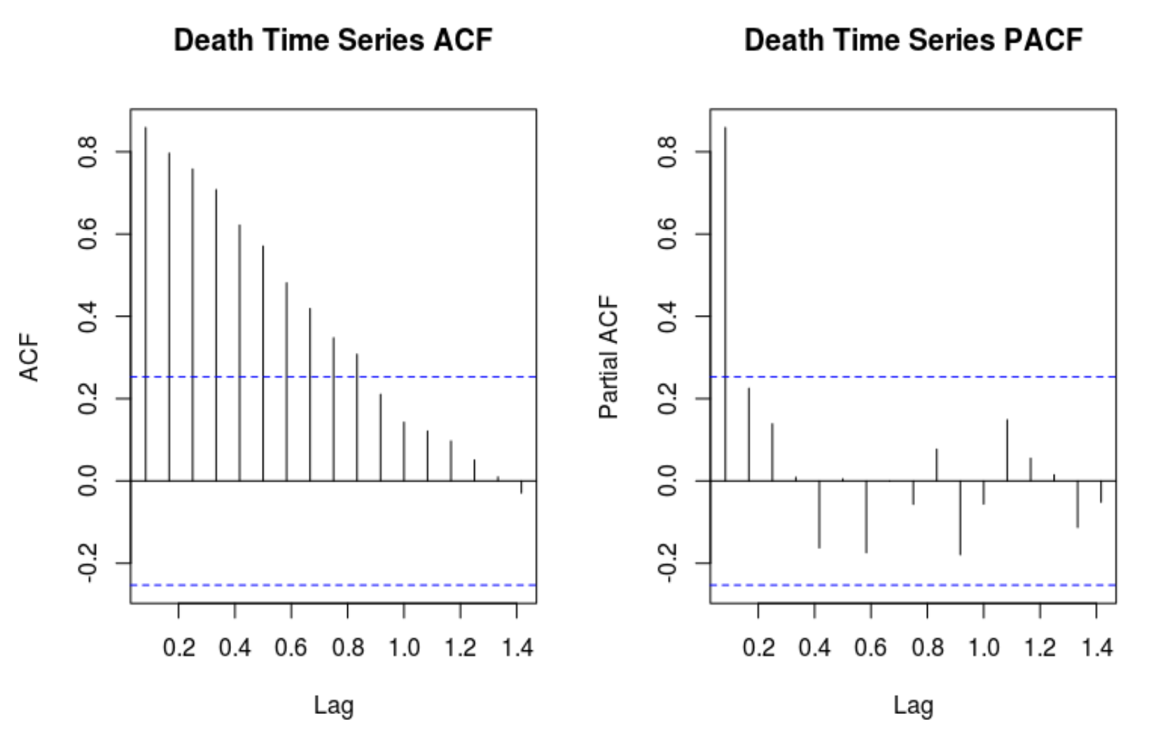
Notes:
Source: “A statistical analysis of drug seizures and opioid overdose deaths in Ohio from 2014 to 2018”
Lam Tran, Lin Ma, and David White
Note to self (Dec 1, 2022): maybe we over-differenced in the published paper. Perhaps an AR(1) would have fit instead of ARIMA(1,2,1). We aimed to minimize AIC but by now we know that’s a process fraught with peril.
Say out loud: we chose to fit an ARIMA(1,1,0) model, i.e., make use of the number of deaths last month to predict the number this month. The residuals are what’s leftover and they were indeed random, independent, and normal.
Note to self (April 2024): the picture above was actually BEFORE differencing. Probably the best model is ARIMA(0,1,0) or ARIMA(1,1,0)
Next slide: same for seizures data.

Slide 44
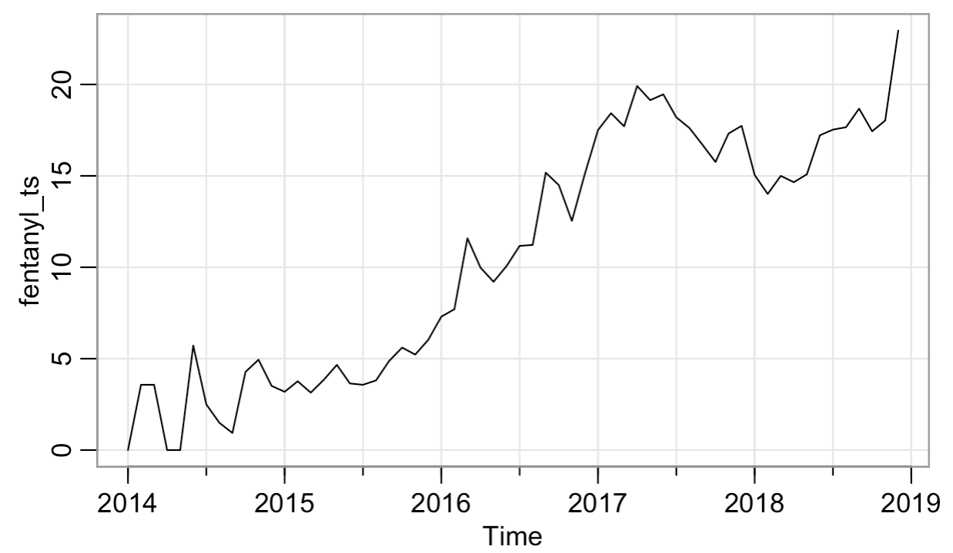
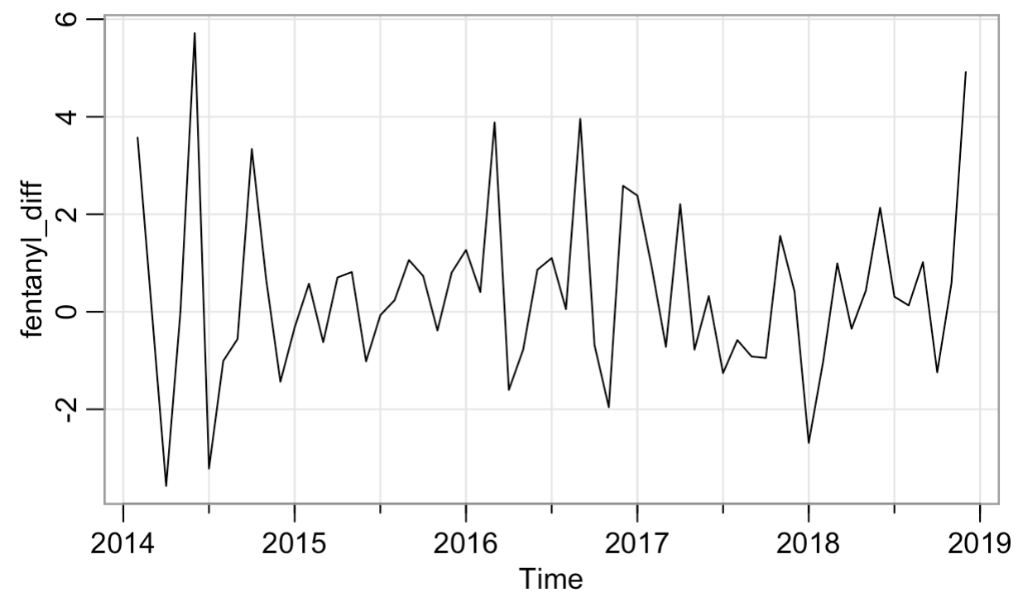
Fentanyl time series is not stationarity, so difference it
Δ Fent_{t} = Fent_{t} - Fent_{t-1}
Δ Fent_{t} is stationary and passes the Augmented Dickey-Fuller test.
In our final model, we do not need any lags of Δ Fent_{t} ; impact of the past is in the death ARIMA(1,1,0) model. No seasonal lags either.
Notes:
Stationary means that the statistical mean, variance, etc. do not change over time. If you look at the deaths time series, this is definitely false. The idea of differencing is to replace y_t by the difference y_t – y_{t-1}. If you difference again, you apply it to this new time series getting (y(t) – y(t-1)) - (y(t-1) – y(t-2)), etc. The first differencing is like a first derivative and the second is like second derivative. So this is a nice application of calculus-style thinking in stats.
Second difference is like local acceleration, i.e. the rate of change of the rate of change.
Test stationarity with the Dickey Fuller ”unit root” test. This means the coeff on y(t-1) is less than 1 in magnitude. That’s necessary to be stationary. This is a test where the alternative hypothesis is stationarity, because we don’t want a unit root.
Next slide: model for deaths based on fentanyl seizures.

Slide 45
Introducing more complex models (ARIMA and GLMM)
The best ARIMA model for drug overdose deaths alone is an ARIMA(1,1,0) model.
Best time series model (R² = .7799) for Deaths based on BCI:
Deaths_{t} ~ ARIMA(1,1,0) + 𝛽₁*Seizures_{t}
+ 𝛽₂*Weight_{t}^{0to0.1}+ 𝛽₃*Weight_{t}^{0.1to0.24} + ε
Here Weight_{t}^{0to0.1} is the number of seizures in month t of weight 0 – 0.1 grams (smallest weight), and Weight_{t}^{0.1to0.24} similar.
Note: this model treats all of Ohio as one. But we also have county-level data on seizures, deaths, unemployment, etc.
Linear mixed model includes both fixed effects and random effects. Powerful application of linear algebra to statistics!
Fixed effects are constant across individuals, and random effects vary.
Notes:
This means there’s a (t-1) term on RHS and also a (t-1) error term. The fact that we’ve differenced twice is ok, because we can always undo this transformation to predict the regular old series we started with. To do this, keep the first two original values then recursively compute the rest of the predicted values based on the predicted values of the differenced thing, just plugging into the equation (y(t) – y(t-1)) – (y(t-1)– y(t-2)) at every step (but now with hat’s)
Note: the model here is the one from the arXiv paper. The one in the published paper was slightly more complicated and that didn’t make it better.
Also note: see arXiv paper for a discussion of the pros and cons of relying on R^2 in time series contexts. It’s not a great idea.
Next slide: GLMM statement

Slide 46
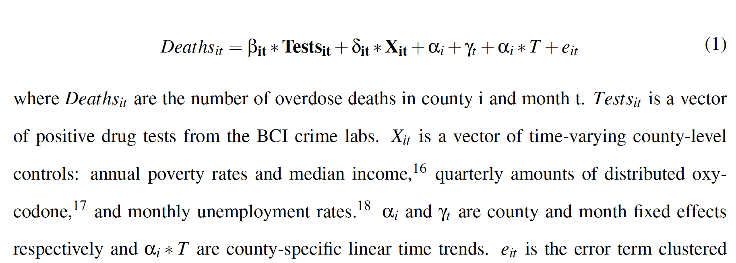
Best General Linear Mixed Model:
Month fixed effect controls for time trends in deaths that are the same across Ohio. County fixed effect controls for county differences that do not vary over time. The county-year linear time trends control for any county-specific linear time trends in deaths.
Next: determine significance of random effects (seizures and X), compute R².
Notes:
Rosenblum and Ciccarone, “The Rapidly Changing US Illicit Opioid Market and the Potential for an Improved Early Warning System: Evidence from Ohio Drug Crime Labs, 2015-2017”
Population is pairs (i,t) of county i at time t.
Tests and X are random effects (they change between counties and across time).
Alpha and gamma are fixed effects, e.g., gamma is keeping track of the epidemic as a whole across time, and alpha is keeping track of the county (e.g. difference between counties due to how the epidemic hit them).
Next: GLMM summary table

Slide 47
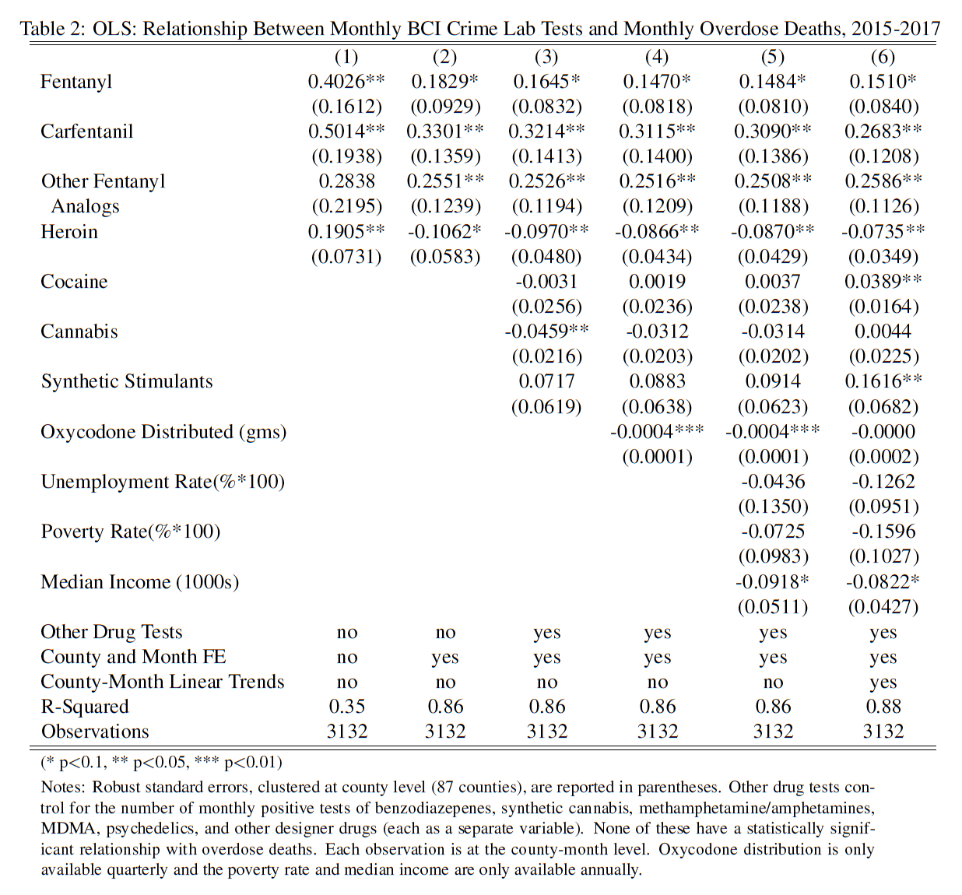
GLMM Results:
Seizures are statistically significant (except cannabis).
With covariates (column 6) we achieve an R² of 0.88.
20 more seizures of fentanyl predict for 3 more deaths.
20 more seizures of carfentanil (or other analog) predicts for 5 more deaths.
Notes:
It’s robust to the choice of covariates, to error term being Poisson, choice of which death variable to use.
Note to self: we are showing six models here, left to right. The best is far right. The coefficient for carfentanil is 0.26. That times 20 is 5.
The coefficient for fentanyl is 0.15; that times 20 is 3.
Punchline: early warning system.
Next slide: about effectiveness of different police types.

Slide 48
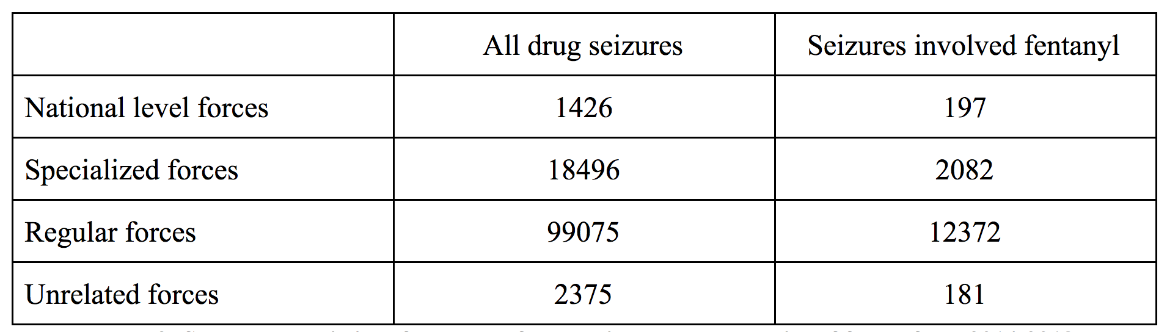
How do different types of law enforcement do in terms of seizing drugs? Seizing fentanyl?
Note: we spend a lot of money on specialized drug task forces. Are they saving lives?
Notes:
Source: “A statistical analysis of drug seizures and opioid overdose deaths in Ohio from 2014 to 2018”
Lam Tran, Lin Ma, and David White
To answer the question posed, note that special forces seize 1/5 as many drugs as regular forces, but 1/6 as much fentanyl. So, regular forces are doing a better job. Regular and national (DEA) are about the same.
Next slide: comparison of forces based on weight of seizures taken. Recall that low weight is much more likely to be fentanyl.

Slide 49
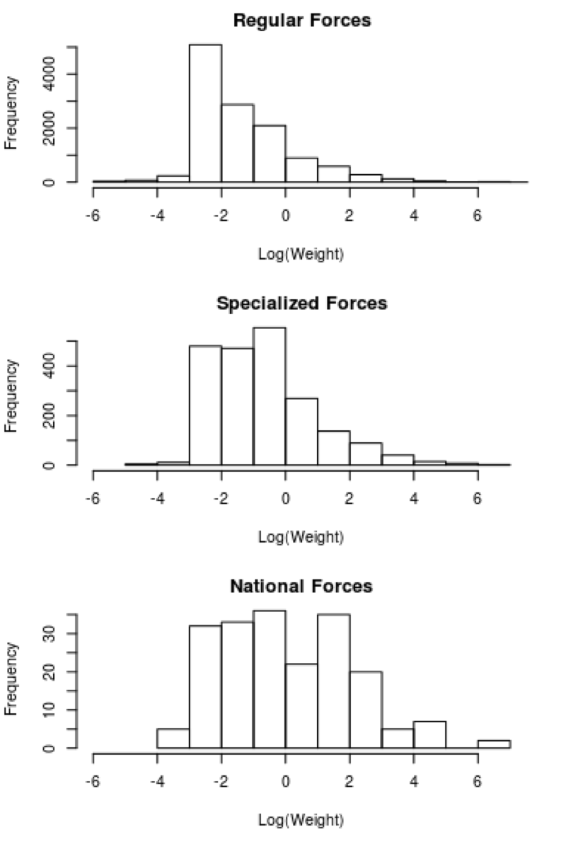
Regular forces include local police, sheriffs.
Specialized forces include drug task forces.
National forces include DEA and FBI.
Notice the y-axis labels!
Regular forces make most seizures
(there are more of them).
Regular forces seize lots of low weight.
Specialized forces seize a mixture.
National forces seize mostly mid-weight and high-weight.
All are important, but it’s essential to remember the Law of Prohibition: when you crack down, people turn to more potent drugs.
Notes:
Source: “A statistical analysis of drug seizures and opioid overdose deaths in Ohio from 2014 to 2018”
Lam Tran, Lin Ma, and David White
Seizing large quantities of Marijuana is not helping.
Regular forces are doing best at seizing low weight.
Next slide: update since 2020 when this work came out.

Slide 50
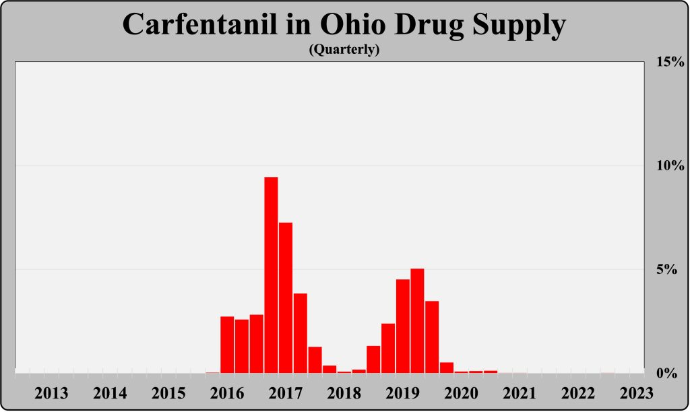
Notes:
https://www.harmreductionohio.org/special-report-changes-in-ohio-drug-supply-from-2013-2023/
Next slide: update on fentanyl

Slide 51
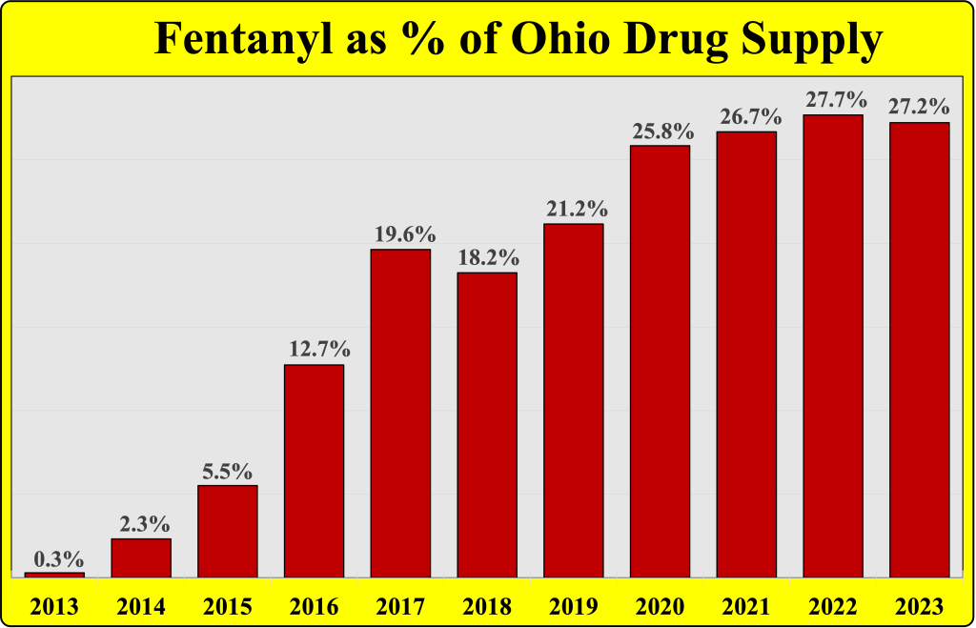
Notes:
This is seizure data, from harm reduction ohio
Next slide: update on counties

Slide 52
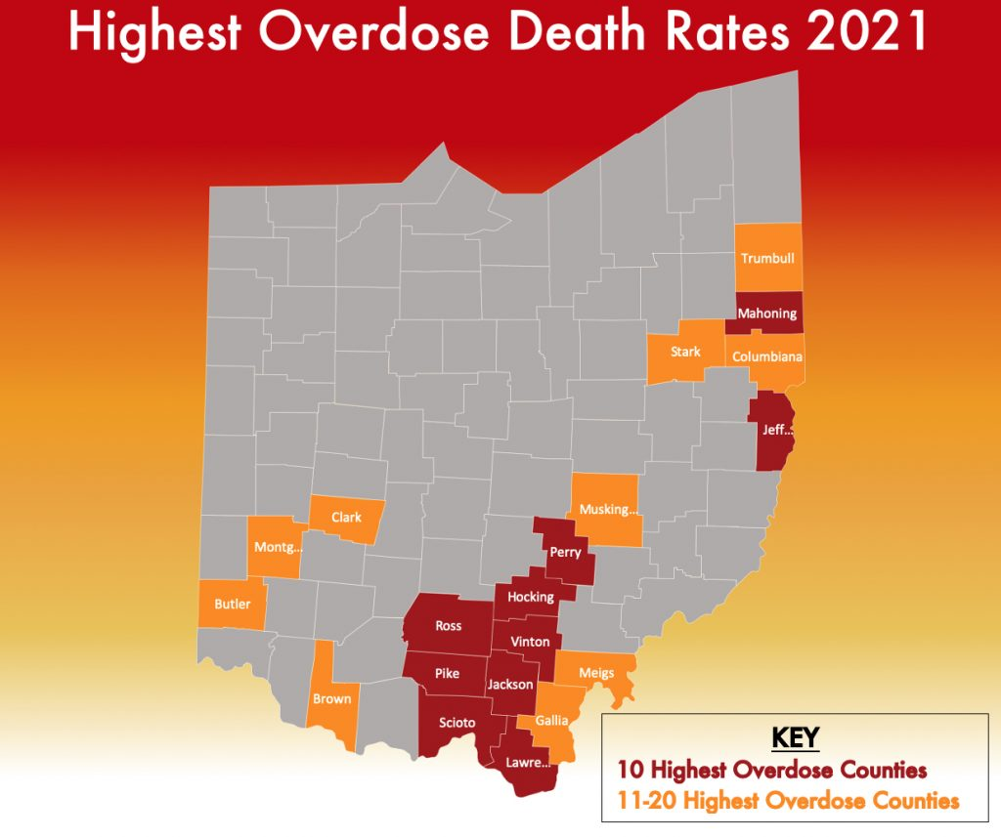
Since 2019, deaths due to carfentanil are down, fentanyl-contaminated meth overdoses are up.
Normal drug-use pattern but more contaminated drug supply in Ohio.
The crisis has shifted from the southwest to the south and east.
Now black people make up 22% of overdose deaths but 14% of the population.
Notes:
This is death data, from harm reduction ohio
Cocaine-fentanyl hits blacks much more than whites: https://www.harmreductionohio.org/is-race-playing-a-role-in-ohios-slow-response-to-cocaine-fentanyl-overdose-deaths/
Next slide: update on deaths

Slide 53
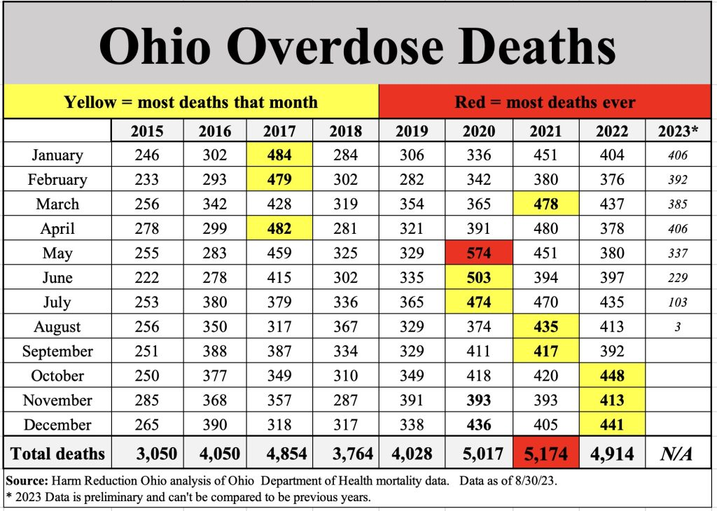
Notes:
This is death data, from harm reduction ohio
Next slide: close to home for Bowling Green

Slide 54
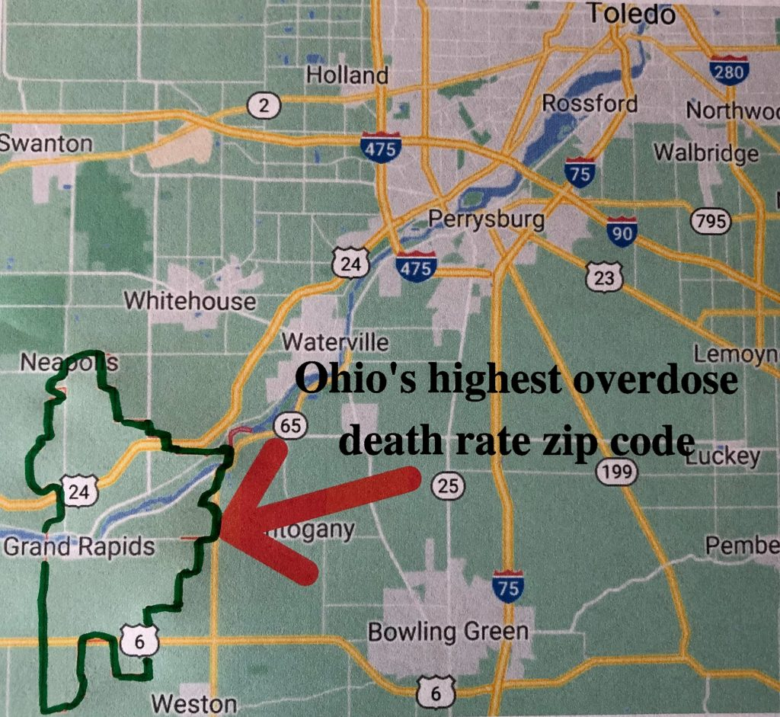
In the spring of 2021, we were able to get data at the level of zip codes instead of county.
Ohio has about 1,300 zip codes.
Data in raw numbers skews attention towards population centers. Data in terms of proportions is more susceptible to outliers.
This is from Jan 2018 - Dec 2020.
Zip code 43522 was worst.
894 per 100,000 died, i.e., 31 people out of 3,466 population.
Narcan can help!
Notes:
This is death data, from harm reduction ohio
Next slide: what can we do?

Slide 55
Harm Reduction talking points
  Naloxone – convincing people to carry and use it
  Fentanyl test strips – determine if drugs have fentanyl
  Good Samaritan laws
  Needle exchanges + educating those who come
  Medication-Assisted Treatment for addiction
  Drug Courts, and treating drug users like human beings
  Counseling for those with mental health disorders
  Alternative treatments for pain
  Marijuana legalization – does it help?
  Study fentanyl analogues: there are many; unknown strength.
  Punchline: Harm Reduction saves lives and is much more cost effective (and ethical) than letting people suffer/die.
Notes:
Naloxone = Narcan; it was illegal drug paraphernalia till around 2015; till sept 2020 you needed a license
Narcan kits distributed in Ohio: 2018 = 38k, 2019 = 58k, 2020 = 137k, 2021 = 231k. Up by 800%.
Fentanyl test strips only legalized in 2022, same for Good Samaritan laws. They cost $1 each and work in 30 seconds.
Lots of open research questions here
Anthony Bonifonte optimal locations for syringe exchanges
research on fentanyl analogues is prohibited by law because they are schedule I drugs
1.8 million people in Ohio use drugs regularly: more than senior citizens or gay people. More than 50% have used at least once.
Next page: another research project I did for them.

Slide 56
Ohio SUDORS Data (2016-2018)
  9,300 individuals who died of drug overdose, 750 attributes for each: demographics, mental health/substance abuse history, personal problems, bystanders, Naloxone, polysubstance abuse, etc.
  Data curated by the Ohio Department of Health
  Includes data from law enforcement, coroners, hospitals, prisons, mental health treatment centers, etc.
  Never previously analyzed in Ohio. Our analysis is based on a 2018 paper on the Rhode Island SUDORS dataset.
  There is much left to be done!
Notes:
Next slide: basic data analysis and summary stats – already publishable

Slide 57
Characteristic | n | %
Age group
18-24 | 725 | 7.79
25-44 | 5029 | 54.00
45-65 | 3366 | 36.14
Other | 193 | 2.07
Sex
Male | 6348 | 68.16
Female | 2965 | 31.84
Race/ethnicity
Black, non-Hispanic | 1069 | 11.48
White, non-Hispanic | 8003 | 85.93
Hispanic | 186 | 2
Other | 55 | 0.59
Education level
Less than high school | 2071 | 22.61
High school Graduate/ GED completed | 5111 | 54.88
Some college/ technical school or more | 1974 | 21.55
Marital Status
Never married / single | 4902 | 53.01
Divorced/ separated | 2480 | 26.8
Widowed | 330 | 3.57
Married/ partnered | 1535 | 16.69
Occupation
Employed/ self-employed | 7526 | 80.81
Unemployed | 322 | 3.46
Unknown | 1465 | 15.73
City/ town of residence
Urbanized | 5279 | 64.43
Urban clusters | 478 | 5.83
Rural | 2461 | 30.03
Out of state
Injury location
House or apartment | 7551 | 81.08
Other | 1336 | 14.35
Injured at victim home
Yes | 5696 | 35.5
No | 3135 | 64.5
Notes:
Most are single, employed, and using drugs at home
Next slide: more basic stats

Slide 58
Precipitating Circumstance | n | %
Life stressor
Physical health problem | 565 | 6.55
Recent criminal legal problem | 70 | 0.81
History of child abuse/ neglect | 17 | 0.2
Job problem | 54 | 0.63
Interpersonal
Intimate partner problem | 210 | 2.43
Family relationship problem | 55 | 0.64
Suicide event
History of suicide attempt | 207 | 2.4
Precipitating circumstance known | 8529 | 98.89
Mental health/Substance abuse
Other substance abuse problem (excludes alcohol) | 7363 | 86.55
Alcohol problem | 1144 | 13.45
Current diagnosed mental health problem | 3497 | 41.11
Depression/ dysthymia | 174 | -
Anxiety disorder | 270 | -
Bipolar disorder | 83 | -
Post-traumatic stress disorder | 64 | -
ADD or ADHD | 61 | -
Other mental problem | 102 | -
Current mental health treatment | 2775 | 32.17
History of ever being treated for a mental health problem | 4190 | 48.58
Notes:
Many have mental health problems.
Next slide: more basic stats

Slide 59
Toxicology test positive | n | %
Substance class and drug cause of death
Opioid | 8230 | 88.37
Fentanyl | 7446 | 81.01
Heroine and/or Morphine | 2662 | 28.96
Oxycodon | 970 | 10.55
Methadone | 262 | 2.85
Buprenorphine | 216 | 2.35
Hydrocodone | 446 | 4.85
Cocaine | 3387 | 36.37
Alcohol | 1901 | 20.41
BAC >= 0.08 | 42 | 2.68
BAC < 0.08 | 1525 | 97.32
Benzodiazepine | 2433 | 26.12
Alprazolam | 1204 | 13.10
Clonazepam | 562 | 6.11
Marijuana | 2156 | 23.15
Antidepressant | 1331 | 14.29
Amphetamine | 1178 | 12.65
Anticonvulsant | 1015 | 10.90
Antipsychotic | 274 | 2.94
Number of substance causing death
1 | 781 | 8.53
2 | 945 | 10.32
3 | 1072 | 11.71
4 | 1022 | 11.16
5 or more | 5337 | 58.28
Notes:
Even a little bit of alcohol can cause an interaction effect.
Polysubstance abuse, but fentanyl is still the killer
Next slide: more basic stats

Slide 60
History of opioid abuse
None | 3045 | 33.72
Substance unknown | 2259 | 25.01
Current or past abuse of heroin | 3024 | 33.48
Prescription opioids | 362 | 4.01
Both prescription opioids & heroin | 341 | 3.78
Scene indications of drug use
Any evidence of drug use | 5884 | 65.05
Evidence of rapid overdose | 797 | 8.81
Needle close to the body | 681 | 7.53
Route of drug administration
Evidence of injection | 3033 | 33.53
Needle/syringe | 2042 | 22.57
Track marks on victim | 1712 | 18.93
Cooker | 1097 | 12.13
Filter report | 292 | 3.23
Touniquet report | 337 | 3.73
Witness report | 90 | 0.99
Evidence of ingestion | 1745 | 19.29
Evidence of snorting | 1139 | 12.59
Evidence of smoking | 709 | 7.84
Substance abuse | n | %
Previous drug overdose
No previous overdose reported | 7839 | 86.8
Previous OD within the past month | 335 | 3.71
Previous OD between a month and 1 year prior | 341 | 3.78
Previous OD that occurred more than 1 year prior | 149 | 1.65
Previous OD, timing unknown | 367 | 4.06
Recent opioid use relapse
No evidence | 8334 | 92.4
Relapse mentioned, timing unclear | 290 | 3.22
Relapse occurred < 2 weeks of fatal overdose | 363 | 4.02
Relapse occurred > 2 weeks < 3 months of fatal overdose | 32 | 0.35
Treatment for substance abuse
No treatment | 7280 | 80.61
No current treatment, but treated in the past | 1076 | 11.91
Current treatment | 675 | 7.47
Notes:
The people who are overdosing have mostly never overdosed before.
Most are NOT in treatment for substance abuse; not relapsing
Next slide: more basic stats

Slide 61
Drug type and response to drug overdose | n | %
Illicit drug | 3413 | 37.73
Evidence of illicit drug: powder | 1127 | 12.46
Evidence of illicit drug: crystal | 108 | 1.19
Evidence of illicit drug: witness report | 591 | 6.53
Prescription drug | 2153 | 23.8
Prescribed to the victim | 1445 | 15.97
Unknown who prescribed | 782 | 8.64
Not prescribed to the victim | 264 | 2.92
Form of prescription drug
Pills/tablets | 644 | 7.12
Bottle | 1596 | 17.64
Patch | 47 | 0.52
Response to drug overdose
Bystander present at time of overdose
No bystander present | 173 | 1.92
One bystander present | 1623 | 17.97
Multiple bystander present | 690 | 7.64
Bystanders present, unknown num | 1003 | 11.11
No person witnessed drug overdose | 626 | 6.93
1+ person withnessed drug overdose | 564 | 6.25
Naloxone administered
Yes | 1174 | 12.98
No | 1802 | 19.92
Unknown | 355 | 3.92
Who administered naloxone?
By EMS/firefighter | 642 | 7.1
By law enforcement | 111 | 1.23
By hospital (ED/Inpatient) | 117 | 1.29
By family member | 32 | 0.35
By intimate partner | 24 | 0.27
Medical history
Yes, treated for pain | 1954 | 21.63
No/Unknown | 7080 | 78.37
Prescription information
Prescribed buprenorphine/methadone | 309 | 3.42
Notes:
Bystanders were usually present, but Narcan was only used in 13% of cases, almost never by a bystander
We wrote an op-ed for the NY Times about this
Next slide: future directions
Presence of bystanders —> Don’t use alone
Prior Overdose —> Not what you’d expect
Comorbidity —> need non-opioid pain treatment programs for some populations
Naloxone administered —> Naloxone access/ education
Bystander response —> Family/friend awareness
Substance potency
Mental health/Substance Abuse History and Status
Job/Financial/Housing/School problems, Relationship problems
Physical health problems/pain
History of institutionalization

Slide 62
Much more research that can be done
  Any question featuring time series analysis, e.g. interrupted time series, changepoint detection, spectral/Fourier.
  Any question using the spatial (geolocation) component of the data. Topological data analysis approaches.
  Polysubstance abuse
  Interaction terms, e.g., polysubstance and race.
  Danger for recent releases from prison to overdose
  Overdoses and local laws
  How many drug users are there? We only see deaths.
  How many lives would it save to open one more needle exchange? Where to open it? Is it cost effective?
Notes:
Mention the Oklahoma team that reached out to us
Next slide: key takeaways

Slide 63
Key Take-Aways
  There are tons of freely available datasets about the opioid epidemic: CDC, SUDORS, BCI, NSDUH, hospitals, prescriptions (OARRS), marijuana laws, NFLIS (DEA), FBI, OMAS Medicaid survey, mental health, etc.
  Many have never been analyzed – lots of low-hanging fruit, and nowhere near enough math/stats people working on this.
  Even simplistic analyses are valuable to harm reduction professionals, can save lives, and can get published. Great for students.
  Huge need to educate people about what actually works to combat the opioid epidemic.
  I’m happy to help you get involved, sharing datasets, analyses, and papers, and connecting you to experts. Email: david.white@denison.edu
Notes:
Epicenter is the hospital data.
Have reached out to CA dept of health (who has sudors) and LA dept
Next slide: references

Slide 64
References
1. Cauchon. “Special Report: Carfentanil’s deadly role in Ohio Drug Overdose death,” 2018.
2. Lin Ma, Lam Tran, David White, “A Statistical Analysis of Drug Seizures and Opioid Overdose Deaths in Ohio from 2014 to 2018,” Journal of Student Research, 10(1), 2021.
3. Lin Ma, Lam Tran, David White, State Unintentional Drug Overdose Reporting Surveillance: Opioid Overdose Deaths and Characteristics in Ohio.
4. Rosenblum, et al., “The Rapidly Changing US Illicit Opioid Market and the Potential for an Improved Early Warning System: Evidence from Ohio Drug Crime Labs, 2015-2017.” 2020.
5. Zibbell, et al., “Association of Law Enforcement Seizures of Heroin, Fentanyl, and Carfentanil with Opioid Overdose Deaths in Ohio, 2014-2017.
6. Hall, et. al. “Street-drug lethality index: a novel methodology for predicting unintentional drug overdose fatalities in population research.”
7. Bonifonte, et. al. “Morphine Equivalent Total Dosage as Predictor of Adverse Outcomes in Opioid Prescribing.”
Notes:
Epicenter is the hospital data.
Have reached out to CA dept of health (who has sudors) and LA dept

Slide 65
THANK YOU

Slide 66
Fourier models
Fit a model like:
Problem: what’s m? What are the periods?
Solution: take the Fourier transform!
Idea: change to a basis where basis vectors correspond to periods, ordered by how much variability they explain. Then just keep the first few.
Same math as Shazam or Sound Hound!

Slide 67
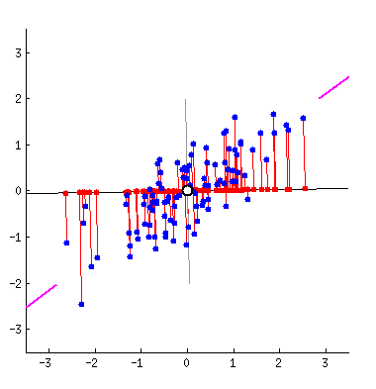
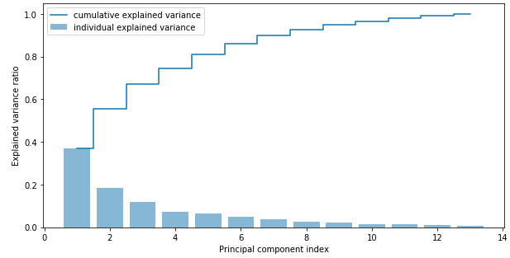
Principal Component Analysis (PCA)
Exact same concept as PCA. Accomplish via Singular Value Decomp.

Slide 68
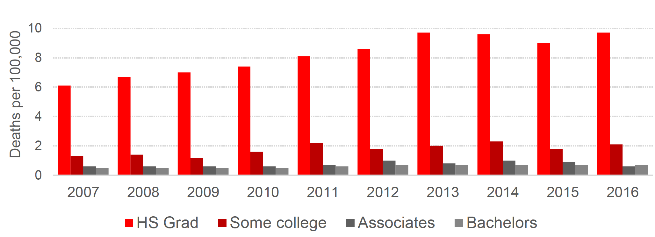
Bonus graph: deaths by education level
Notes:
SWANK report: https://cpb-us-w2.wpmucdn.com/u.osu.edu/dist/2/14548/files/2017/10/SWANK-Taking-Measure-of-Ohios-Opioid-Crisis-1vtx548.pdf

Slide 69
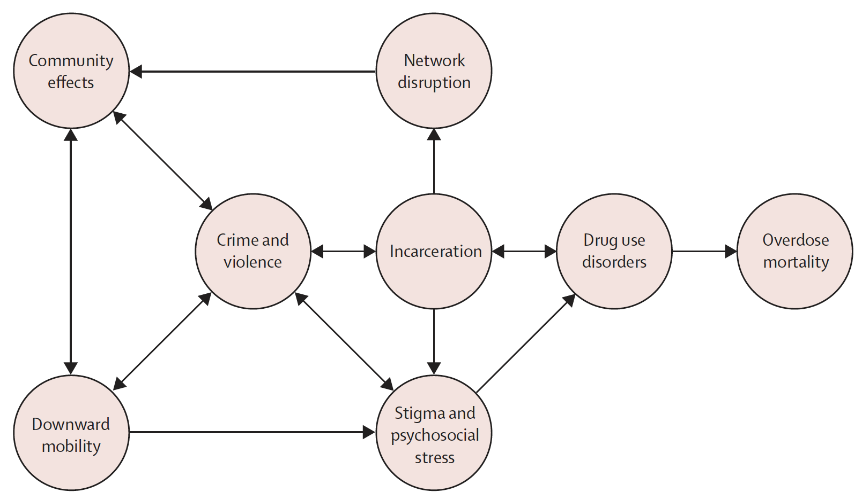
Bonus graph: possible causal patterns
Notes:
Nosrati et al. - 2019 - Economic decline, incarceration, and mortality from drug use disorders

Slide 70
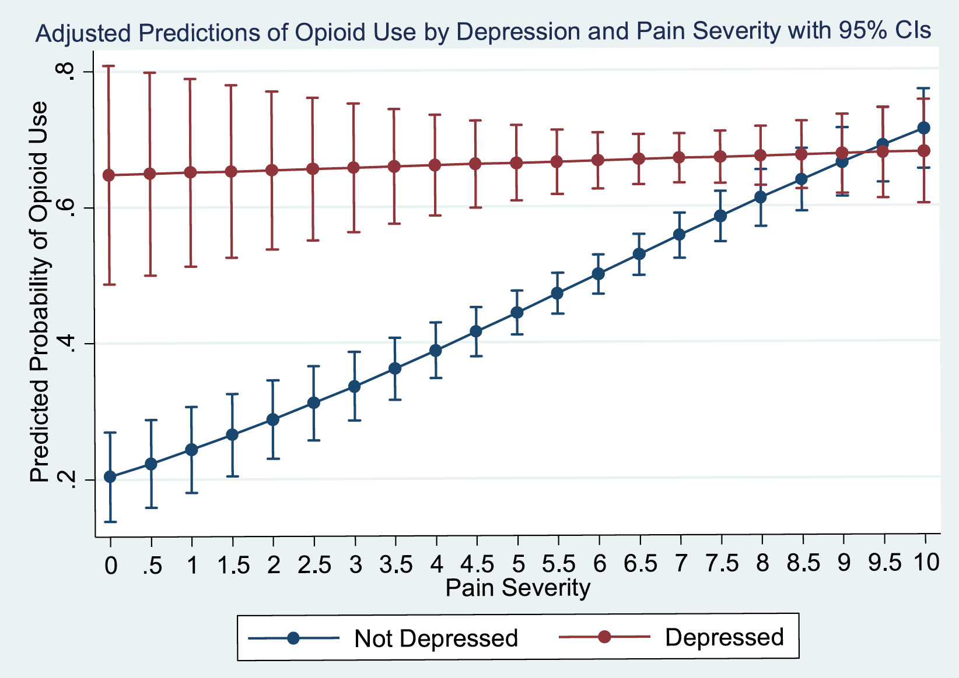
Notes:
Goesling et al Symptoms of Depression Are Associated With Opioid Use Regardless of Pain Severity and Physical Functioning Among Treatment-Seeking Patients With Chronic Pain

Slide 71

Bonus graph: deaths by marriage status
Notes:
Source: Licking County mortality report summer 2019

Slide 72

Bonus graph: deaths by age group

Slide 73

Notes:
https://odh.ohio.gov/wps/wcm/connect/gov/5deb684e-4667-4836-862b-cb5eb59acbd3/2017_OhioDrugOverdoseReport.pdf?MOD=AJPERES&CONVERT_TO=url&CACHEID=ROOTWORKSPACE.Z18_M1HGGIK0N0JO00QO9DDDDM3000-5deb684e-4667-4836-862b-cb5eb59acbd3-moxPbu6

Slide 74

Bonus graph: deaths by census block
Notes:
Source: Monnat et al 2019, Using Census Data to Understand County-Level Differences in Overall Drug Mortality and Opioid-Related Mortality by Opioid Type
See also the supplement to her article

Slide 75

Notes:
Source: Florence The Economic Burden of Prescription Opioid Overdose, Abuse and Dependence in the United States, 2013

Slide 76

Notes:
Olaisen and Anderson, NCHS data brief number 343 July 2019, Unintentional Injury Death Rates in Rural and Urban Areas: United States, 1999–2017

Slide 77


Slide 78

Notes:
Spencer, national vital statistics volume 68, issue 3, March 2019, Drug Overdose Deaths Involving Fentanyl, 2011–2016

Slide 79

Notes:
https://drugabusestatistics.org/drug-overdose-deaths/
2023

Slide 80

Which states have been most affected?
Notes:
Hedegaard, Drug Overdose Deaths in the United States, 1999–2016, NCHS Data Brief No. 294, December 2017
California is not doing terribly. Part of the reason is that the most common heroin here is black tar heroin, which is hard to mix with fentanyl. However, there is still danger, because fentanyl is getting into the drug supply of cocains and meth.

Slide 81

It’s affecting both rural and urban areas
Notes:
Age-adjusted death rates for unintentional drug overdose, by urbanization level United States
Source: Olaisen and Anderson, NCHS data brief number 343 July 2019, Unintentional Injury Death Rates in Rural and Urban Areas: United States, 1999–2017

Slide 82

Death toll is rising across all racial/ethnic groups.
Notes:
Spencer, national vital statistics volume 68, issue 3, March 2019, Drug Overdose Deaths Involving Fentanyl, 2011–2016

Slide 83

Notes:
Haffajee, JAMA, Characteristics of US Counties With High Opioid Overdose Mortalityand Low Capacity to Deliver Medications for Opioid Use Disorder
We actually have data at the county level.
Note: most of this is missing data.

Slide 84

Different states face different issues
Notes:
California tends to get black tar heroin, which is harder to cut with fentanyl, and hence is safer than powder heroin that we get in Ohio.
Source: Monnat et al 2019, Using Census Data to Understand County-Level Differences in Overall Drug Mortality and Opioid-Related Mortality by Opioid Type
See also the supplement to her article

Slide 85

Notes:
Source: Monnat et al 2019, Using Census Data to Understand County-Level Differences in Overall Drug Mortality and Opioid-Related Mortality by Opioid Type
See also the supplement to her article

Slide 86

Notes:
Zoorob: Fentanyl shock: The changing geography of overdose in the United States

Slide 87



One problem: death data is often delayed by a year or more.
Coroners are sometimes wrong, and the CDC has to correct coroner data.
Police data is immediate and can be an “early warning system”
Notes:
SWANK report: https://cpb-us-w2.wpmucdn.com/u.osu.edu/dist/2/14548/files/2017/10/SWANK-Taking-Measure-of-Ohios-Opioid-Crisis-1vtx548.pdf

Slide 88



2014 2015 2016
Deaths due to fentanyl are driving the increase in deaths.
Notes:
Deaths
Hall, et al, Years of Life Lost due to Opioid Overdose in Ohio: Temporal and Geographic Patterns of Excess Mortality

Slide 89

Notes:
Source: https://moritzlaw.osu.edu/depc/wp-content/uploads/sites/115/2018/10/Dan-Rosenblum-presentation.pdf

Slide 90

Notes:
Source: https://moritzlaw.osu.edu/depc/wp-content/uploads/sites/115/2018/10/Dan-Rosenblum-presentation.pdf

Slide 91

Notes:
Source: https://moritzlaw.osu.edu/depc/wp-content/uploads/sites/115/2018/10/Dan-Rosenblum-presentation.pdf

Slide 92

Notes:
Rosenblum and Ciccarone, “The Rapidly Changing US Illicit Opioid Market and the Potential for an Improved Early Warning System: Evidence from Ohio Drug Crime Labs, 2015-2017”

Slide 93
Notes:
From Rosenblum
Source: https://moritzlaw.osu.edu/depc/wp-content/uploads/sites/115/2018/10/Dan-Rosenblum-presentation.pdf

Slide 94

Notes:
Source: https://moritzlaw.osu.edu/depc/wp-content/uploads/sites/115/2018/10/Dan-Rosenblum-presentation.pdf
This slide shows that fentanyl is driving overdoses

Slide 95

Notes:
Source: zibbell aldridge cauchon 2019 Association of Law Enforcement Seizures of Heroin, Fentanyl, and Carfentanil With Opioid Overdose Deaths in Ohio

Slide 96


Notes:
https://www.harmreductionohio.org/where-is-fentanyl-added-to-cocaine-mostly-in-ohio/
https://www.harmreductionohio.org/special-report-carfentanils-deadly-role-in-ohio-drug-overdose-deaths/

Slide 97

Notes:
https://www.harmreductionohio.org/special-report-carfentanils-deadly-role-in-ohio-drug-overdose-deaths/

Slide 98

Notes:
https://www.harmreductionohio.org/news-alert-carfentanil-returns-to-ohio-take-precautions/
This is seizure data

Slide 99

Notes:
This is death data, from harm reduction ohio

